Slide 1
Welcome to our assembly

Slide 2
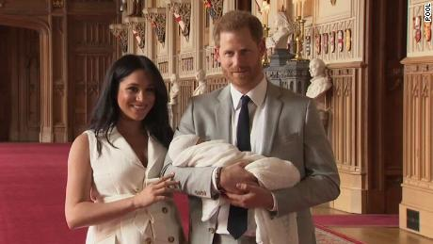
Archie Harrison Mountbatten-Windsor

Slide 3
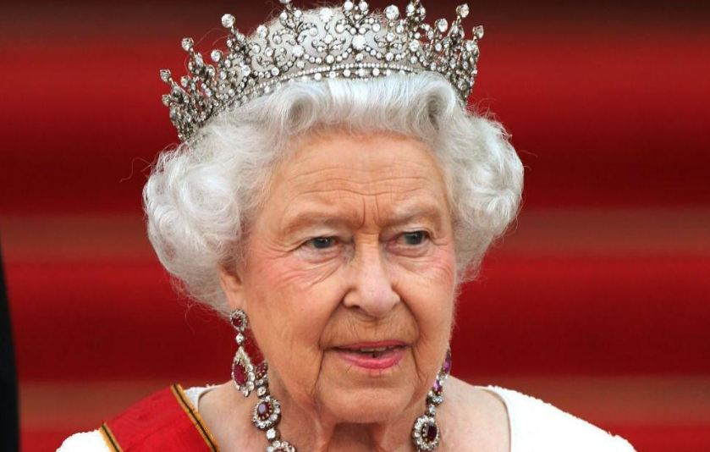
Her Majesty The Queen

Slide 4
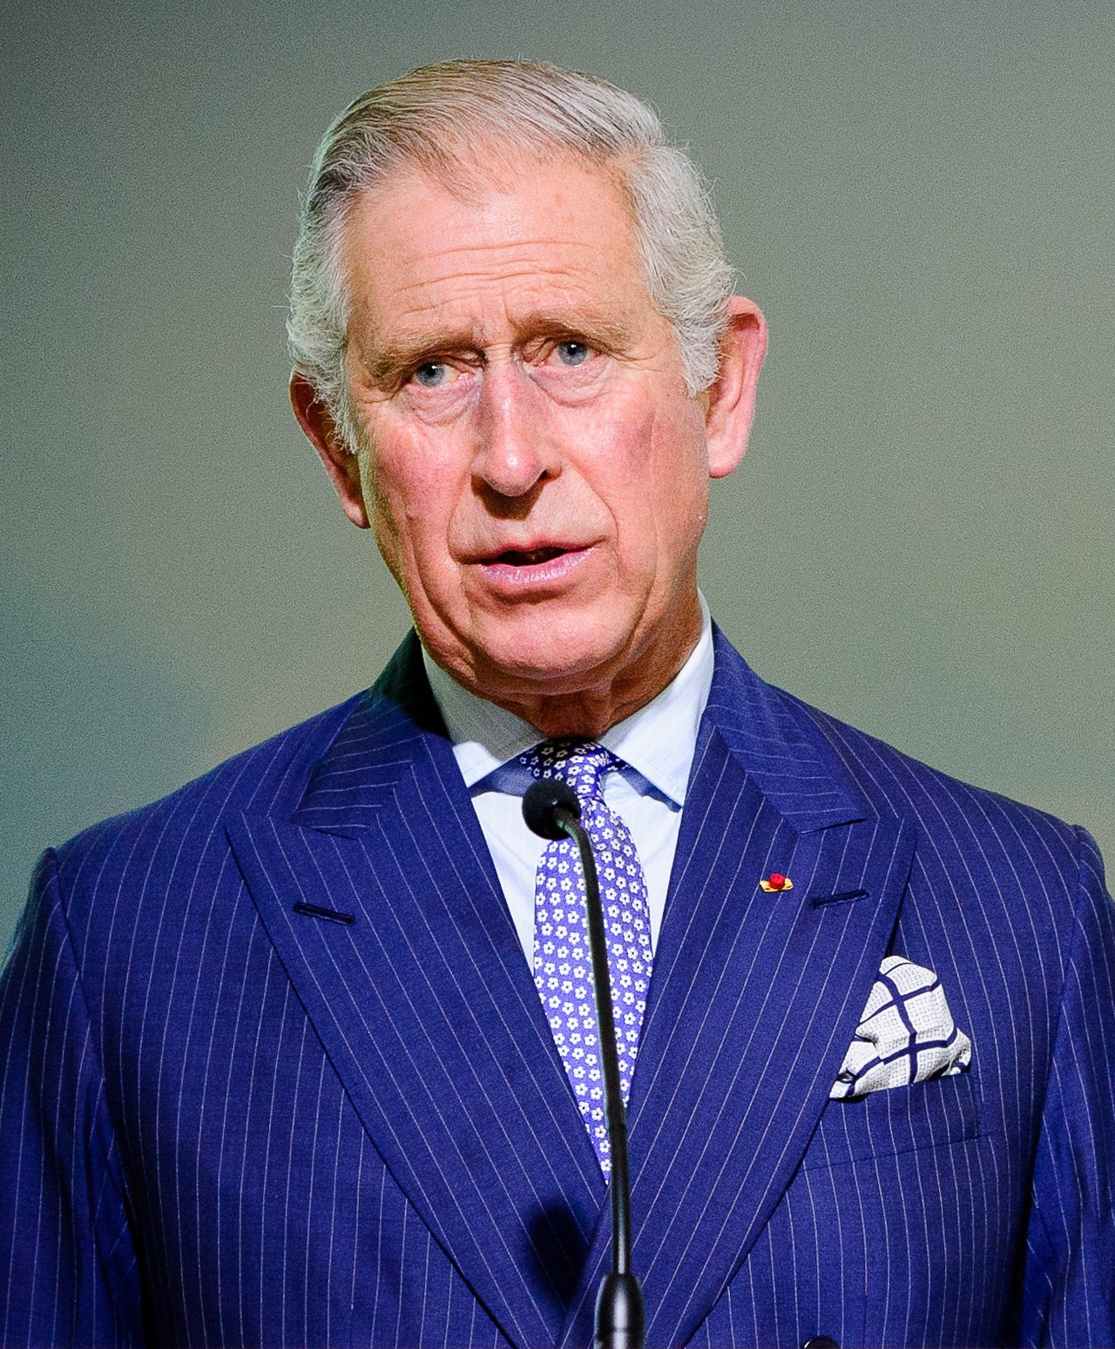
HRH Prince Charles, Prince of Wales

Slide 5
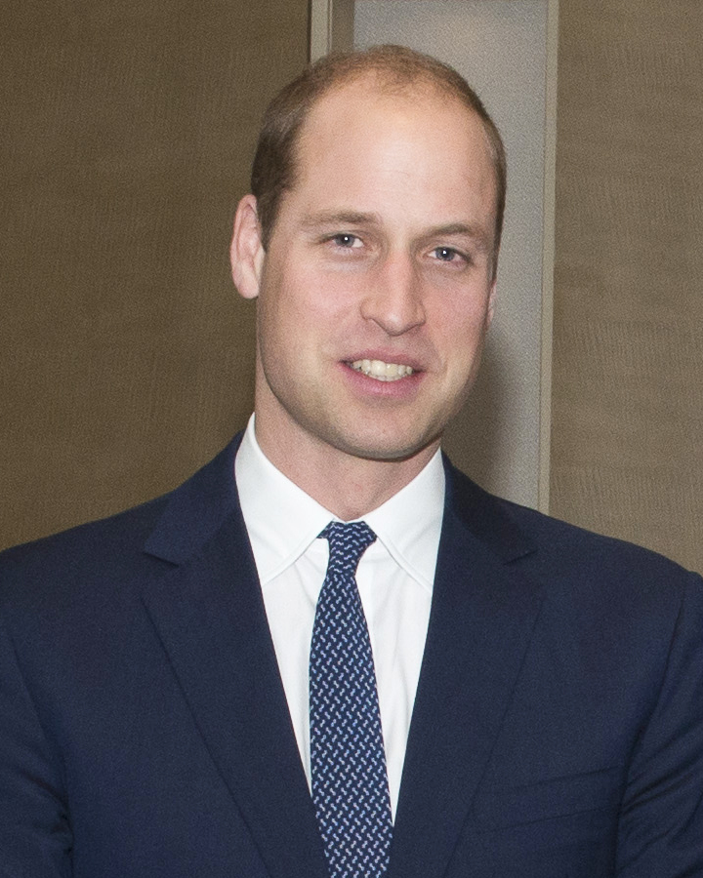
HRH Prince William, Duke of Cambridge

Slide 6
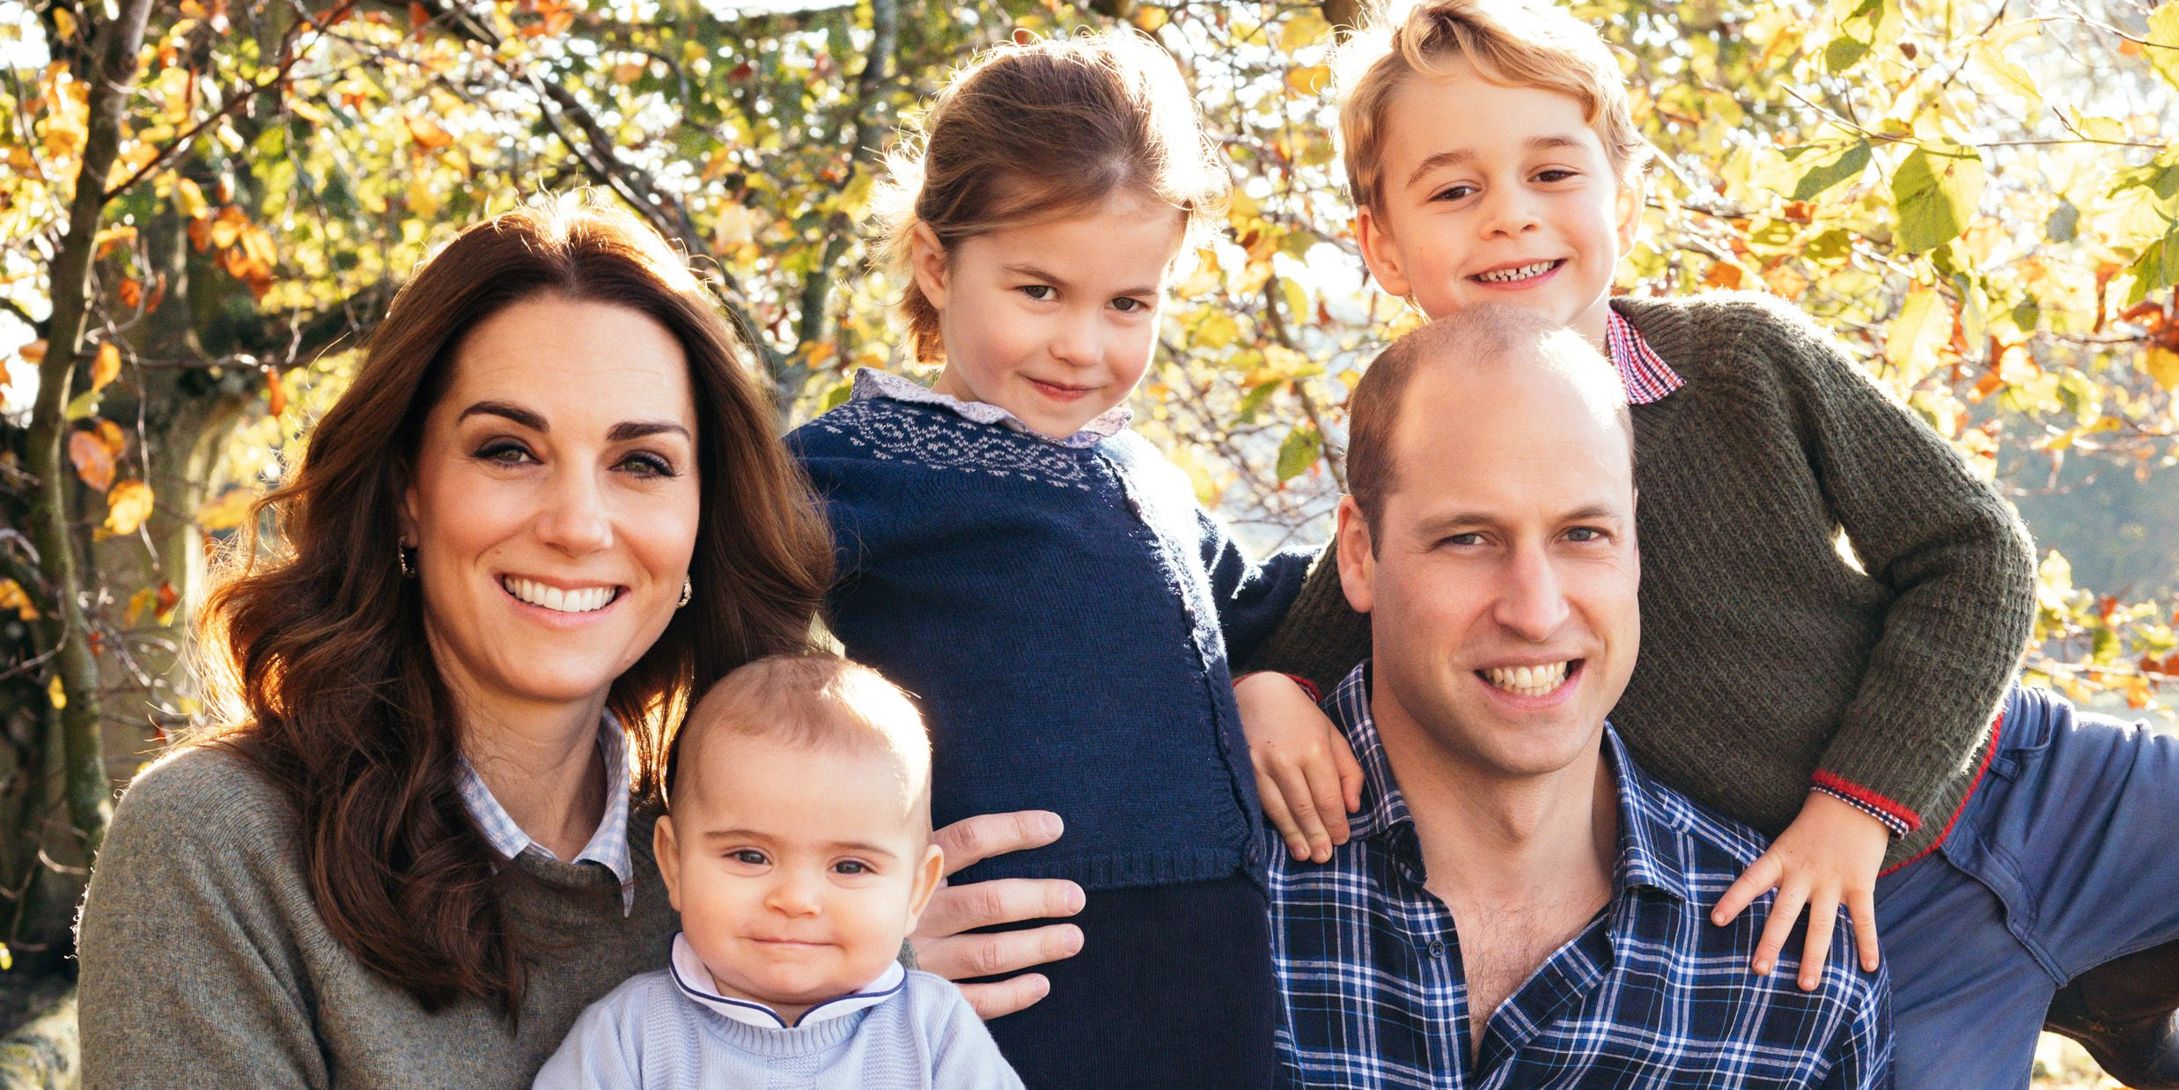
HRH Princess Charlotte of Cambridge
HRH Prince Louis of Cambridge
HRH Prince George
of Cambridge

Slide 7
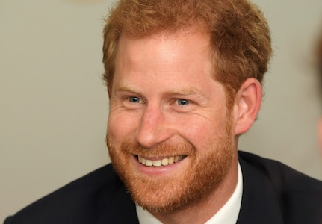
HRH Prince Harry, Duke of Sussex

Slide 8
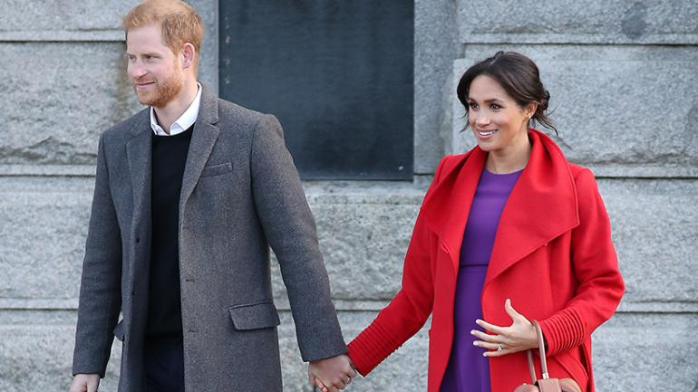

Slide 10
