Slide 1
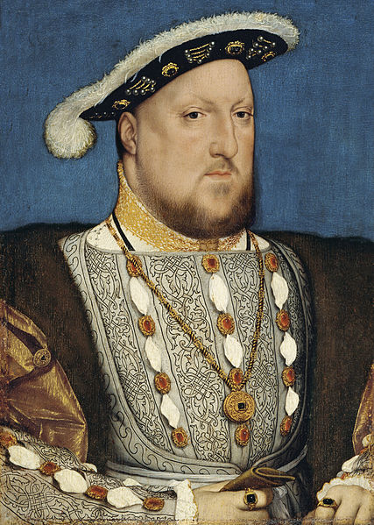
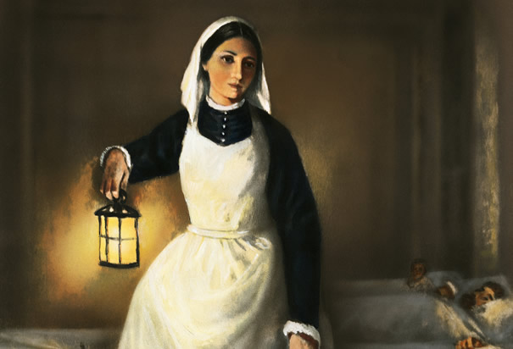
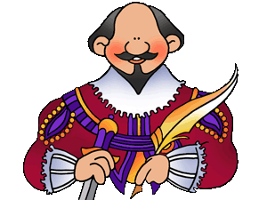
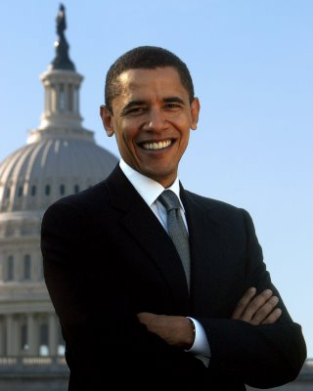
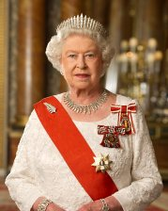
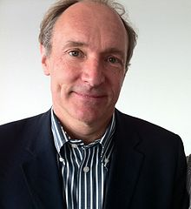
History-Makers

Slide 2

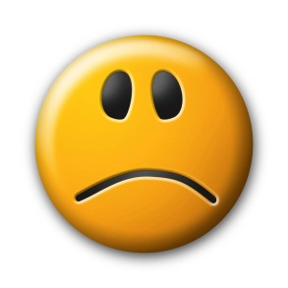
History-Makers
A history-maker is a person who changes one person or lots of people, a place, a country or the world

Slide 3
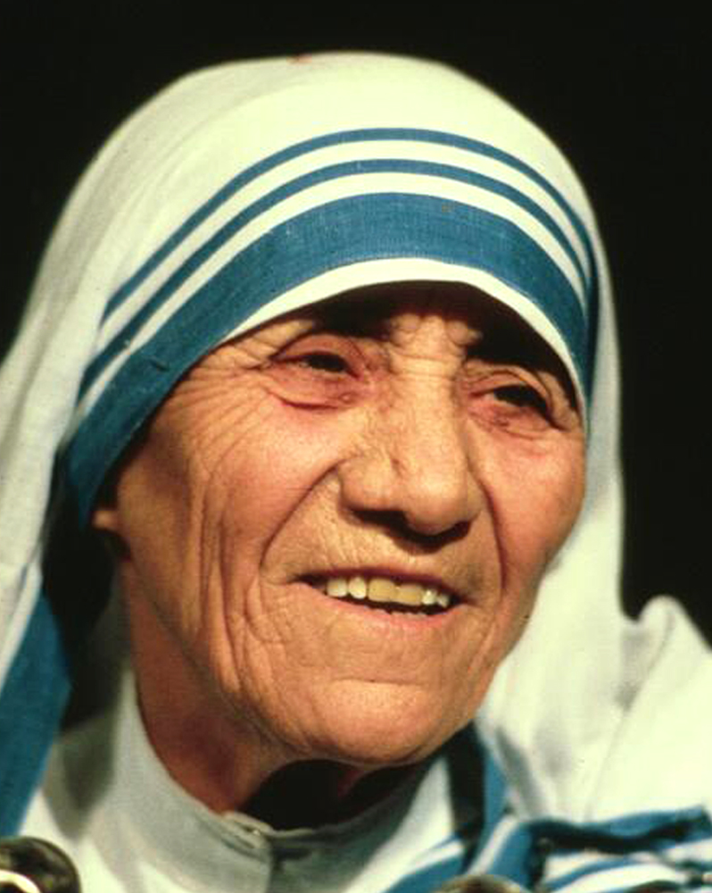
History-Makers
Mother Teresa

Slide 4
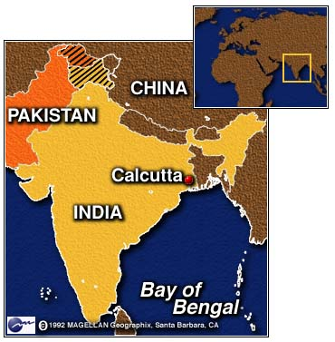
History-Makers

Slide 5
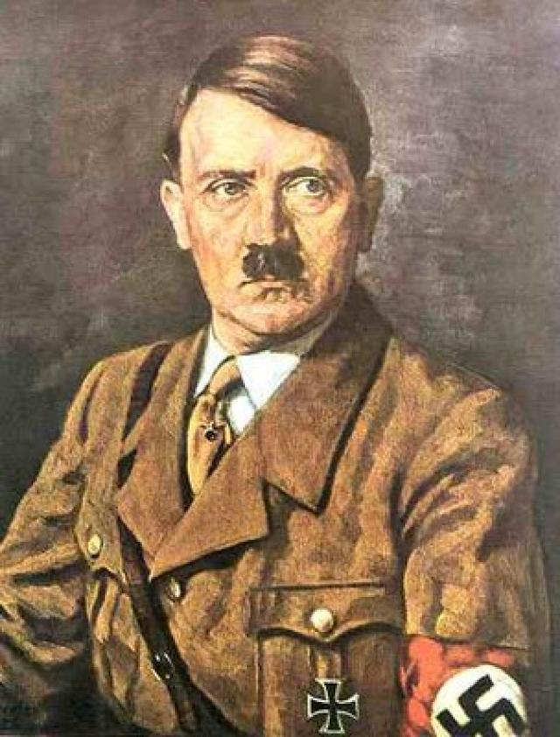
History-Makers
Adolf Hitler

Slide 6

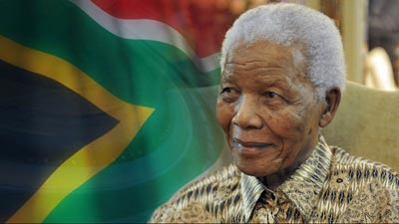
History-Makers
Nelson Mandela

Slide 7
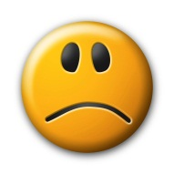



History-Makers
Don’t work for the love of power . . .
but
work through the power of love

Slide 8

History-Makers
‘Not all of us can do great things. But we can do small things with great love.’

