Slide 1





Slide 2
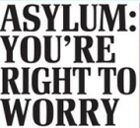

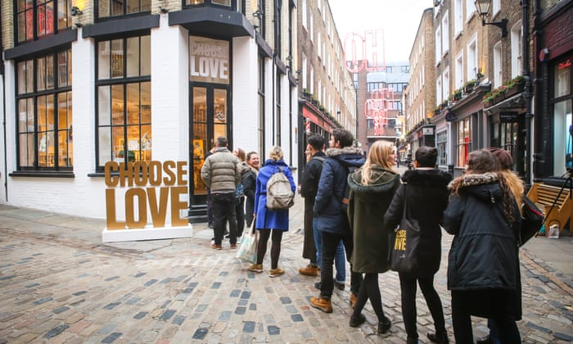
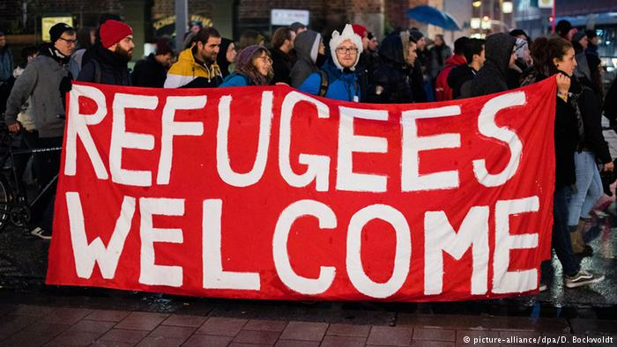


Notes:
The Jesuit Refugee Service (JRS) is an international Catholic organisation with a mission to accompany, serve and advocate on behalf of refugees and other forcibly displaced persons.
JRS programmes can be found in over 50 countries providing assistance to: refugees in camps and cities, internally displaced people, asylum seekers in cities and those asylum seekers and refugees held in detention centres.
The majority of JRS’ work is concentrated on education, emergency assistance, healthcare, livelihood activities and social services.
At the end of 2016, more than 733,400 individuals were in direct beneficiaries of JRS projects.
JRS also advocate on behalf of refugees and their human rights

Slide 3

Refugee - is someone who has been forced to flee his or her country because of persecution, war, or violence. A refugee has a well-founded fear of persecution for reasons of race, religion, nationality, political opinion or membership in a particular social group.
Definitions
Notes:
UN definitions for Refugee and Asylum seeker

Slide 4
Asylum Seeker – A person who has fled their own country and seeks sanctuary in another country, applies for asylum – the right to be recognized as a refugee according to the laws of that country and receive legal protection and material assistance. An asylum seeker must demonstrate that his or her fear of persecution in his or her home country is well-founded.
Definitions
Notes:
UN definitions for Refugee and Asylum seeker

Slide 5

How many refugees were there worldwide at the end of 2017?
25.4 million
2.54 million
254,000
Source: UNHCR Global Trends Report 2017. Available at: http://www.unhcr.org/globaltrends2017/
Notes:
At the end of 2016 there were 22.5 million refugees.
In addition to this there were 40.3 million internally displace people. These are people who have been forced to leave their homes but still reside in their home nation
There were also 2.8 million asylum seekers
This gives a total of 65.6 million forcibly displaced people worldwide

Slide 6
Which country hosts the most refugees?
Turkey
Germany
Uganda
Source: UNHCR Global Trends Report 2017. Available at: http://www.unhcr.org/globaltrends2017/
Notes:
Turkey hosted the largest number of refugees worldwide with 2.9 million people
2nd was Pakistan with 1.4 million and third was Lebanon with 1 million
Due to its large intake of refugees comparable to its population 1 in 6 people are a refugee in Lebanon
84% of refugees are hosted by developing regions with the least developed countries providing asylum to 28% of the refugee population

Slide 7
How many asylum seekers came to the UK in 2017?
1.36 million
135,000
33,500
Source: UNHCR Global Trends Report 2017. Available at: http://www.unhcr.org/globaltrends2017/
Notes:
Only 36,000 asylum seekers came to the UK, meaning the UK had the 8th highest number of asylum seekers out of the EU countries; about 5% of the number in Germany
Approximately 633,000 people arrived in Britain in the year up to March 2016. Asylum seekers coming into Britain escaping persecution made up 7% of this figure

Slide 8

“Like we don’t want to be dependent on the government all the time. At least we should work and do some certain jobs we can do so that we don’t just rely on the government for everything. There are some things that we can do, to earn some money for ourselves. The government should give the asylum seekers who have been here for many years, sometimes like 10 years, to give them their documents so they can work.”

Slide 9
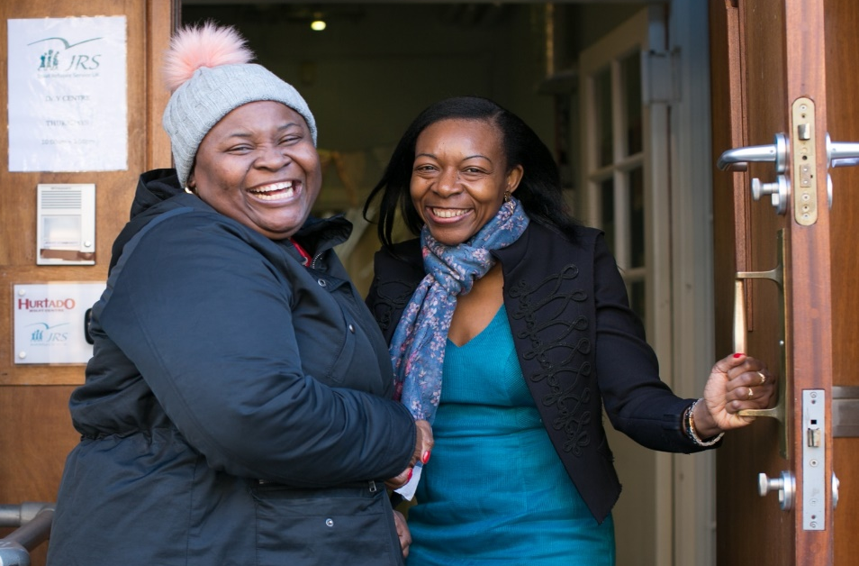
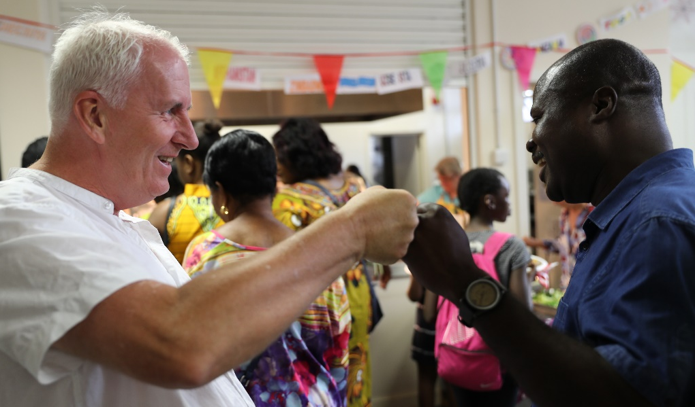
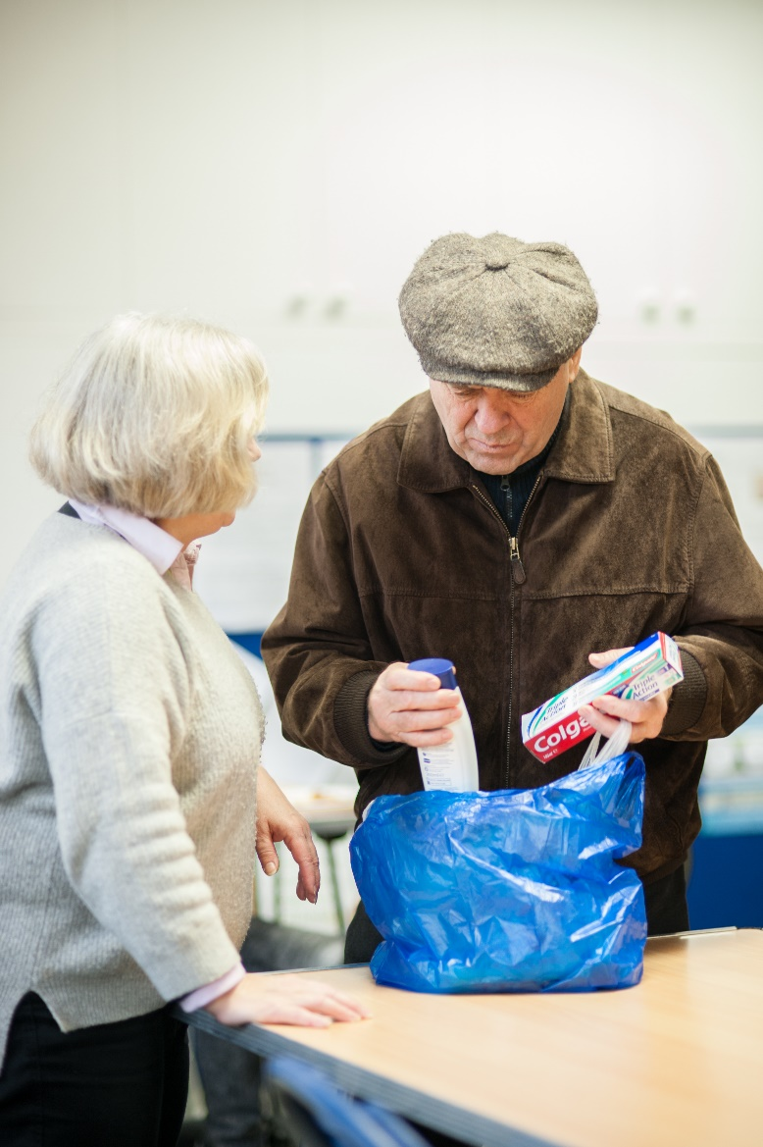
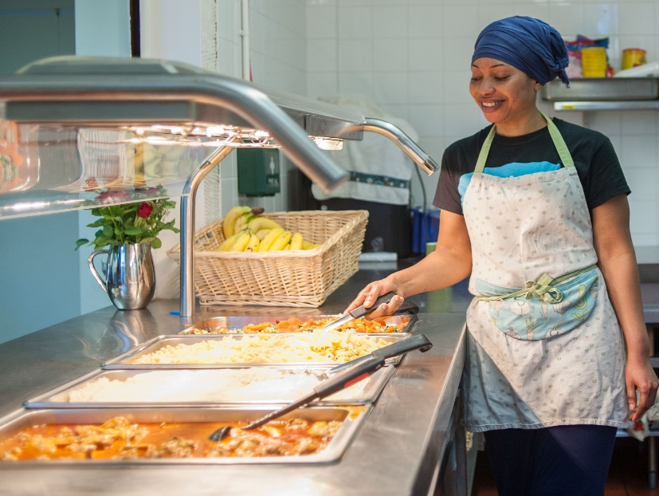
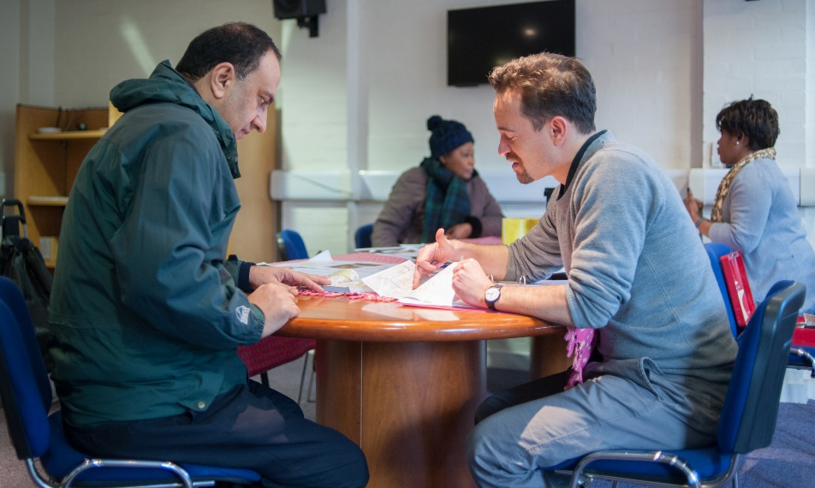

Notes:
The Jesuit Refugee Service (JRS) is an international Catholic organisation with a mission to accompany, serve and advocate on behalf of refugees and other forcibly displaced persons.
JRS programmes can be found in over 50 countries providing assistance to: refugees in camps and cities, internally displaced people, asylum seekers in cities and those asylum seekers and refugees held in detention centres.
The majority of JRS’ work is concentrated on education, emergency assistance, healthcare, livelihood activities and social services.
At the end of 2016, more than 733,400 individuals were in direct beneficiaries of JRS projects.
JRS also advocate on behalf of refugees and their human rights

Slide 10
“The toughest thing about being destitute? Not having a place to shower or to clean your teeth or to take good care of yourself. It’s humiliating when you see someone, even a friend, turn away from you because you’ve not been able to wash yourself or your clothes for the last couple of days. It’s not easy”.

Slide 11
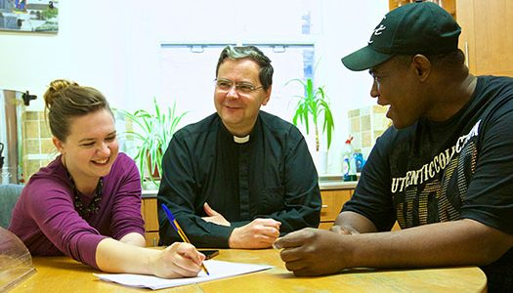

"They showed me acceptance and love...unconditional love. I felt like a part of the family, I truly felt at home."

Slide 12
Here’s some things to do to mark refugee week:
Visit the Refugee Week website to see what events are taking place: http://refugeeweek.org.uk/
Spend some time thinking about what it would be like to flee your home and have to go a seek safety in a completely foreign country.
You may have family members, parents or grandparents who came to live in this country. Ask them about how it felt to come to a new place – refugee or not, they will help you understand a little!
Find out more about the work of JRS UK and see how they help those refugees who are in need in the UK.
Pray for refugees and all those seeking safety!

Slide 13
