Slide 1


Slide 2



Slide 3


Slide 4


Slide 5


Slide 6


Slide 12
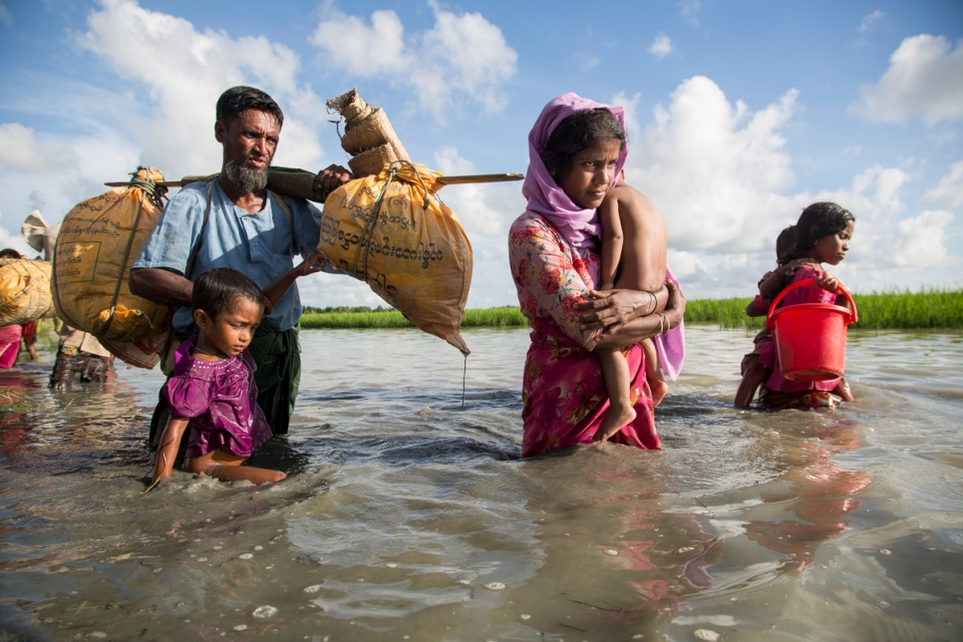
Refugee - a person who has been forced to leave their country in order to escape war, persecution, or natural disaster.
A Rohingya family wades through water crossing the border from Myanmar into Bangladesh.

Slide 13
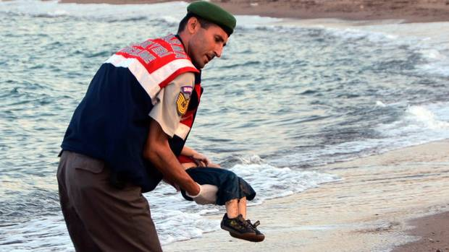

Slide 14
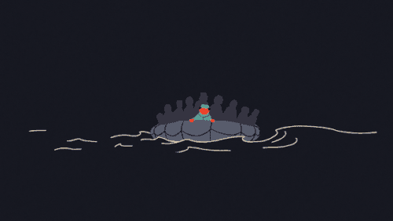

Slide 15


Slide 16


Slide 17



Slide 18
