Slide 1


Slide 2
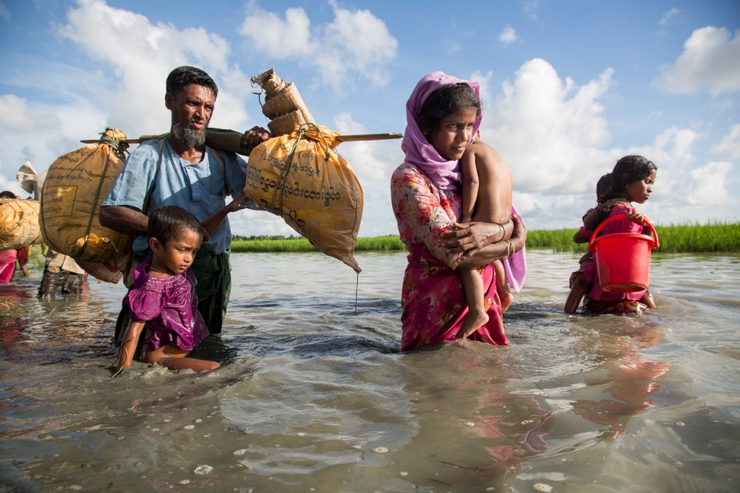
Refugee - a person who has been forced to leave their country in order to escape war, persecution, or natural disaster.
A Rohingya family wades through water crossing the border from Myanmar into Bangladesh.

Slide 3
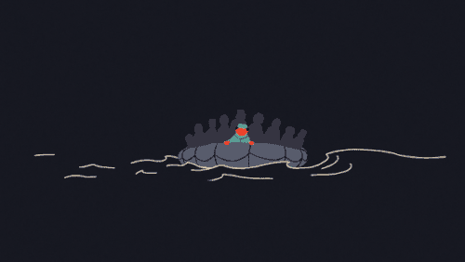

Slide 4


Slide 5


The Boy At the Back of the Class by
Onjali Q. Rauf
The Boy at the Back of the Class tells the story of a refugee. It shows the importance of friendship and kindness in a world that doesn't always make sense.

Slide 6
