Slide 1
What do they have in common?

Slide 2
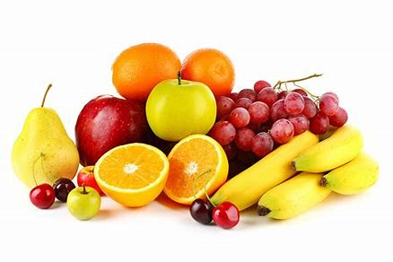
Oranges
Apples
Pears
Grapes
Bananas
Raspberries

Slide 3
Citroën
Ford
Peugeot
Volkswagen
Vauxhall
Renault

Slide 4
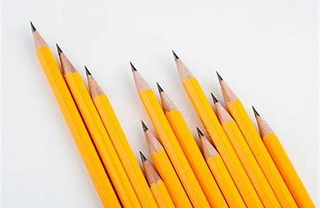
Pencil
Whiteboard
Desk
Dictionary
Paintbrush
Calculator

Slide 5
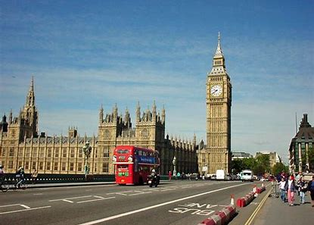
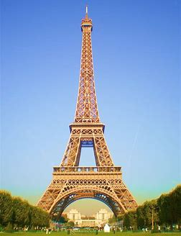
London
Paris
Nairobi
Stockholm
Beijing
Washington

Slide 6
Meconopsis
Nigella
Allium
Leucojum
Adonis
Echinopsis

Slide 7
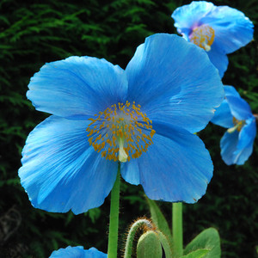
Meconopsis

Slide 8
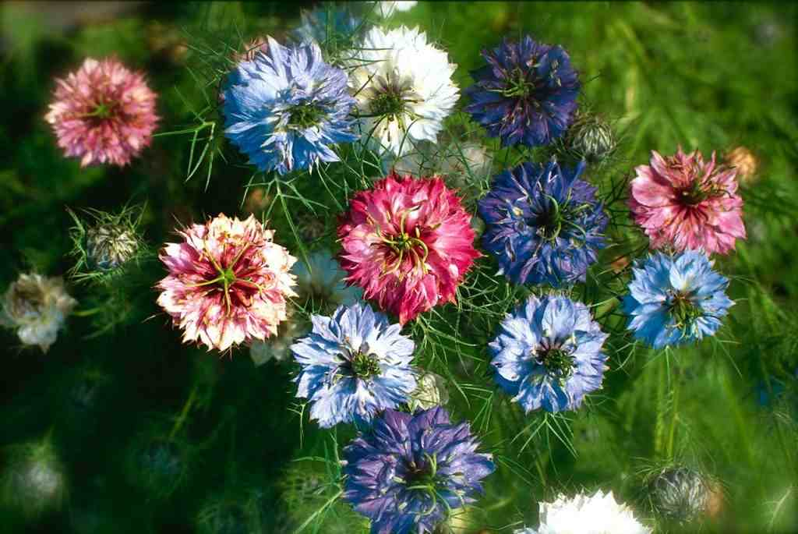
Nigella

Slide 9
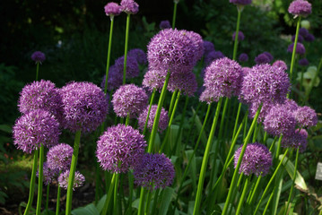
Allium

Slide 10
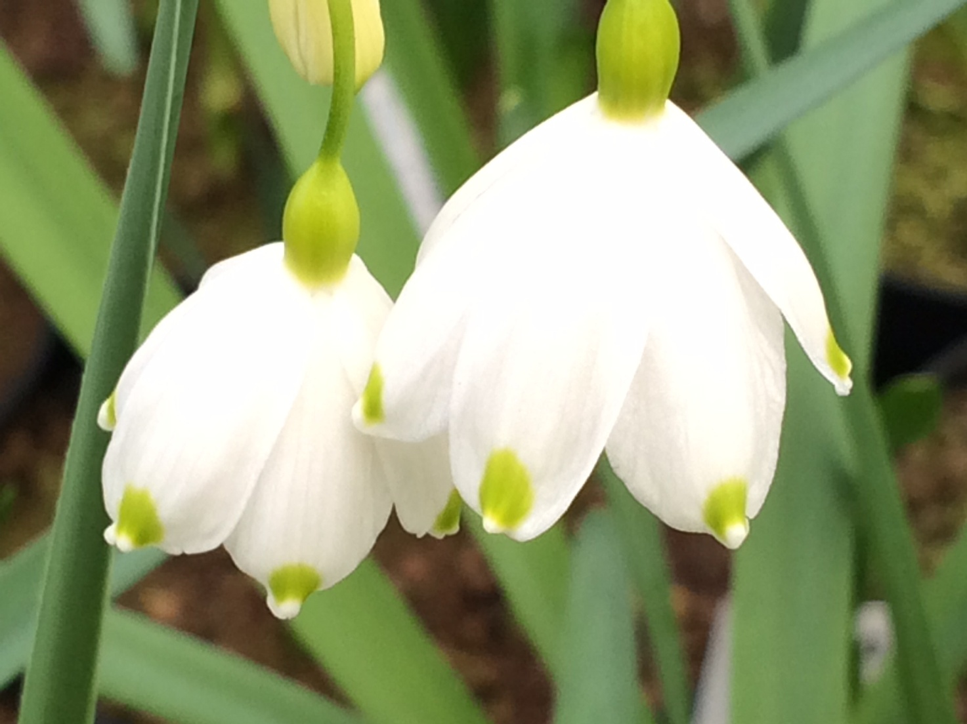
Leucojum

Slide 11
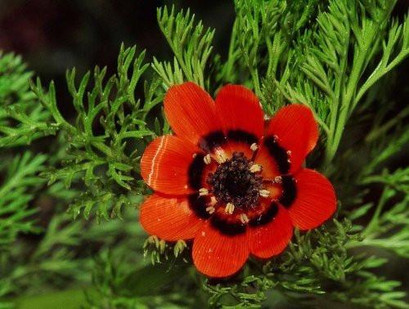
Adonis

Slide 12
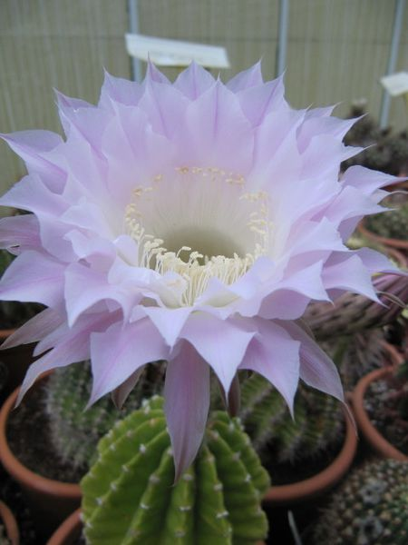
Echinopsis

Slide 13


