Slide 1
Welcome

Slide 2


Slide 3


Slide 4
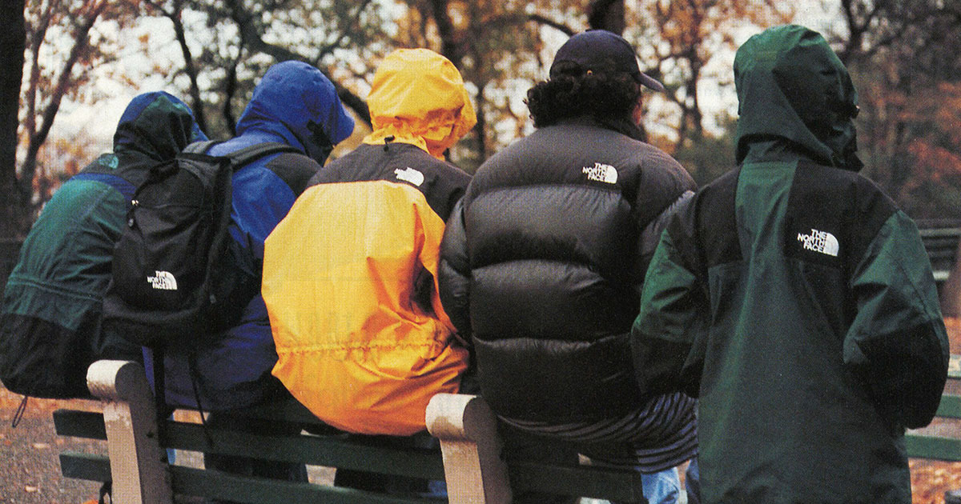

Slide 5
What groups do I belong to? Do these groups help me to feel secure and at peace?
Do I make efforts to include people, to welcome people who feel alone or isolated?
How do I feel about Robert’s example of turning to God to find true belonging? Is that something I have ever considered?
What actions do I want to take today as a result of this assembly? Do I want to speak to anyone or seek out anyone’s advice?

