Slide 1

No smoking

Slide 2

No entry

Slide 3

Give way

Slide 4
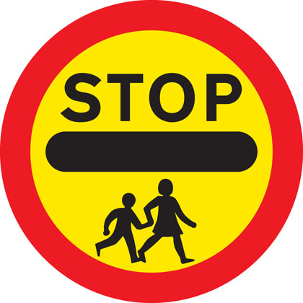
School crossing patrol

Slide 5

Roundabout

Slide 6
Group 1: Hosanna to the Son of David!
Group 2: Blessed is the king who comes in the name of the Lord!
Group 3 (shouting angrily): Kill him! Crucify him!
Group 4: It is finished. Jesus knows that what he came to do on Earth has been completed.
Group 5: Why look for the living among the dead?
Group 6 (shouting joyfully): He is risen!

