Slide 1






#Easter

Slide 2
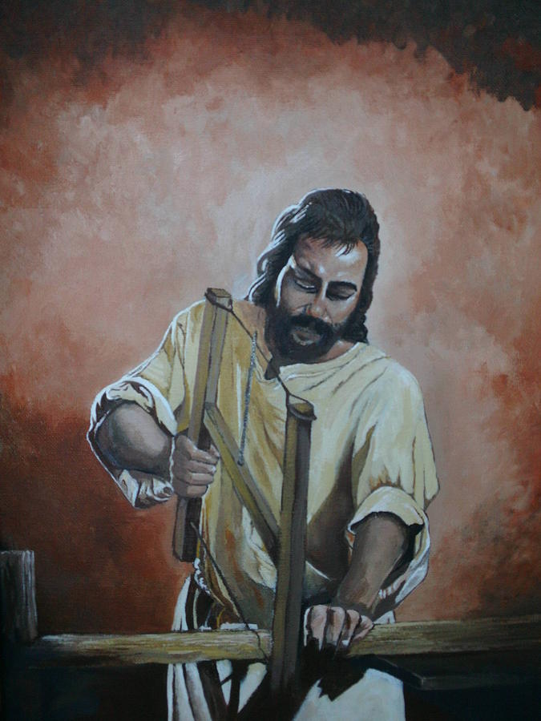

#Easter
Free tools. Giving up carpentry. Father in Heaven’s work to do. #Right time
Jesus@Carpenter of Nazareth

Slide 3
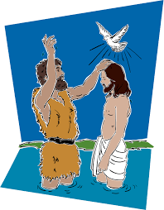
#Easter
Busy day. Baptised God’s son, Jesus. #Huge honour!
John the Baptist@River Jordan

Slide 4
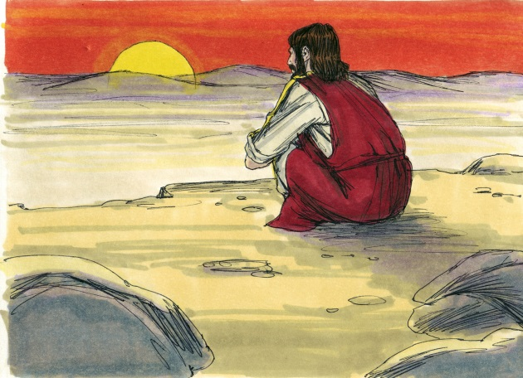
#Easter
Visit from Angel. I’m having God’s son. #Worried!
40 days in the desert. Been tested by the Devil. A time of preparation. #Faith building
Jesus@God’s son on Earth

Slide 5
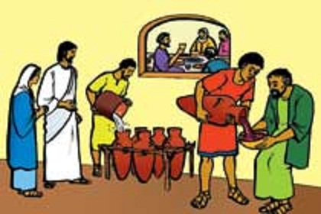
#Easter
Jesus’ first miracle. Turned water into wine. #Tasty #Proud Mum!
Mary@Mother of Jesus

Slide 6
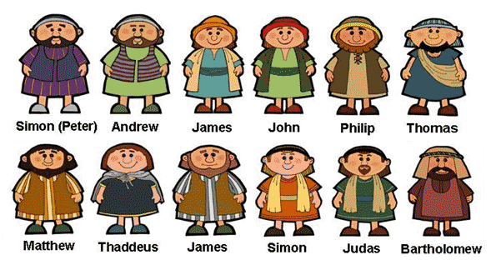
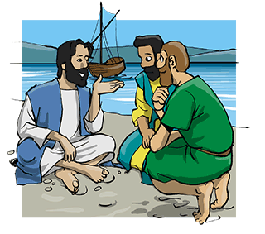
#Easter
No longer fishing. Now one of Jesus’ 12 disciples. #Learning about God
Peter@Disciple of Jesus

Slide 7
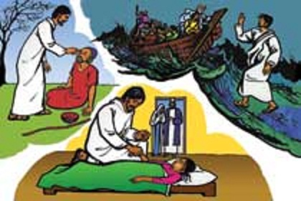
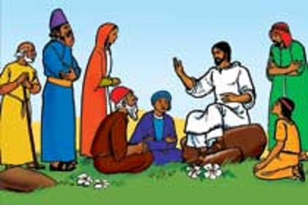
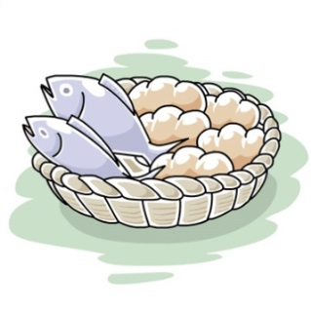
#Easter
Jesus calmed a storm. Healed the sick. Fed 5000 people with some bread and fish. #Wow!
Peter@Disciple of Jesus

Slide 8
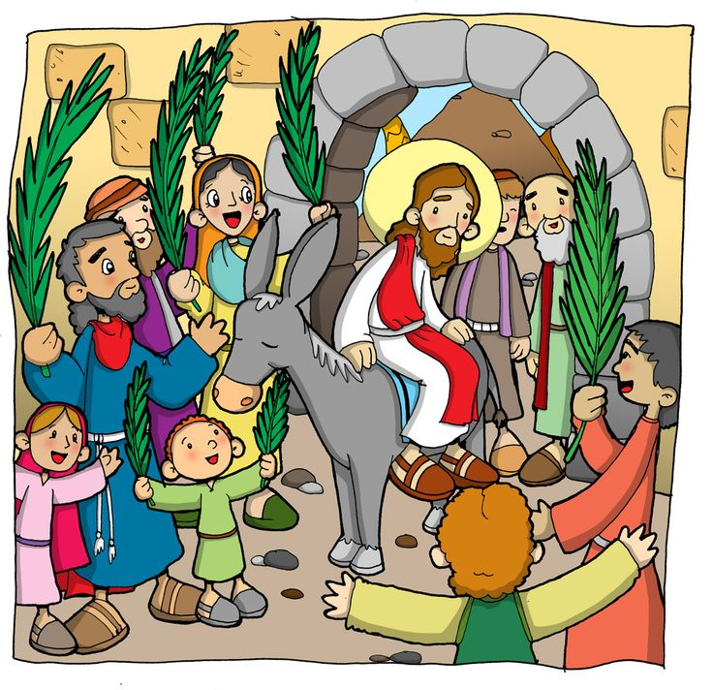
#Easter
After 3 years of teaching about God. Time to return to Jerusalem. #Complete God’s work
Jesus@God’s son on Earth

Slide 9
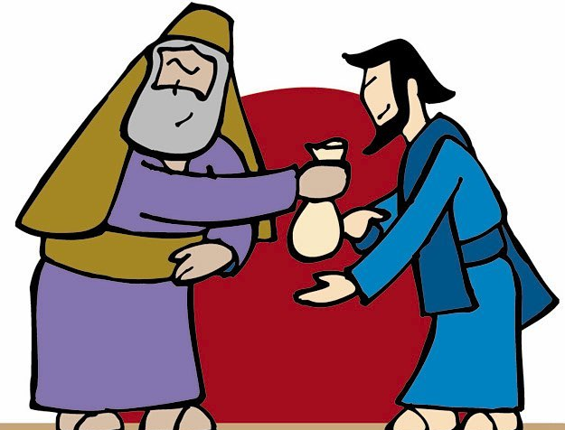
#Easter
Been talking to the Priests. Fed up with Jesus. Now have 30 pieces of silver. #Rich #A job to do!
Judas@Disciple of Jesus

Slide 10
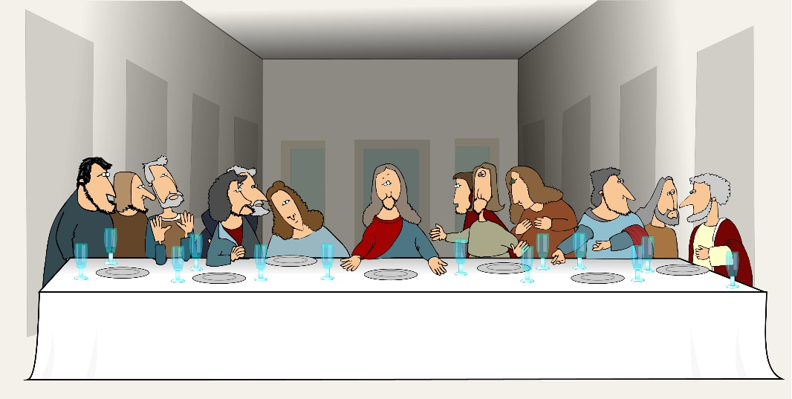
#Easter
Gave Jesus frankincense. #The world will worship him. #Hallelujah!
Eating the Passover Meal with my disciples. Judas has left. Time to pray in the Garden of Gethsemane. #God’s will not my will
Jesus@God’s son on Earth

Slide 11
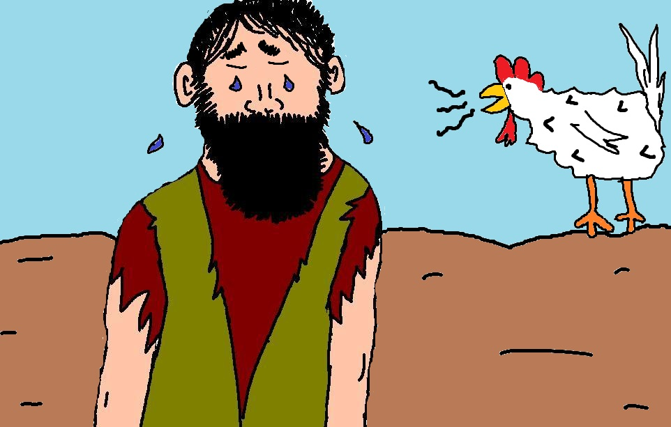
#Easter
Gave Jesus frankincense. #The world will worship him. #Hallelujah!
Jesus arrested…betrayed by Judas. I denied knowing Jesus 3 times. #Ashamed #Distressed
Peter@Disciple of Jesus

Slide 12
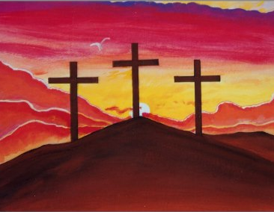
#Easter
My beautiful son, Jesus, died on a cross today. #Not a criminal #He forgave those who hurt him #It is finished
Mary@Mother of Jesus

Slide 13

#Easter
Jesus’ tomb empty. He has arisen. #Jesus is alive!
Mary@Mother of Jesus

Slide 14

#Easter
Adam and Eve introduced sin. I took the punishment for this and the things people do wrong today. Allows for relationship with God. #All for love
Jesus@God’s son on Earth

Slide 15
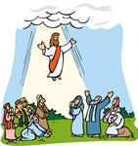
#Easter
Jesus has returned home. Sat with me in Heaven. Love my son. Loving you, loving the world. #You’re amazing! #Happy Easter!
God@In Heaven

