Slide 1
Koinonia
A Greek term used about 20 times in the Bible
Translated in the King James Bible as:
  Fellowship: 12 times
  Communion: 4 times

Slide 2
Ubuntu
Means ‘I am because we are’
Encompasses humanity towards others
‘Ubuntu . . . speaks of the very essence of being human . . . [If you have ubuntu], you are generous, you are hospitable, you are friendly and caring and compassionate.’
Archbishop Desmond Tutu

Slide 3
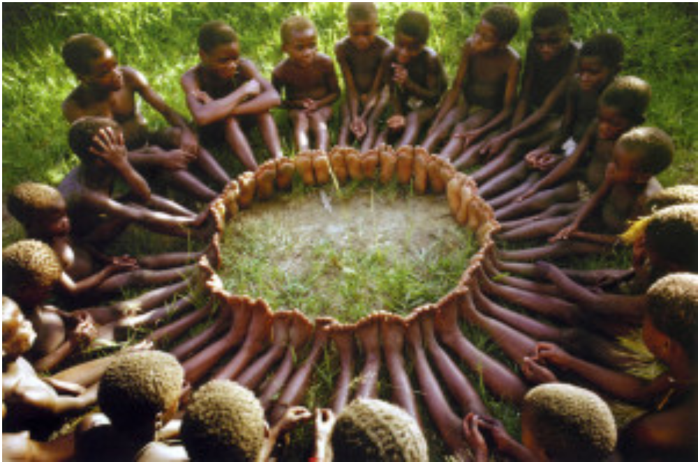
‘How can one of us be happy if all the others are sad?’

Slide 4
‘You seek to work for the common good because your humanity comes into its own in community, in belonging.’
Archbishop Desmond Tutu

