Slide 1
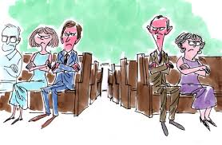
Unity or disunity?

Slide 2
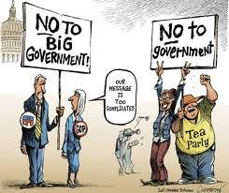
Unity or disunity?

Slide 3
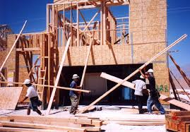
Unity or disunity?

Slide 4

Unity or disunity?

Slide 5

Unity or disunity?

Slide 6

Unity or disunity?

Slide 7

Unity or disunity?

Slide 8

Unity or disunity?

