Slide 1
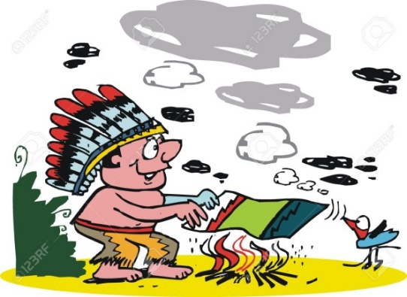

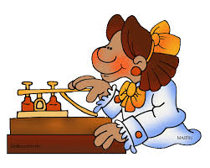




#Christmas

Slide 2
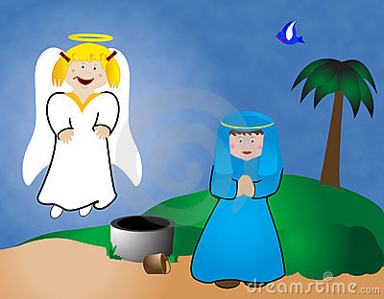

#Christmas
Had a visit from an angel and I’m having God’s son. #troubled
Mary@Mother to Be

Slide 3
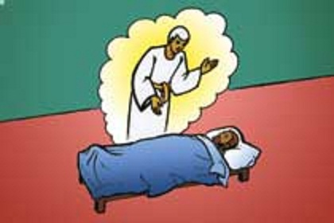
#Christmas
Had strange dream where an angel visited me. Told me to call son Jesus, which means The Lord Saves. #hugeresponsibility
Joseph@Carpenter of Nazareth

Slide 4
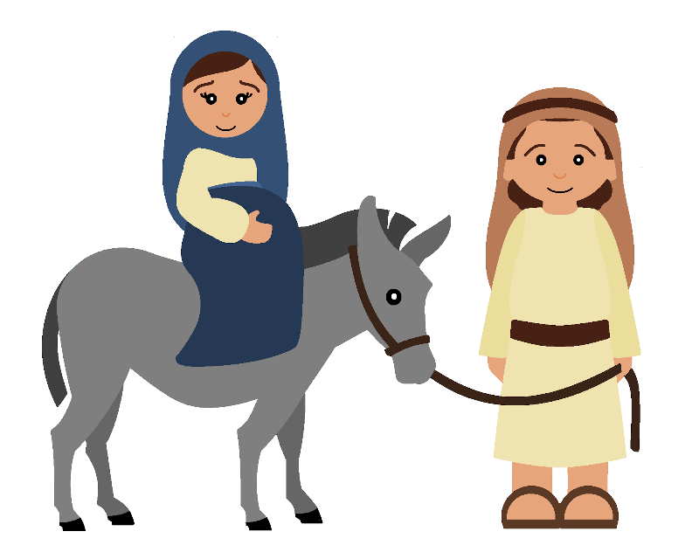
#Christmas
Visit from Angel. I’m having God’s son. #Worried!
Heavily pregnant and riding on a donkey. #uncomfortable
Mary@Mother to Be
Riding on a donkey heavily pregnant. #Uncomfortable!
Hope Mary doesn’t give birth during the journey to Bethlehem. #panicking
Joseph@Carpenter of Nazareth

Slide 5
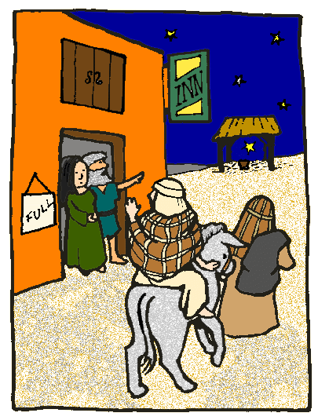
#Christmas
No room at any of the inns, so staying in a stable. #resting #sleepatlast
Joseph@Carpenter of Nazareth
In labour! Had to wake Joseph up. #painful
Mary@Mother to Be

Slide 6
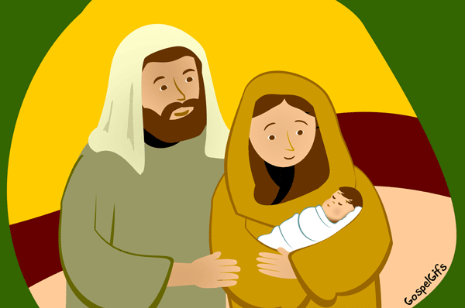
#Christmas
We’ve had a beautiful baby boy! His name is Jesus. #proudparents
Joseph@Carpenter of Nazareth

Slide 7
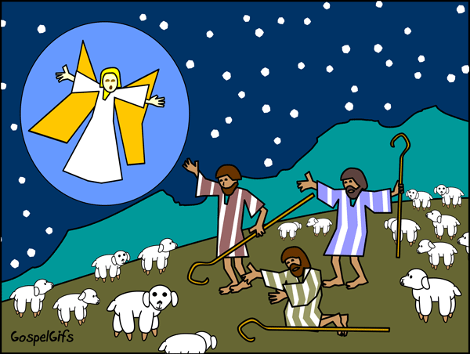
#Christmas
Been visited by angels and now on our way to see God’s son. #surprised #a-ma-zing
Shepherds@Watching the Flocks

Slide 8
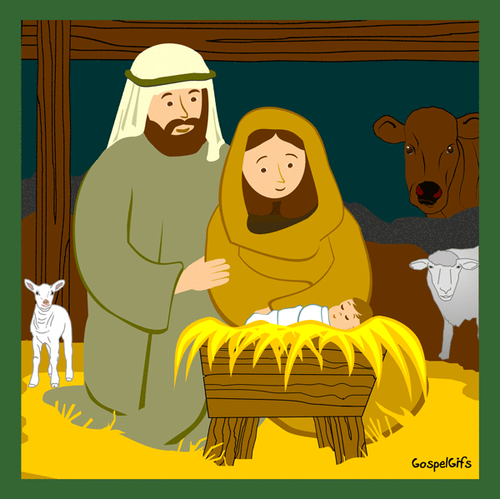
#Christmas
Shepherds have been. Gave us a lamb for a present. #cute #whatsfortea
Joseph@Carpenter of Nazareth

Slide 9
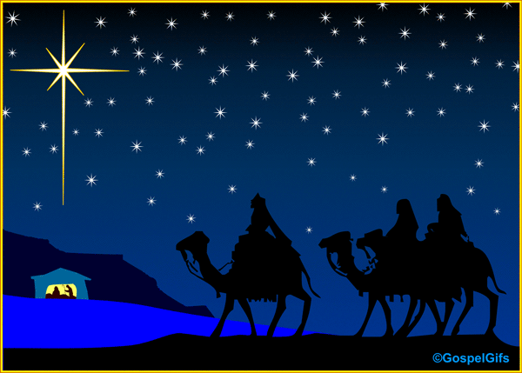
#Christmas
Have followed bright star for months and now the time has come to visit the King. #excited
King 1@We 3 Kings

Slide 10
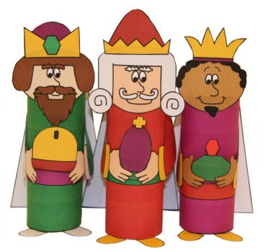
#Christmas
Gave Jesus gold. #kingofkings #glorious
King 1@We 3 Kings
Gave Jesus frankincense. #theworldwillworshiphim #hallelujah
King 2@We 3 Kings
Gave Jesus frankincense. #The world will worship him. #Hallelujah!
Gave Jesus myrrh. #hewillhaveaspecialdeath #saviour
King 3@We 3 Kings

Slide 11
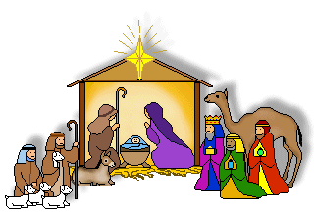
#Christmas
Thank you for the wonderful gifts. #feelingblessed
Mary@Mother of Jesus

Slide 12
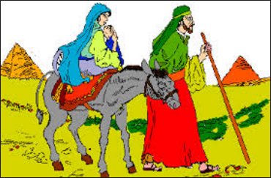
#Christmas
King Herod being nasty, so have escaped to Egypt. #relieved
Joseph@Carpenter of Nazareth

Slide 13
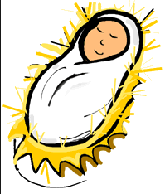
#Christmas
Jesus, a gift for everyone. Loving you, loving the world. #youreamazing #happychristmas
God@In Heaven

