Slide 1
The people walking in darkness
have seen a great light;
on those living in the land of deep darkness
a light has dawned…
For to us a child is born…
And he will be called
Wonderful Counsellor,
Mighty God,
Everlasting Father,
Prince of Peace.
Isaiah 9:2,6

Slide 2
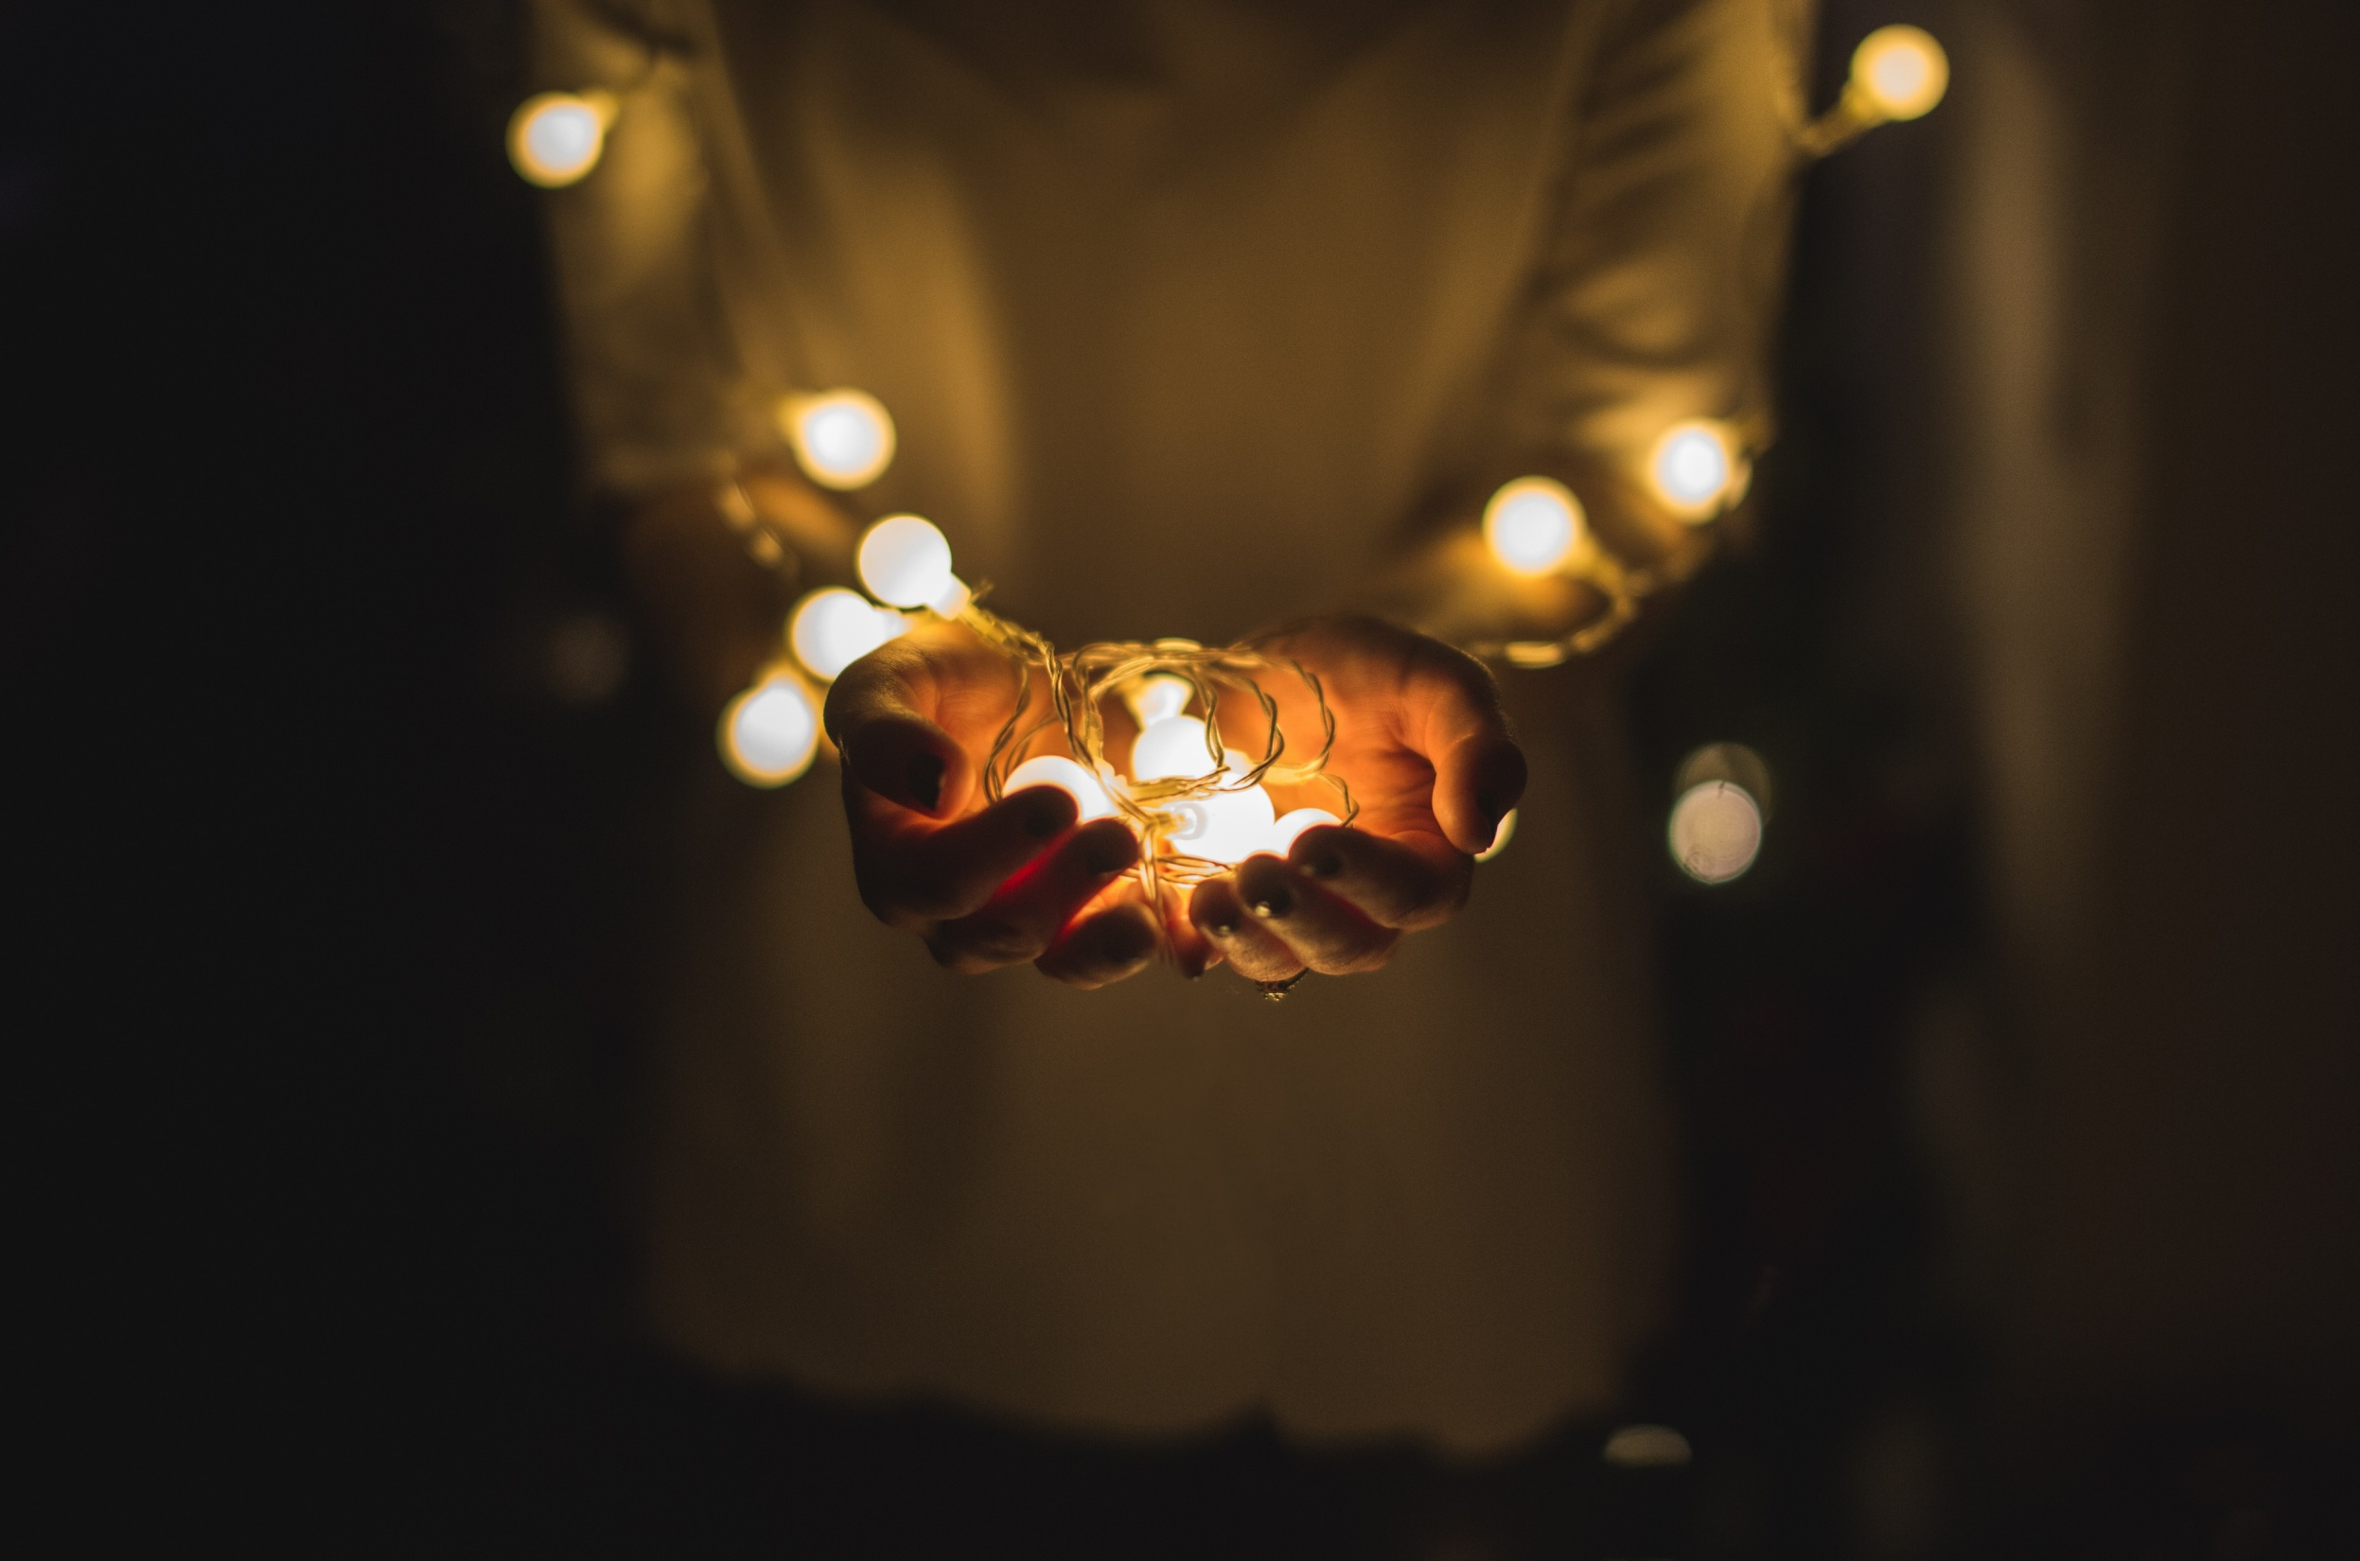
ADVENT
Photo by Josh Boot on Unsplash

