Slide 1
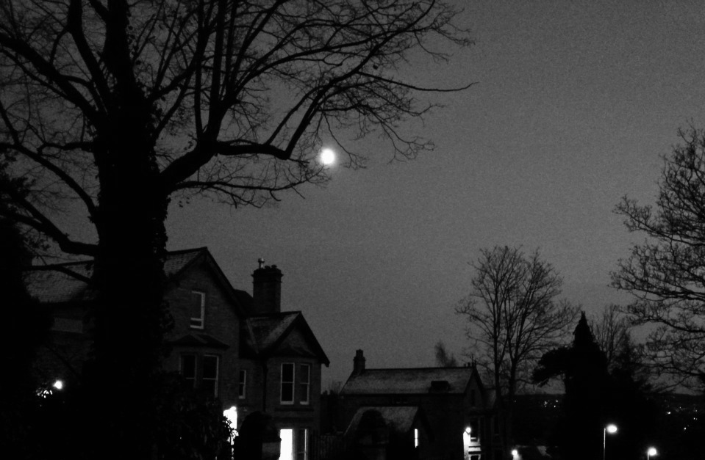

Slide 2
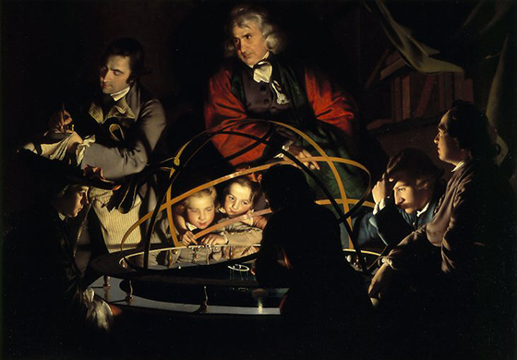
Joseph Wright of Derby, A Philosopher Giving a Lecture at the Orrery c. 1763-65

Slide 3
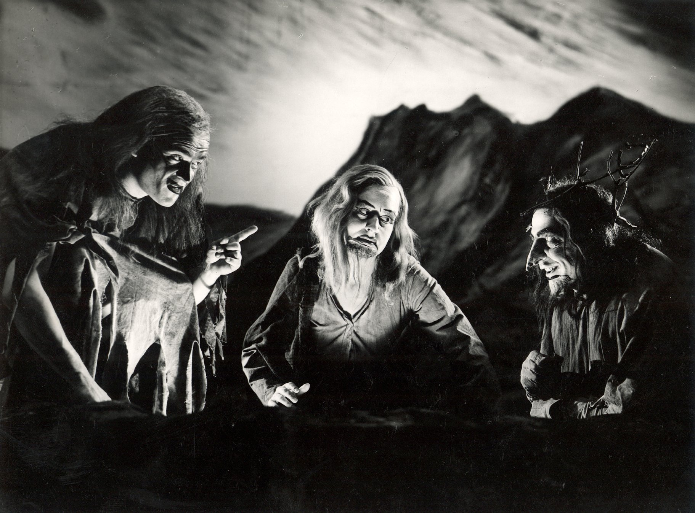
The Three Witches, from the 1956 RSC production of Shakespeare’s Macbeth

Slide 4
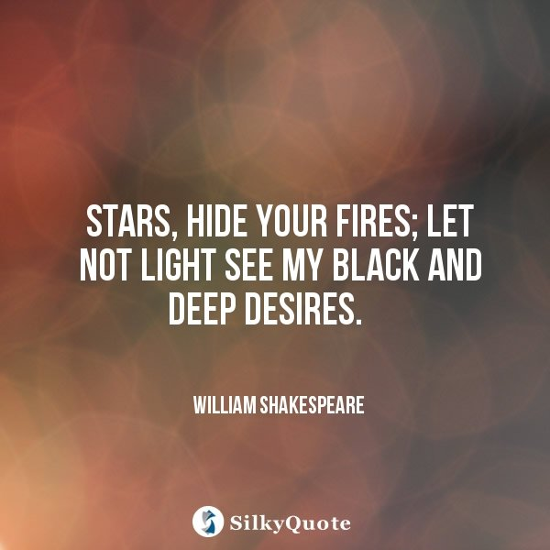

Slide 5
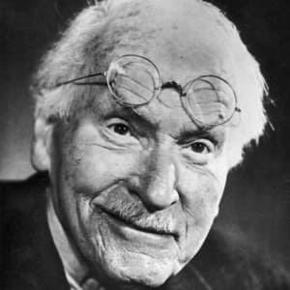
Carl Jung (1875–1961)

Slide 6
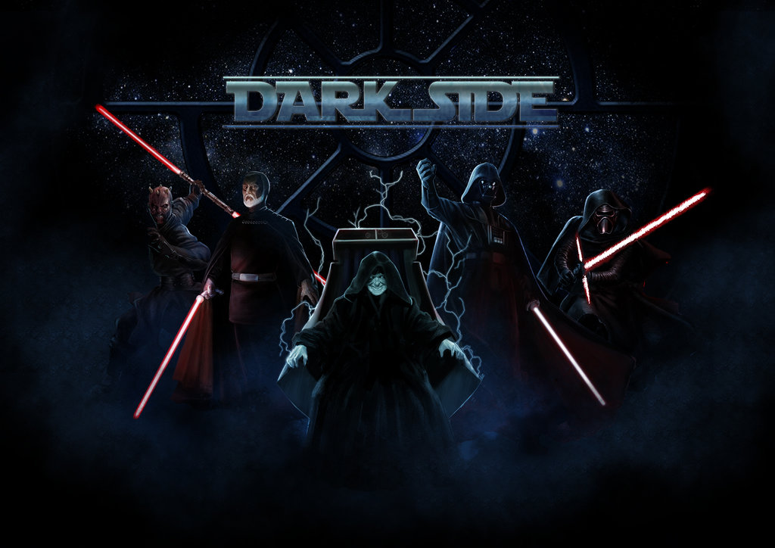

Slide 7
In the beginning the Word already existed; the Word was with God, and the Word was God. From the very beginning the Word was with God. Through him God made all things; not one thing in all creation was made without him. The Word was the source of life, and this life brought light to people. The light shines in the darkness, and the darkness has never put it out.
John 1:1-5

