Slide 1
Welcome

Slide 2


Slide 3
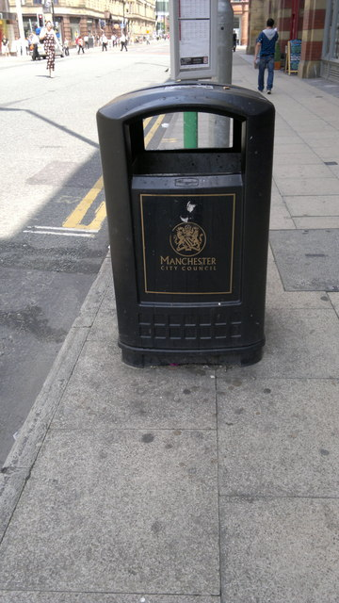


Slide 4


Slide 5
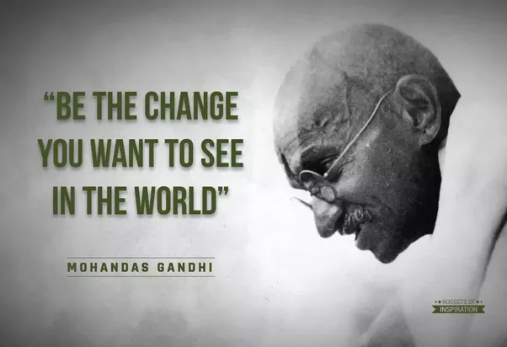

Slide 6
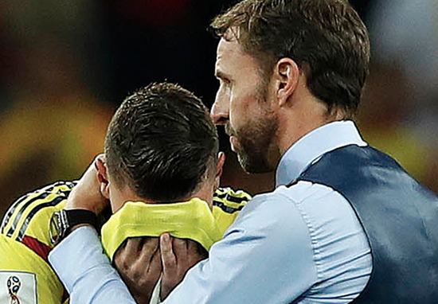

Slide 7
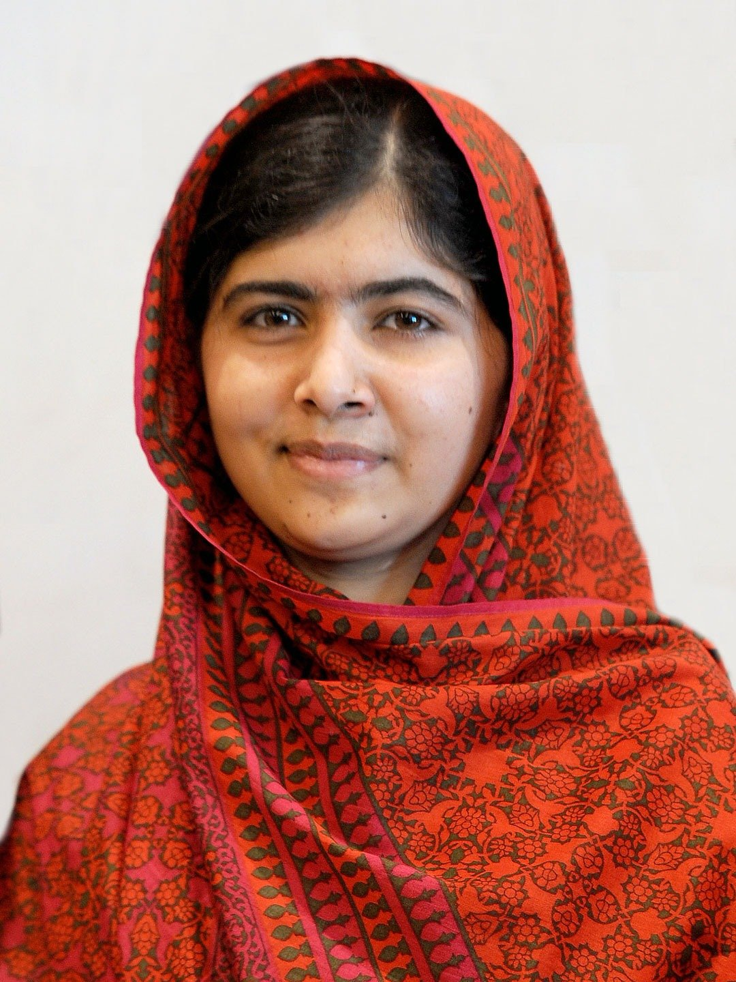

Slide 8


Slide 9
Kindness
Generosity
Forgiveness
Honesty
Compassion
Fairness

