Slide 1
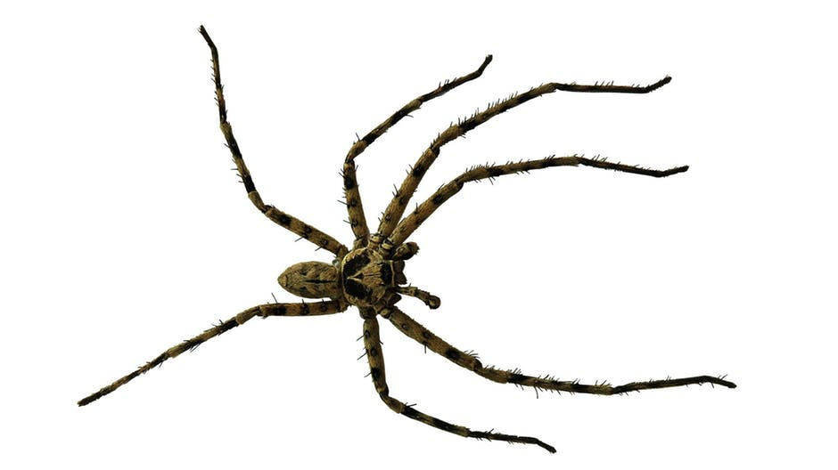
SPIDERS

Slide 2
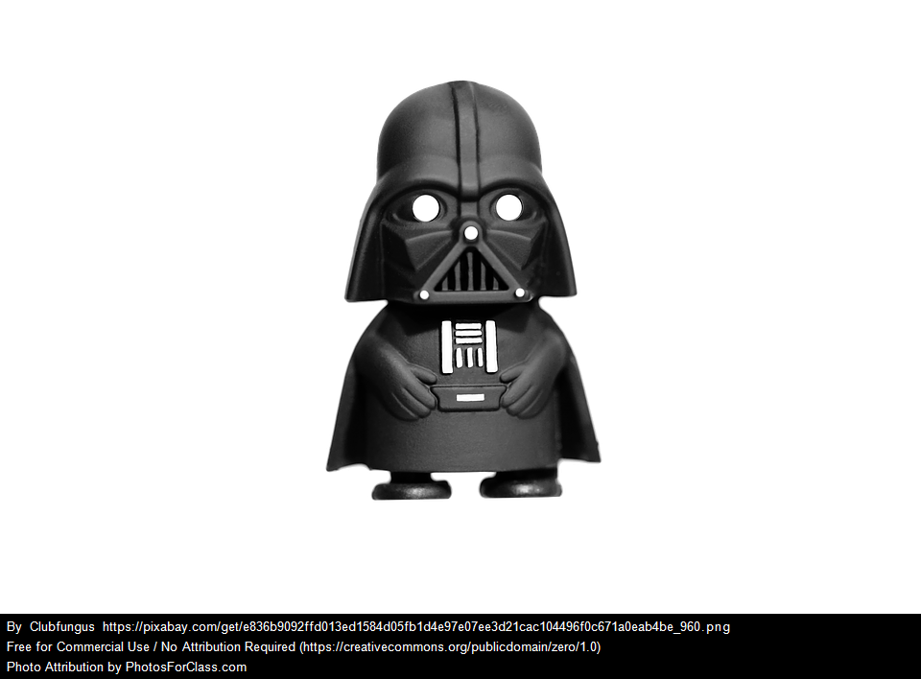
DARTH VADER

Slide 3
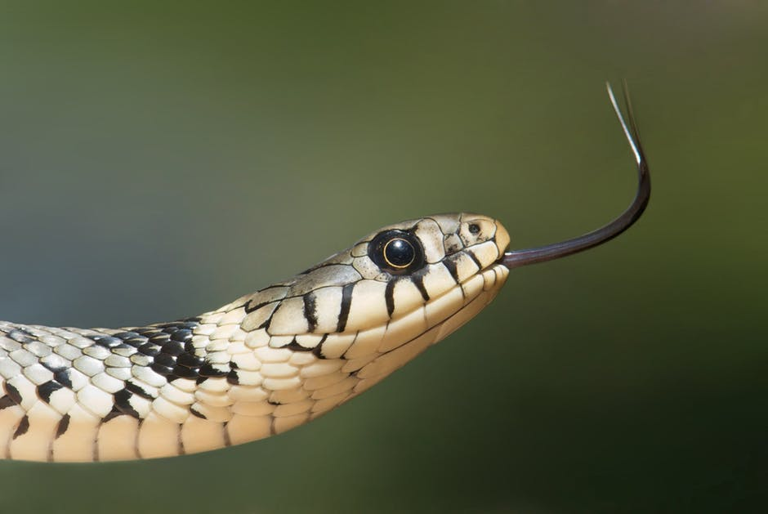
SNAKES

Slide 4
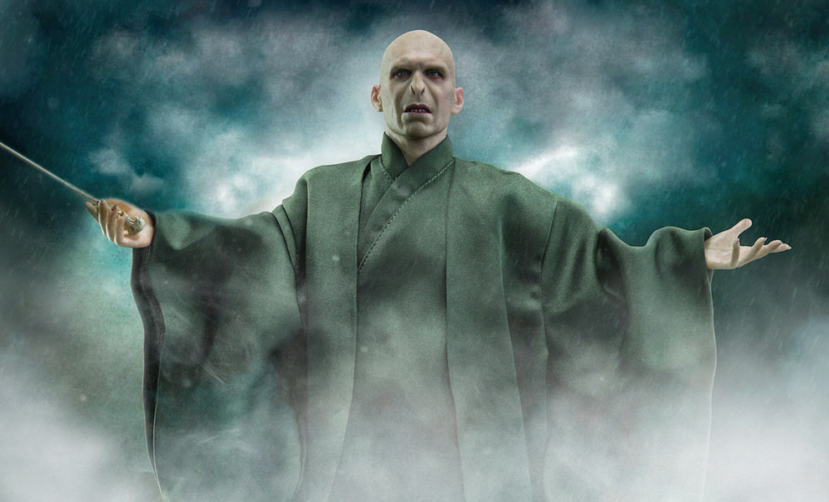
LORD VOLDEMORT

Slide 5


Slide 6
Perfect love
drives out
all fear
1 John 4:18

Slide 7

Image: World Vision

