Slide 1
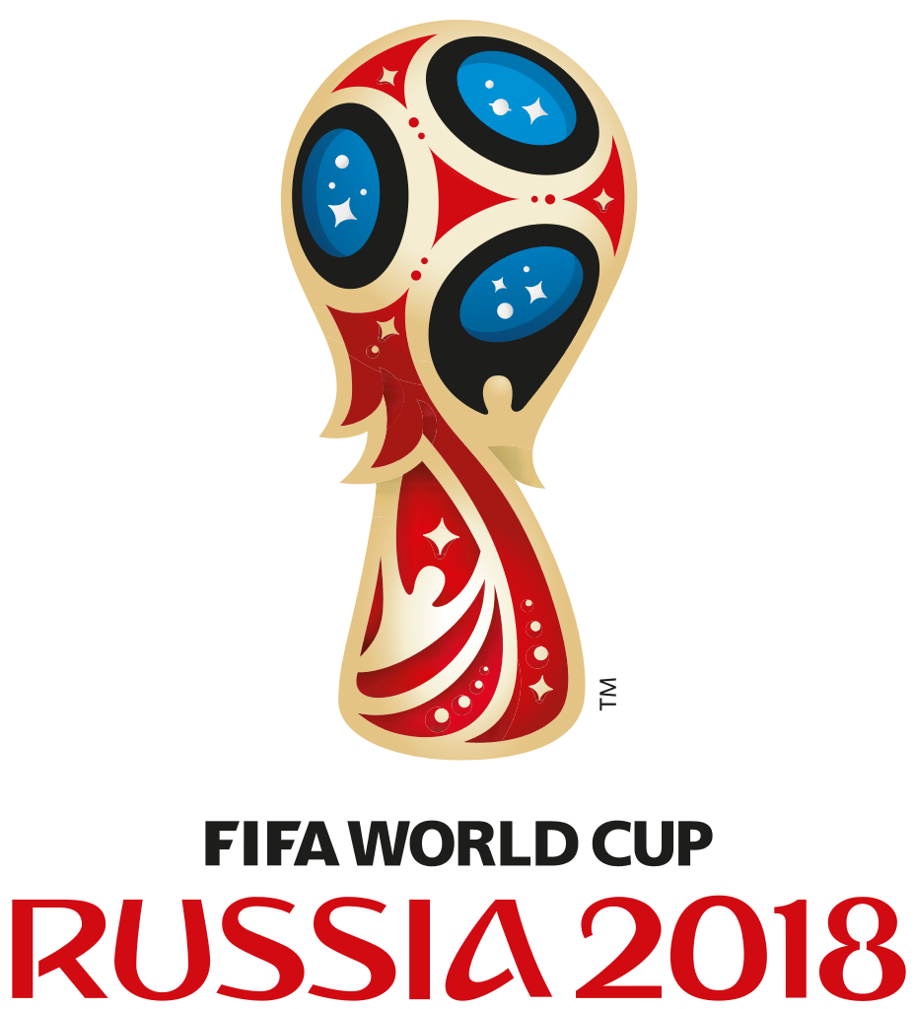

Slide 2
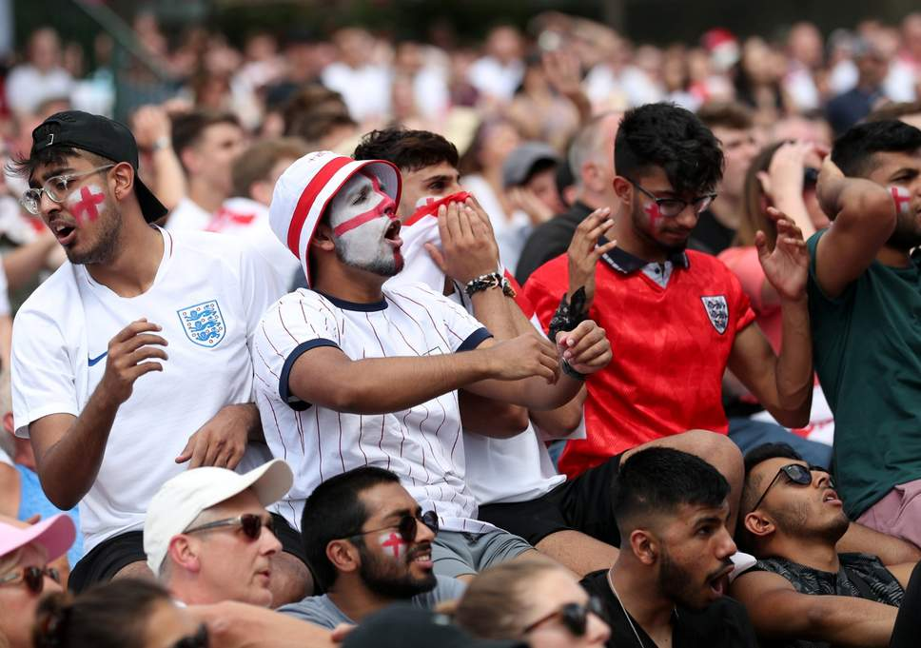

Slide 3
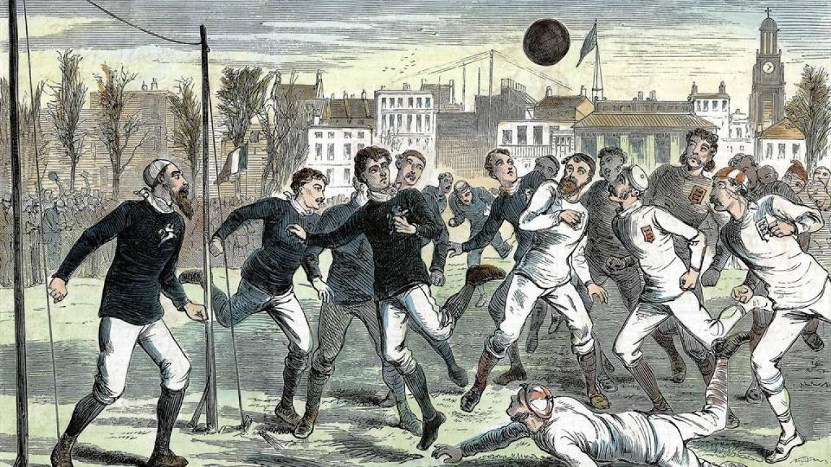

Slide 4
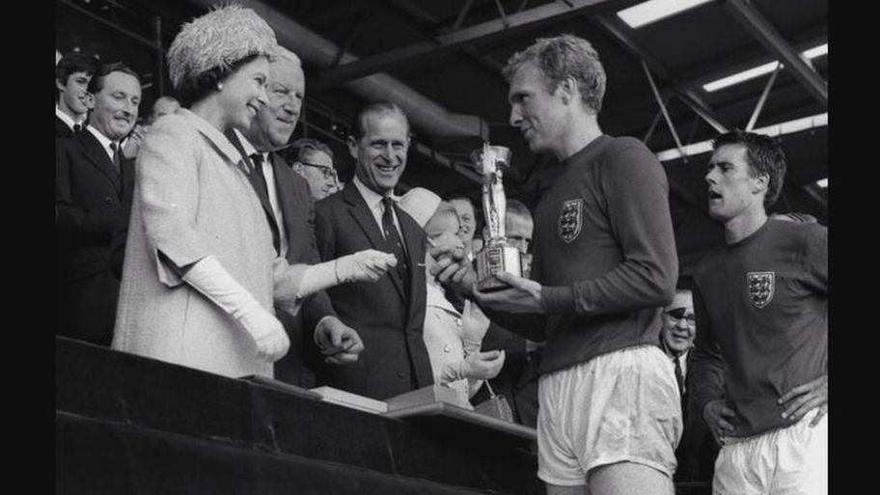
England captain Bobby Moore collecting the World Cup trophy from Queen Elizabeth II back in 1966

Slide 5
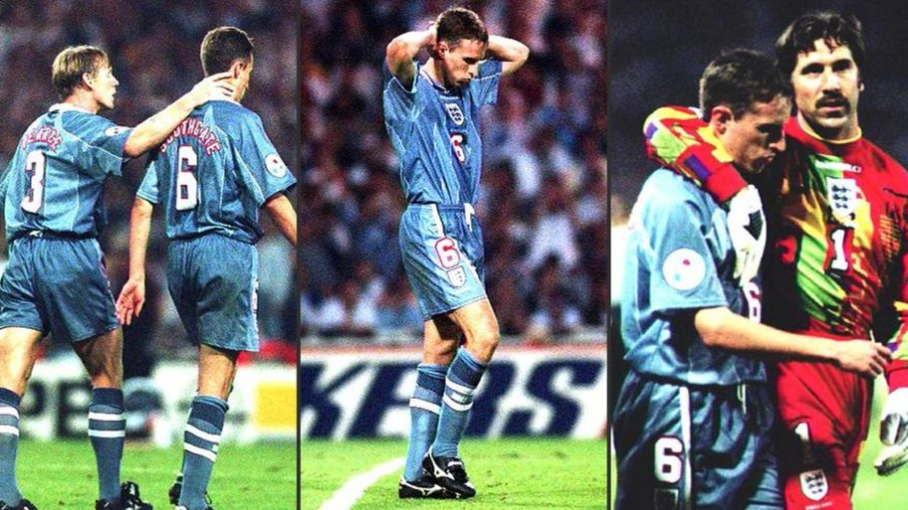
England manager Gareth Southgate missed a decisive penalty for England in the Euros back in 1996, when the song was released

Slide 6
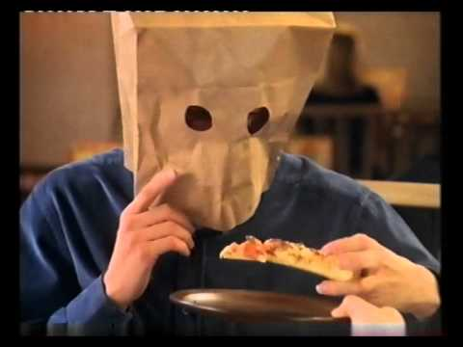

Slide 7
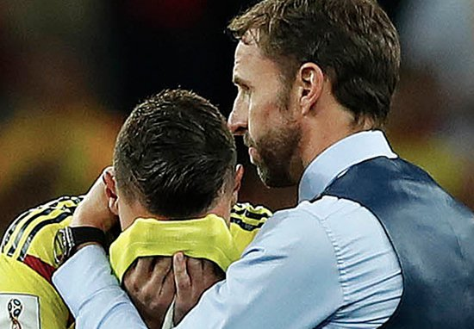

Slide 8
