Slide 1
Welcome

Slide 2


Slide 3
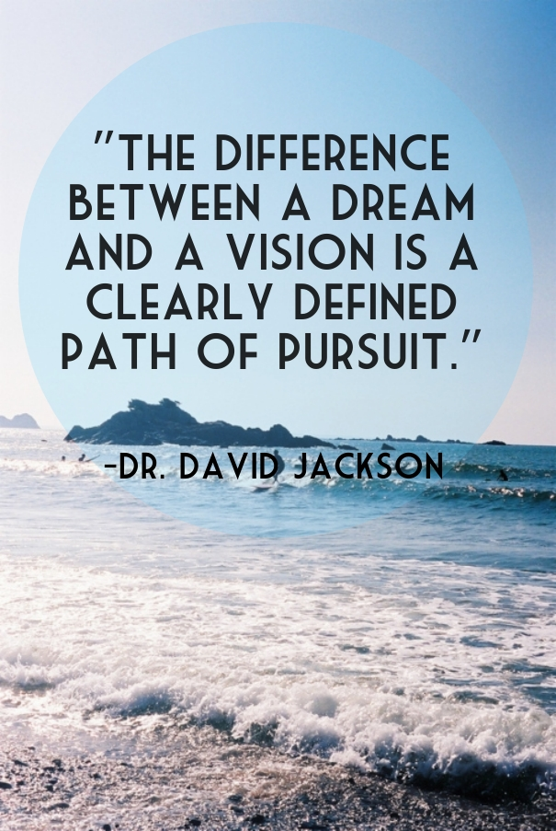

Slide 4
Dream | Vision
A big idea The ‘what’ you want to achieve | A big idea The ‘what’ you want to achieve PLUS The ‘how’ you are going to achieve it (the ‘path of pursuit’)

Slide 5
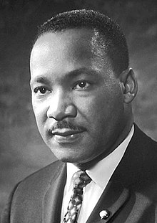
Martin Luther King, Jr
(1929–1968)
‘I have a dream that my four little children will one day live in a nation where they will not be judged by the colour of their skin, but by the content of their character.’

Slide 6

‘May he give you the desire of your heart and make all your plans succeed.’
Psalm 20.4

