Slide 1
Welcome to our assembly ☺

Slide 2


Slide 3


Slide 4
I haven’t made it onto the football team . . .
I haven’t managed to pass my maths exam . . .
I’m not friends with them . . .

Slide 5
The game-changing three-letter word is . . .
YET

Slide 6
I haven’t made it onto the football team . . . YET.
I haven’t managed to pass my maths exam . . . YET.
I’m not friends with them . . . YET.

Slide 7
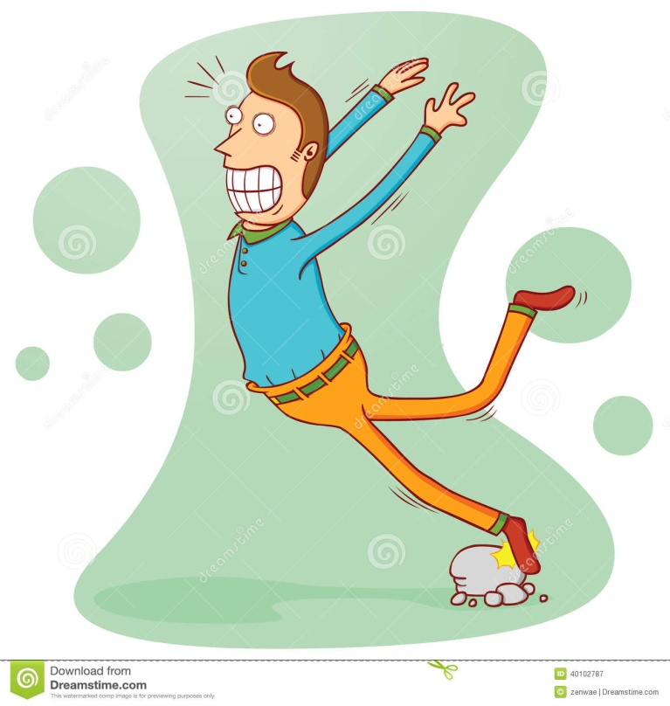
Stumbling – can any benefit come from setbacks?
Setbacks are opportunities to learn. We learn what doesn’t work.
Setbacks offer a chance to reflect, refine and change our plans.
Setbacks help us to develop resilience. We will handle other setbacks with greater confidence if we can manage this one.
Setbacks enable us to understand other people’s experiences better – we all face setbacks.

