Slide 1
Welcome to our assembly

Slide 2
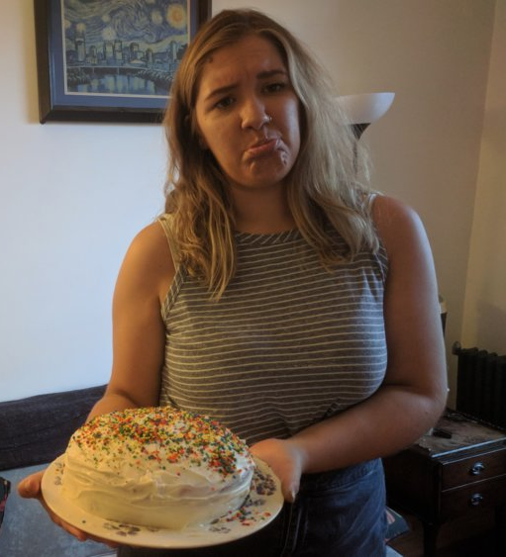
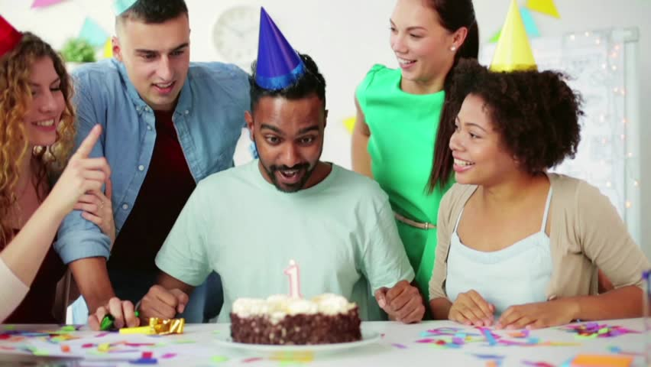
Who is having a better time on their birthday?

Slide 3
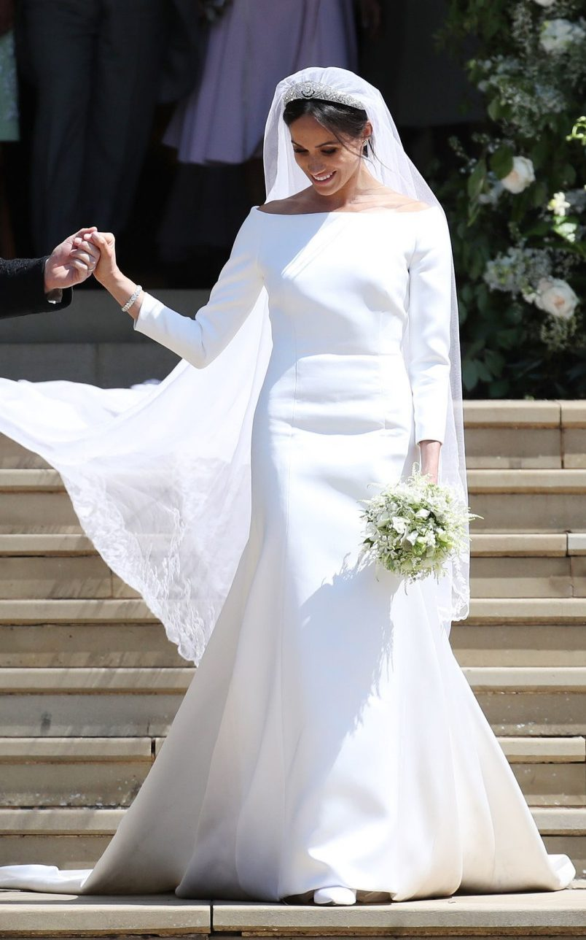
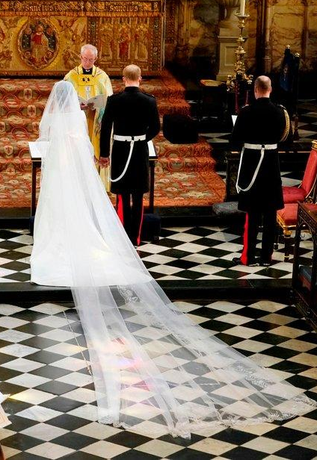
Meghan’s wedding dress was designed by Givenchy’s Clare Waight Keller

Slide 4
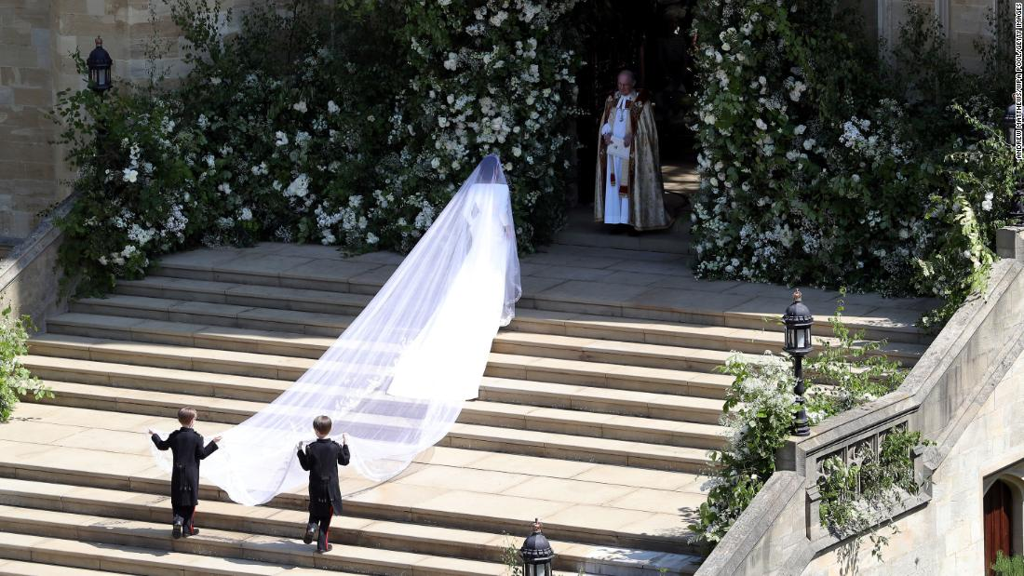
Meghan waits to enter St George’s Chapel at Windsor Castle

Slide 5
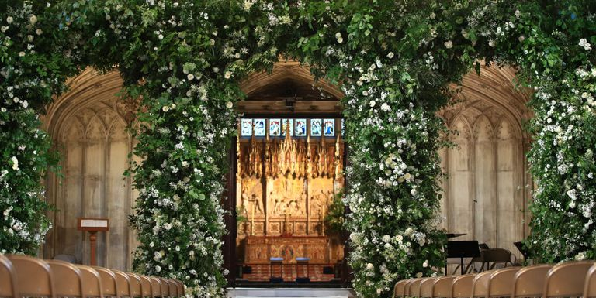
Flowers in St George’s Chapel at Windsor Castle

Slide 6
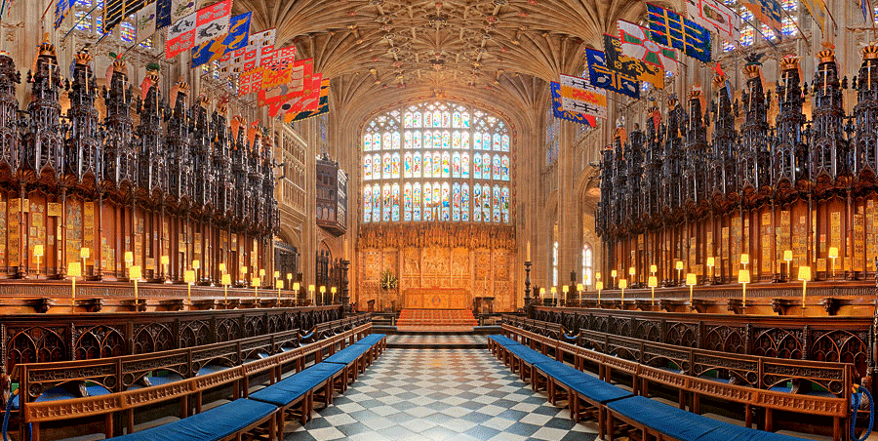
The Quire inside St George’s Chapel at Windsor Castle

Slide 7
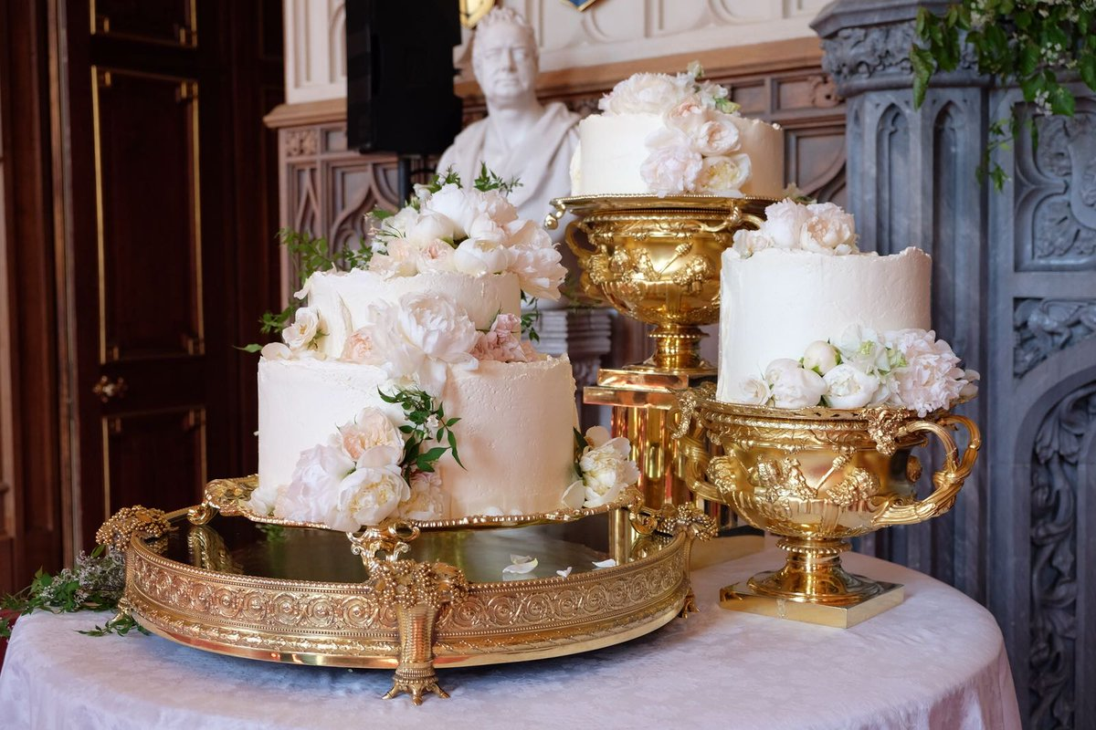
The cake was designed by Claire Ptak and contained elderflower syrup made from elderflowers at the Queen’s Sandringham residence

Slide 8







Prince Harry and Meghan suggested that guests donate to these seven charities instead of giving them a wedding present

Slide 9
