Slide 1
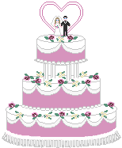
Welcome to our assembly

Slide 2
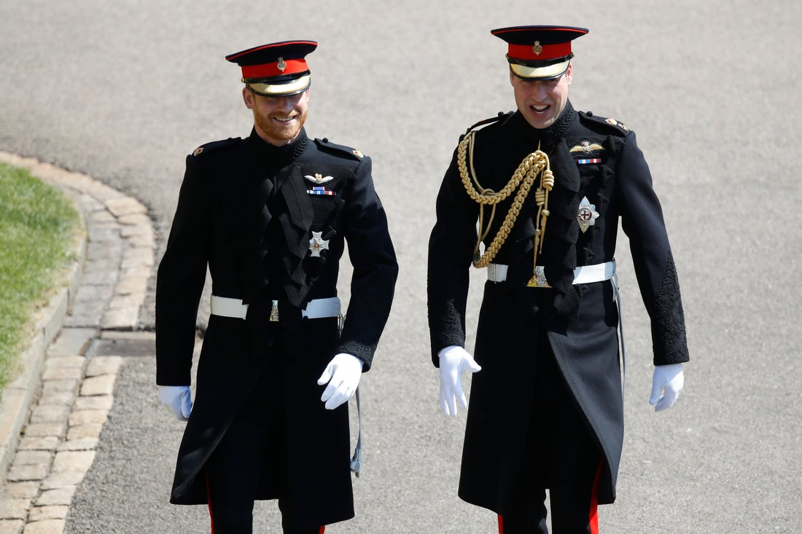
Prince Harry and Prince William arrive at St George’s Chapel, Windsor Castle, before the wedding

Slide 3
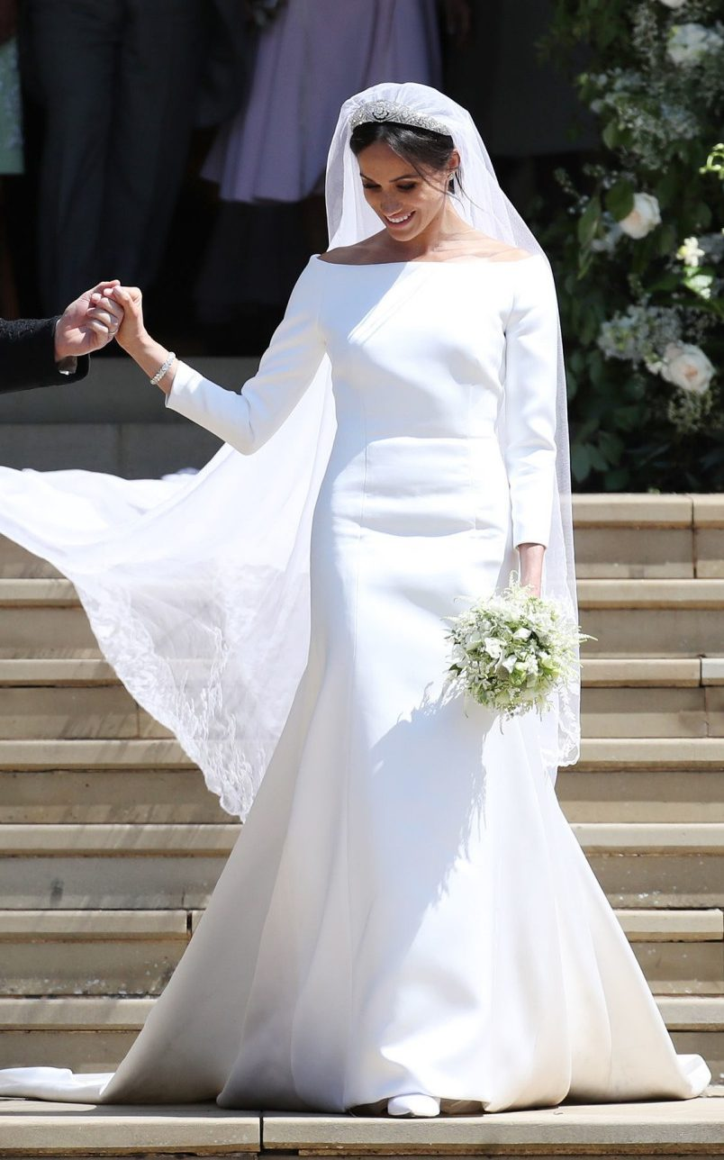
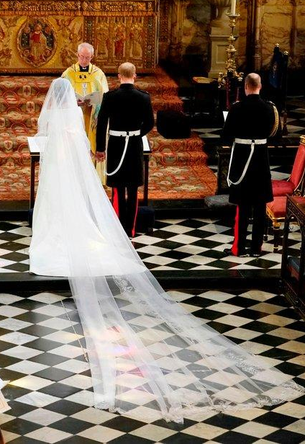
Meghan’s wedding dress was designed by Givenchy’s Clare Waight Keller

Slide 4
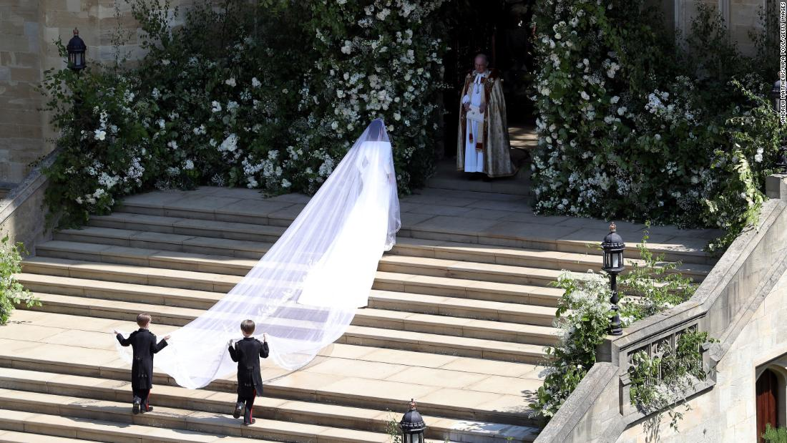
Meghan waits to enter St George’s Chapel at Windsor Castle

Slide 5
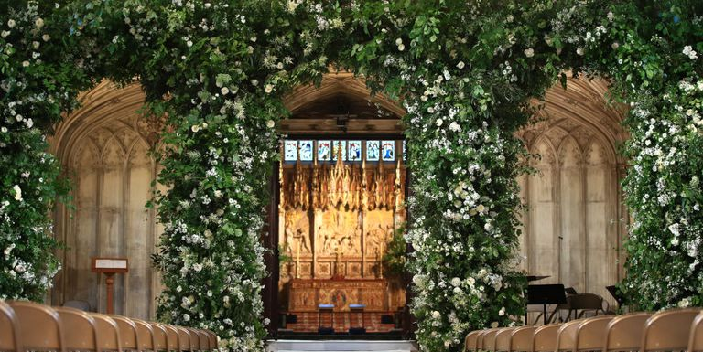
Flowers in St George’s Chapel at Windsor Castle

Slide 6
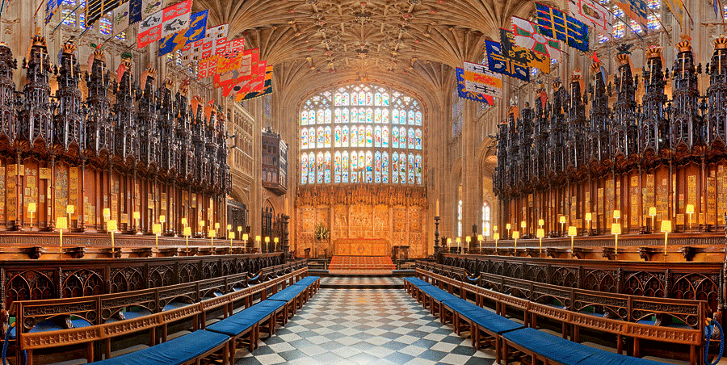
The Quire inside St George’s Chapel at Windsor Castle

Slide 7
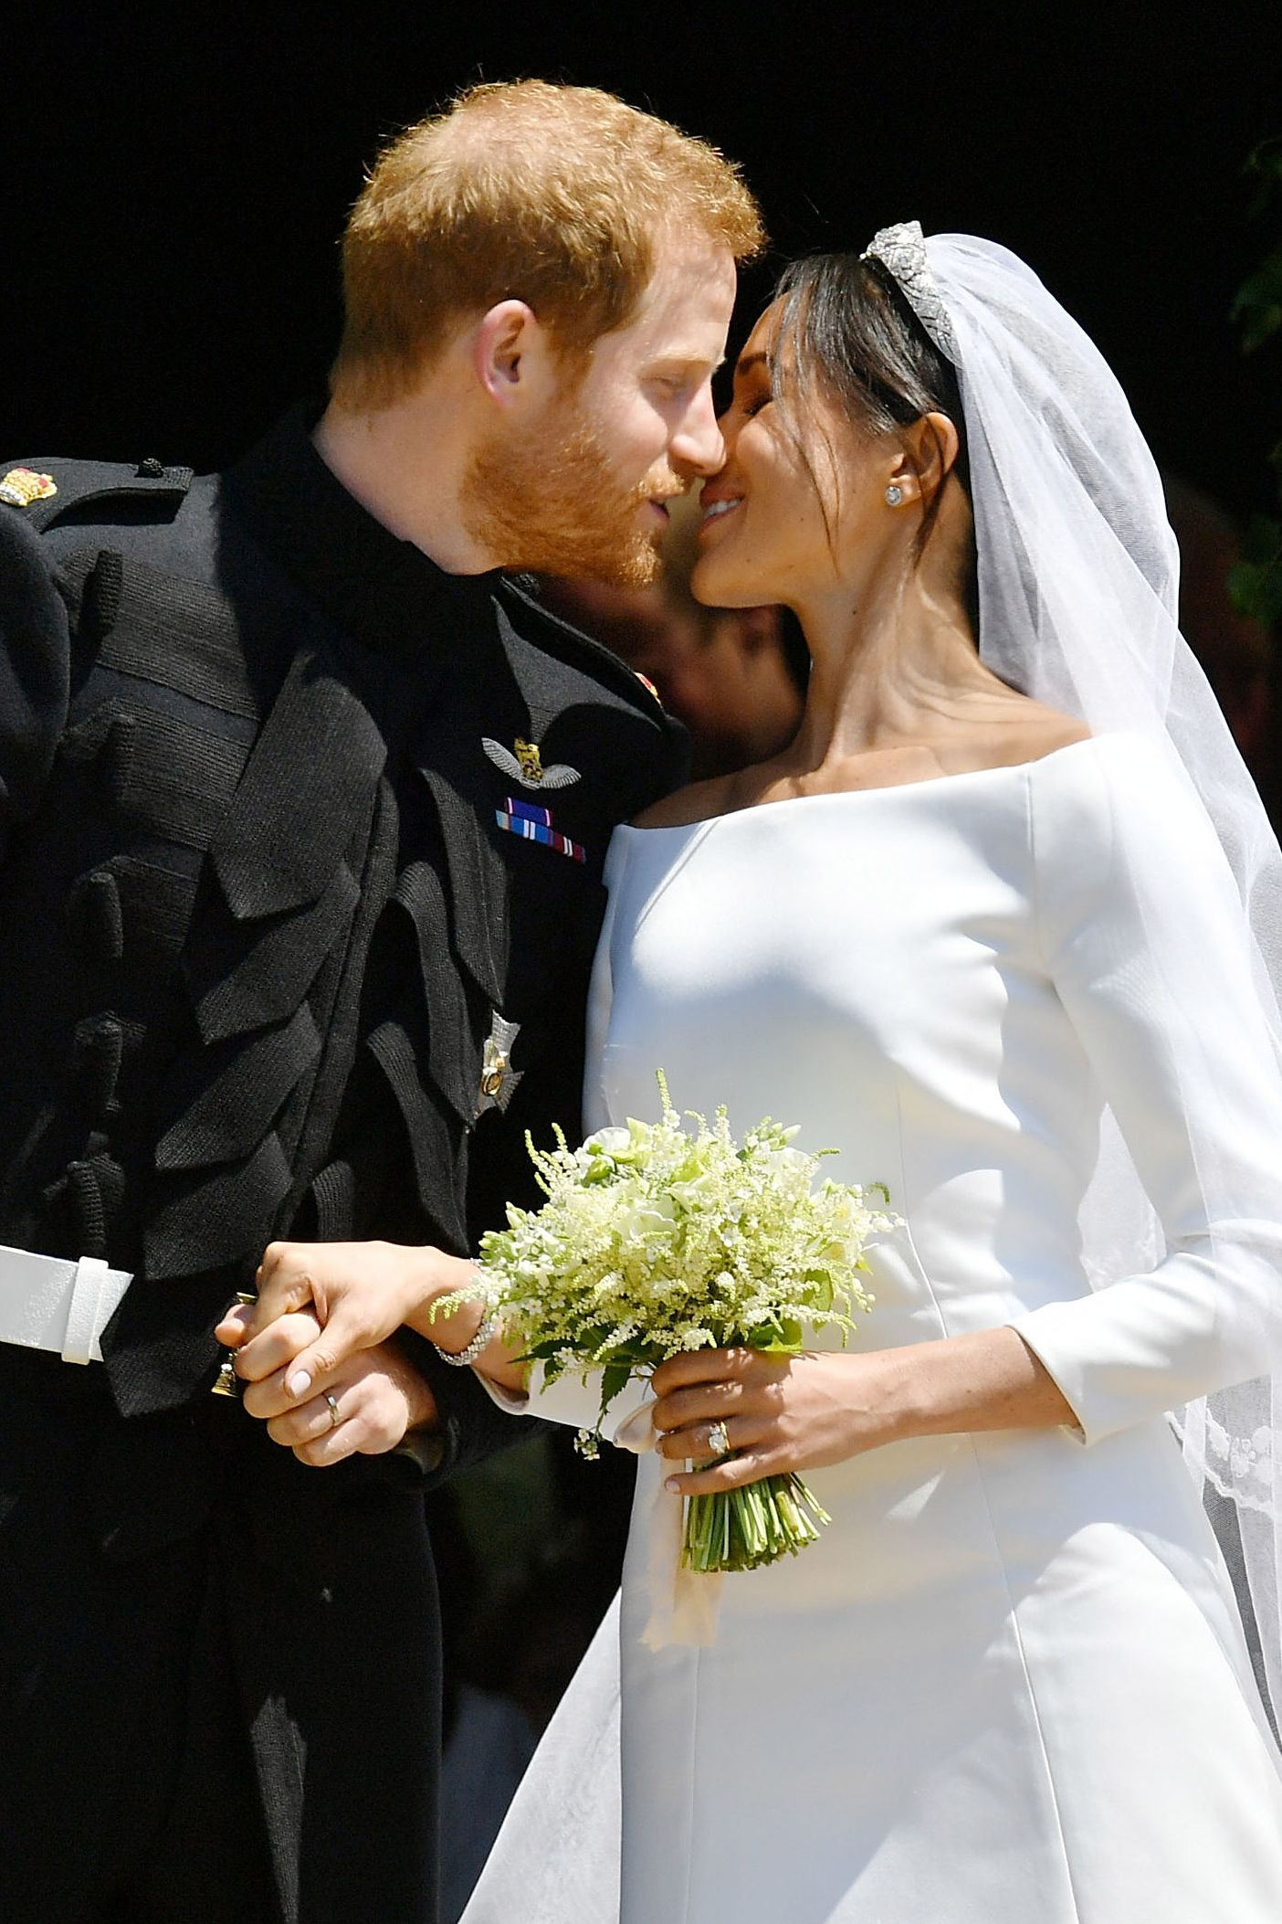
The flowers in Meghan’s wedding bouquet included sweet peas, lilies of the valley, jasmine and myrtle.
Prince Harry handpicked some of the flowers from their garden at Kensington Palace.

Slide 8
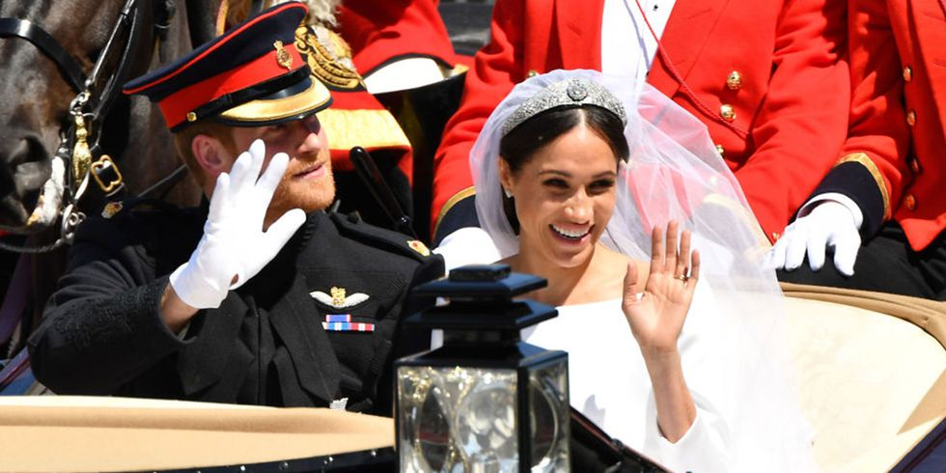
Harry and Meghan leave St George’s Chapel to begin their procession through the streets of Windsor

Slide 9
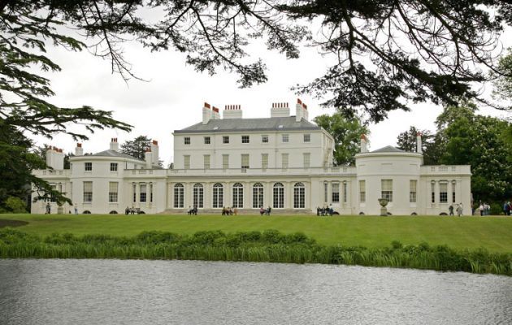
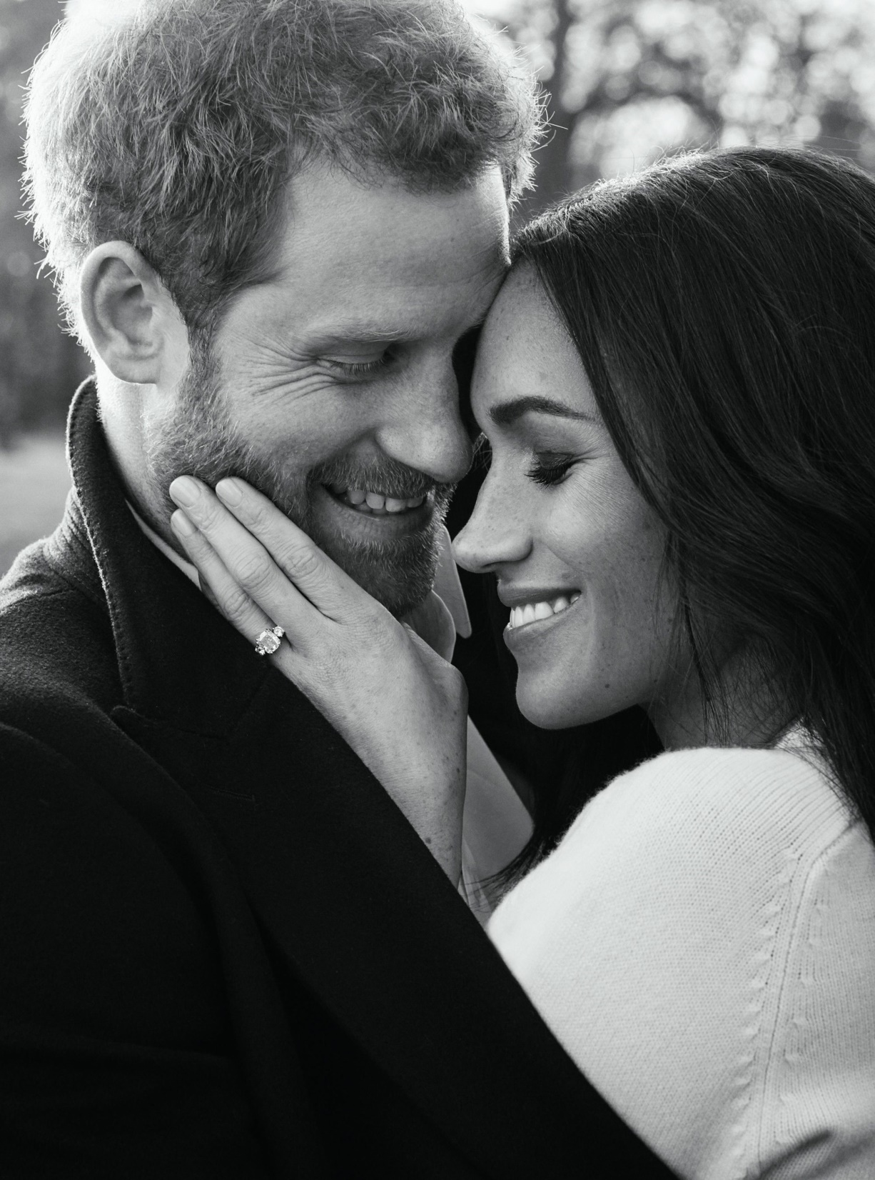
Frogmore House
The venue for the evening reception and the place where the couple had their engagement photos taken

Slide 10







Prince Harry and Meghan suggested that guests donate to these seven charities instead of giving them a wedding present

Slide 11
