Slide 1
Welcome to our assembly

Slide 2
Fastest human?

Slide 3
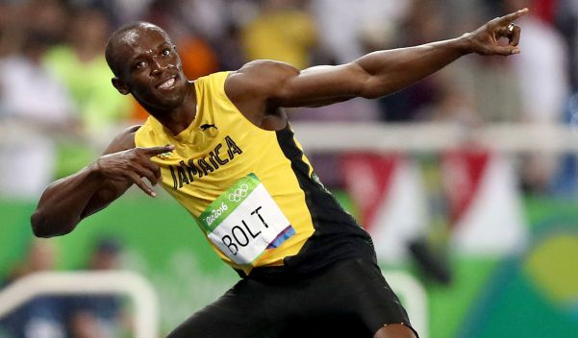

Slide 4
Fastest train?

Slide 5
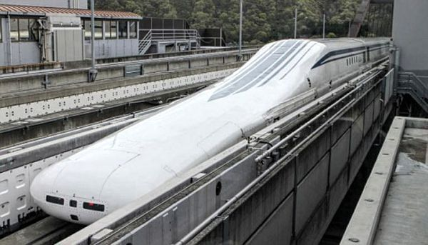

Slide 6
Fastest rollercoaster?

Slide 7
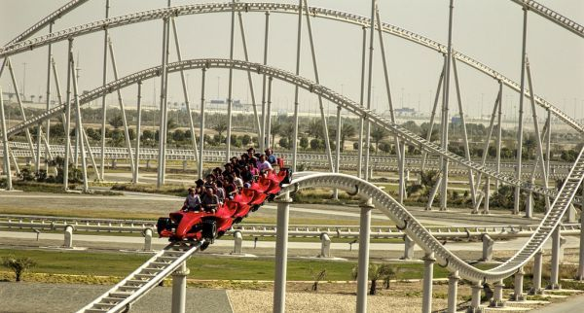

Slide 8
Fastest land animal?

Slide 9
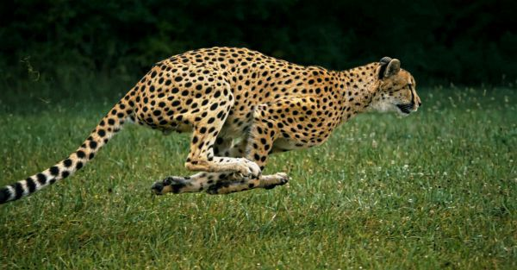

Slide 10

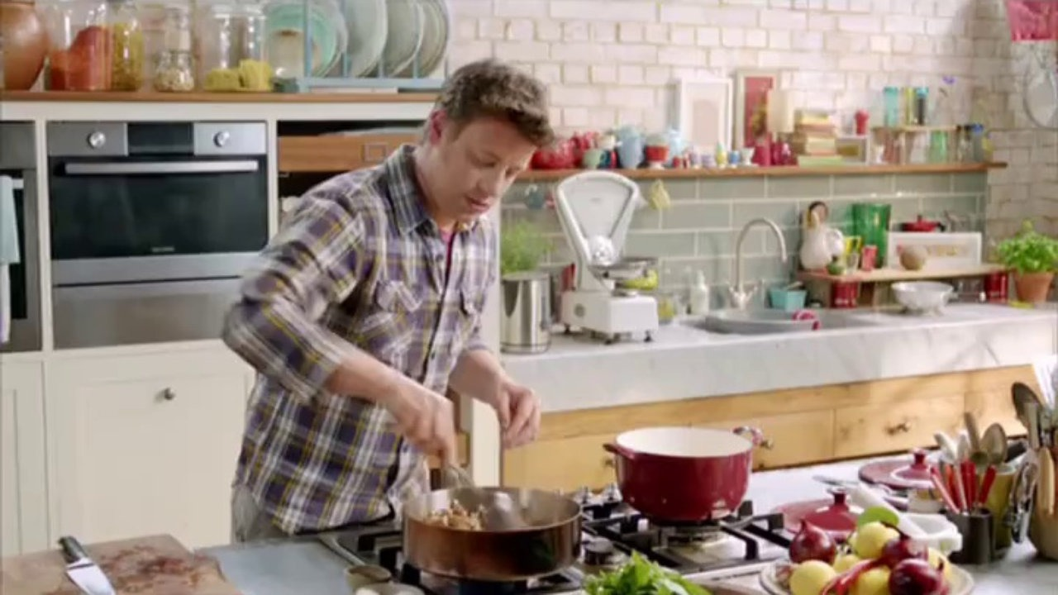

Slide 11
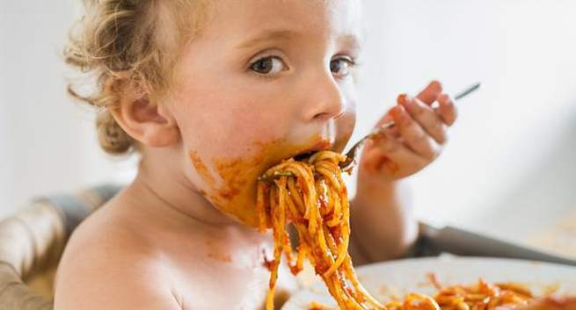

Slide 12


Slide 13
‘Be still, and know that I am God.’
Psalm 46

