Slide 1
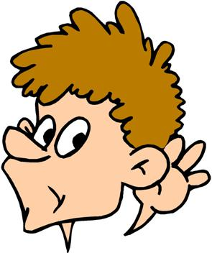
Can you identify the TV programme?
https://www.youtube.com/watch?v=Jv0u18eFj1M

Slide 2


Slide 3

Total transformation!

Slide 4
https://www.youtube.com/watch?v=Iz1pJDCbJRM
This song is about someone struggling to adapt to the changes around them – people moving away and friendship groups adapting.
How do you feel when things change?

Slide 5
‘To live is to change, and to be perfect is to have changed often.’
John Henry Newman

Slide 6
‘You must be the change you want to see in the world.’
Mahatma Ghandi.

Slide 7


