Slide 1
Welcome to our assembly

Slide 2
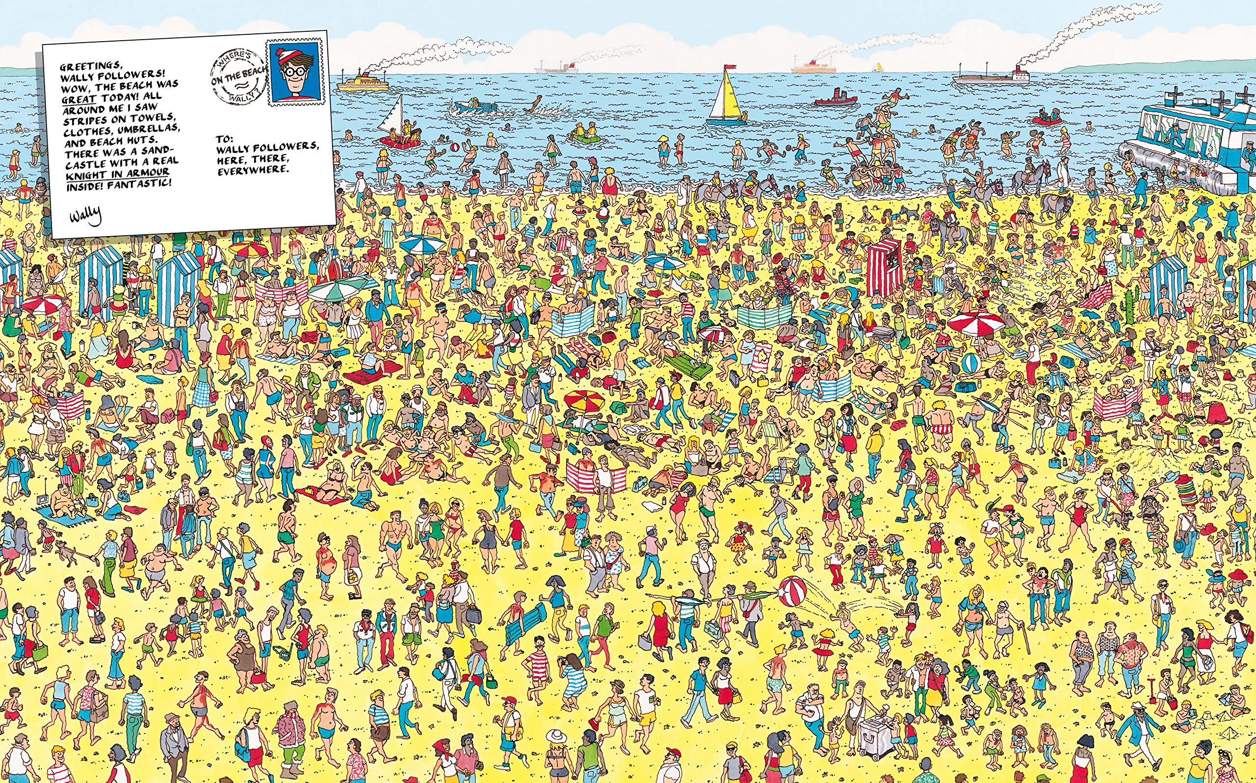

Slide 4
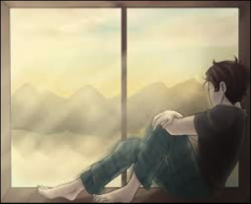
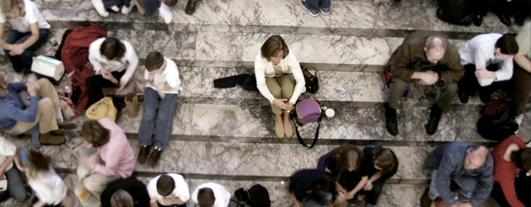
Loneliness is ‘sadness because one has no friends or company’

Slide 5
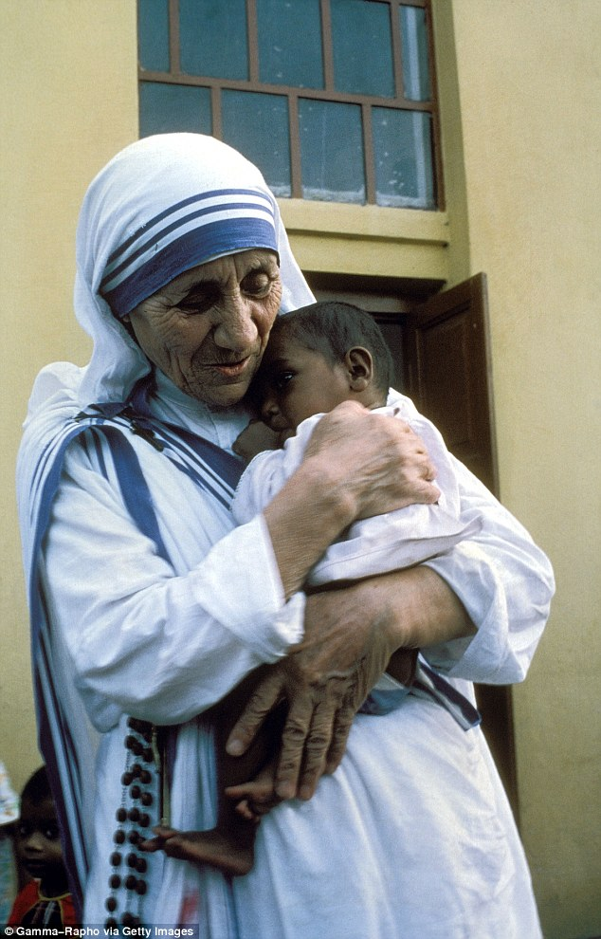
‘The most terrible poverty is loneliness, and the feeling of being unloved.’
Mother Teresa

Slide 6

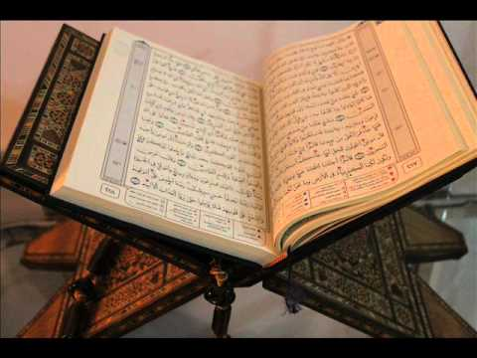
‘Your God, the Lord himself, will be with you. He will not fail you or abandon you.’
Bible, Deuteronomy 31.6
‘By the morning brightness, and by the night when it is stillest, your Lord has not forsaken you.’
Qur’an, Surah 93

