Slide 1
Fish and . . .

Slide 2
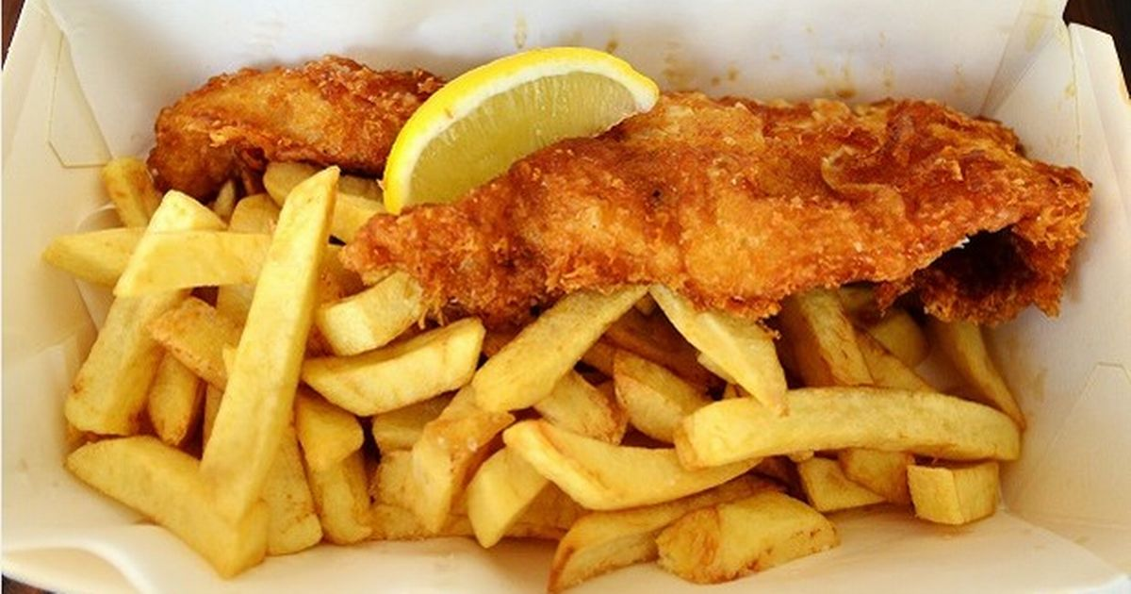
Fish and chips!

Slide 3
Knife and . . .

Slide 4
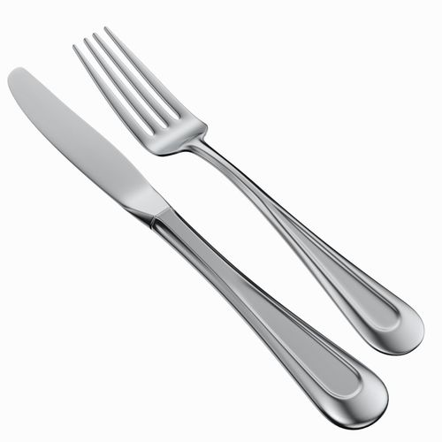
Knife and fork!

Slide 5
Hide and . . .

Slide 6
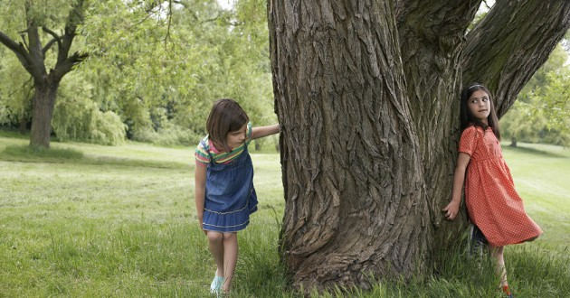
Hide and seek!

Slide 7
Prince Harry and . . .

Slide 8
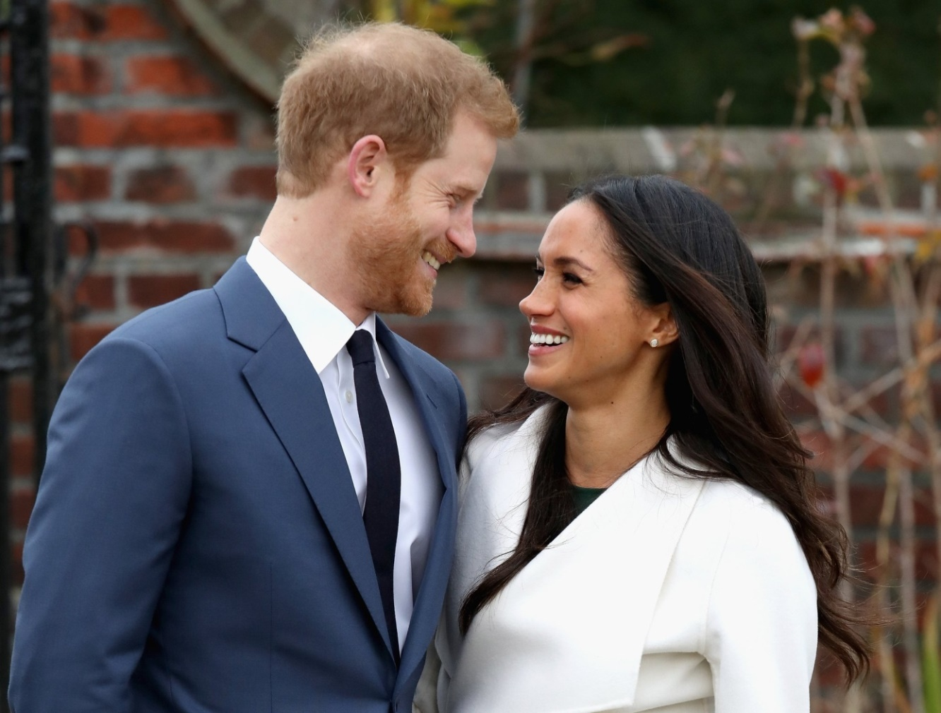
Prince Harry and Meghan Markle!

Slide 9
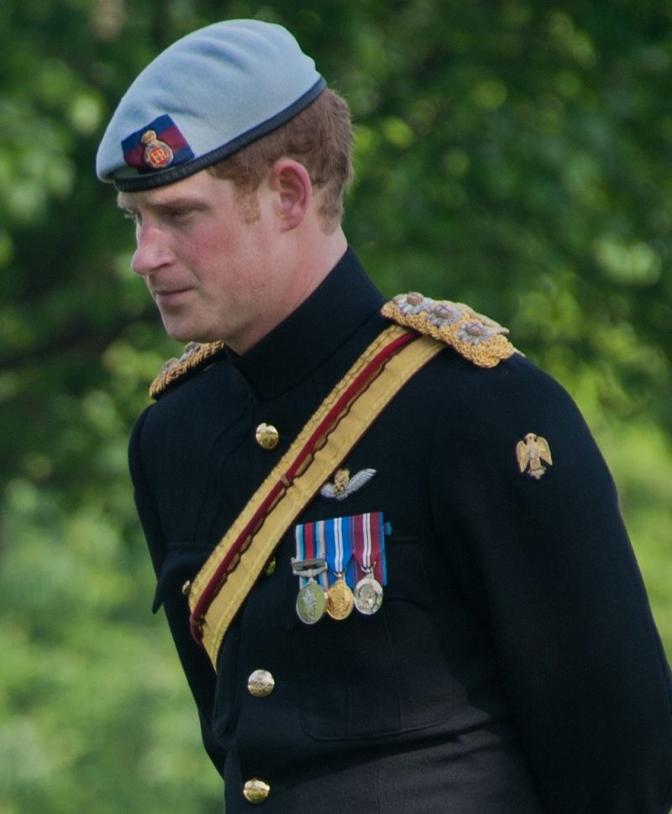
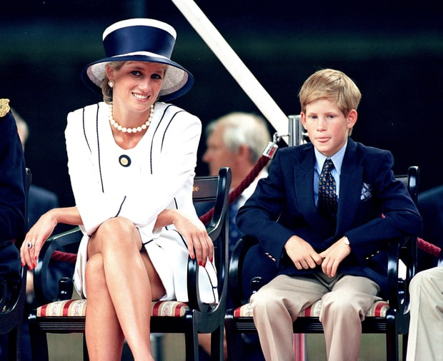
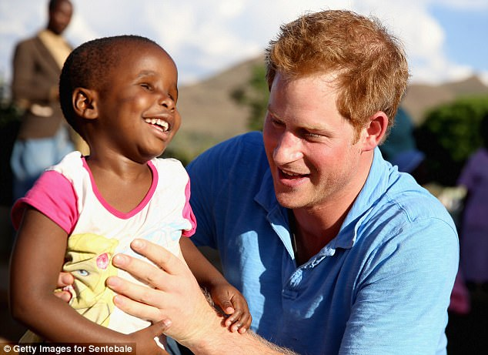

Slide 10
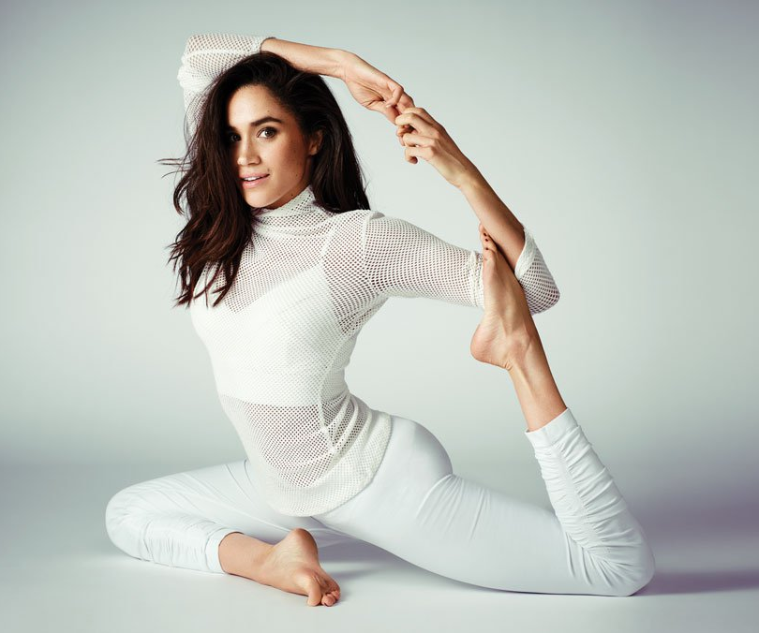
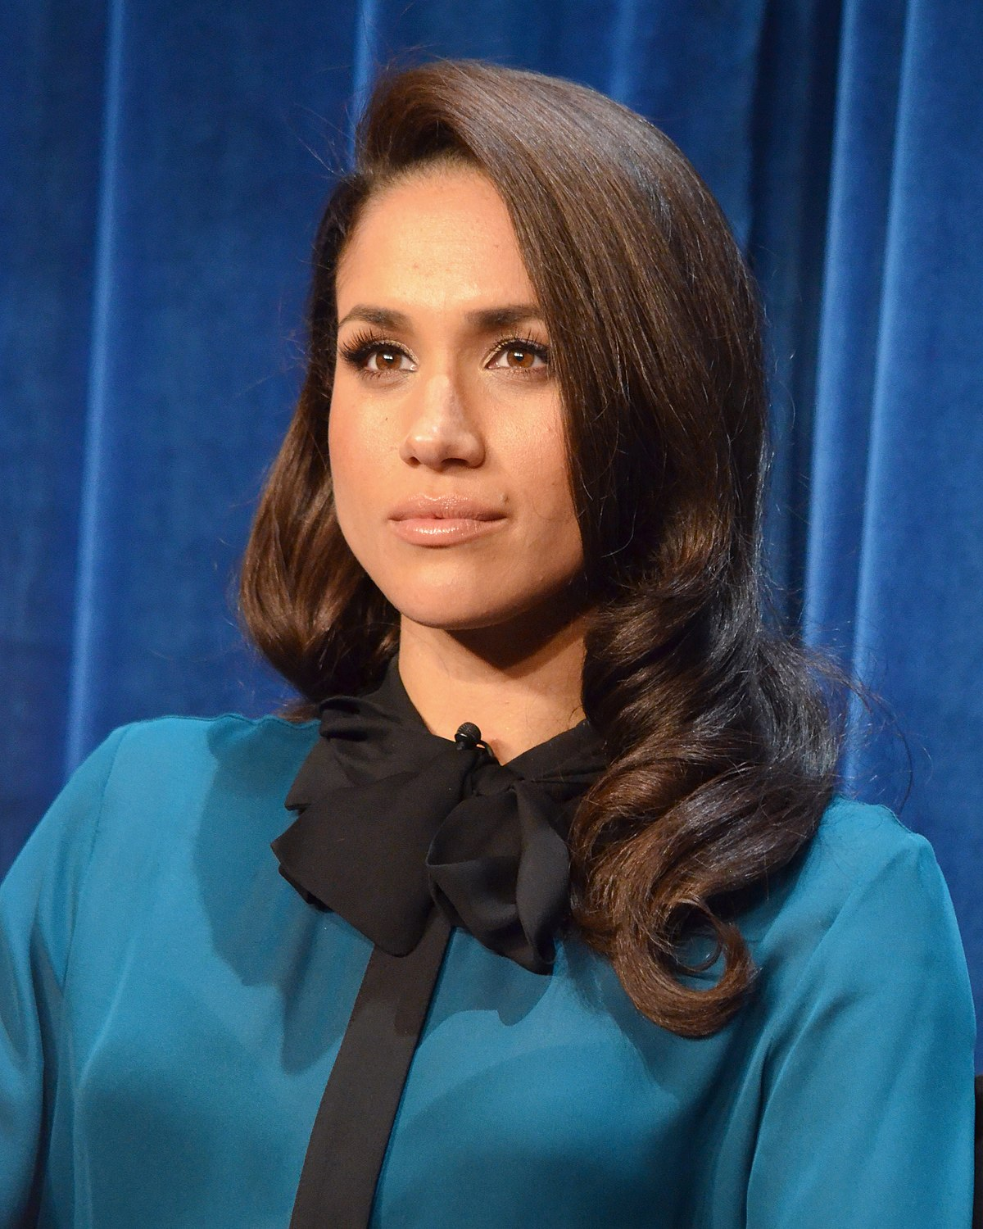


Slide 11


Slide 12
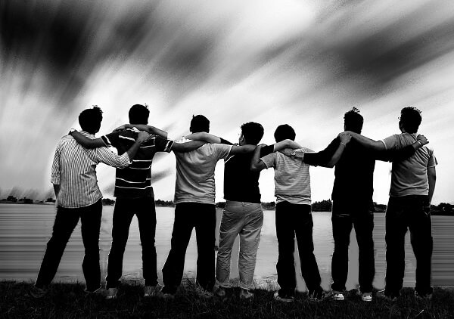

Slide 13


