Slide 1
Mountains

Slide 2
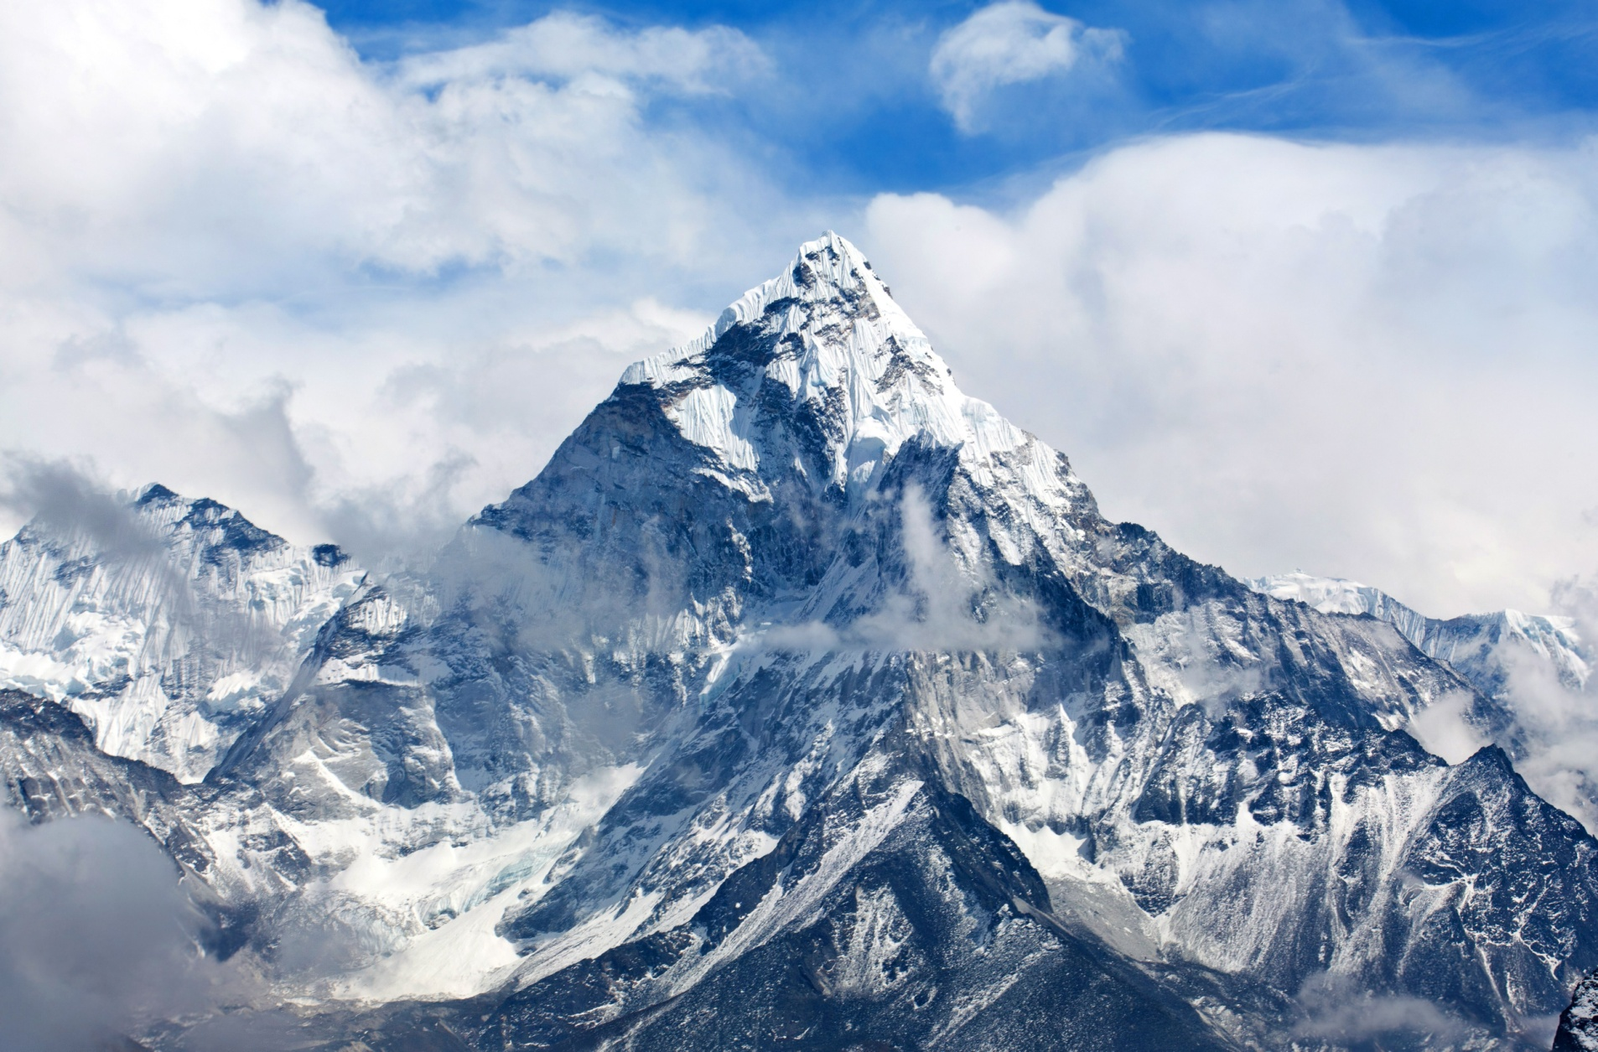
Mount Everest, Nepal

Slide 3
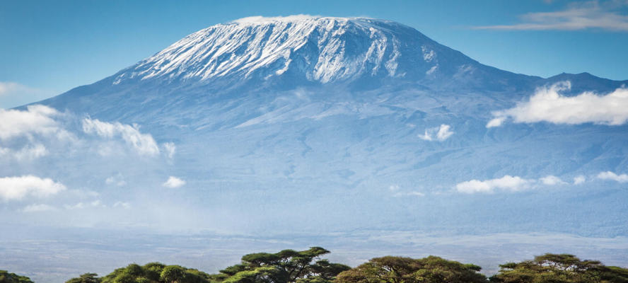
Mount Kilimanjaro, Tanzania

Slide 4
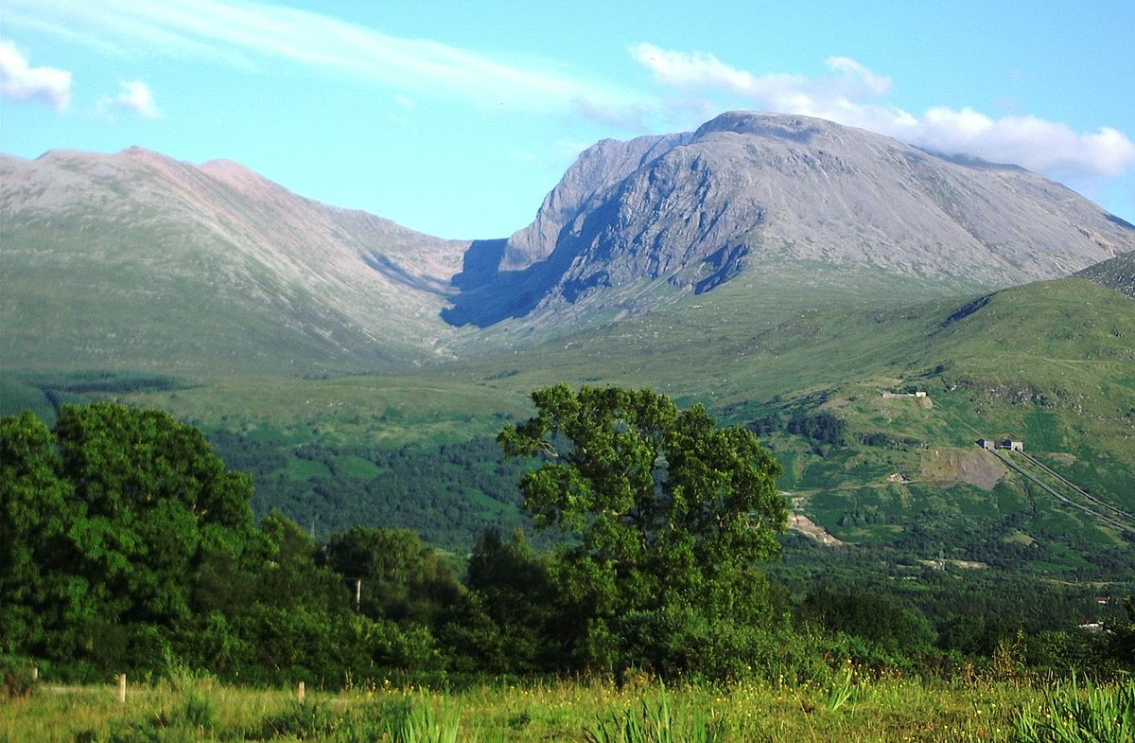
Ben Nevis, Scotland

Slide 5
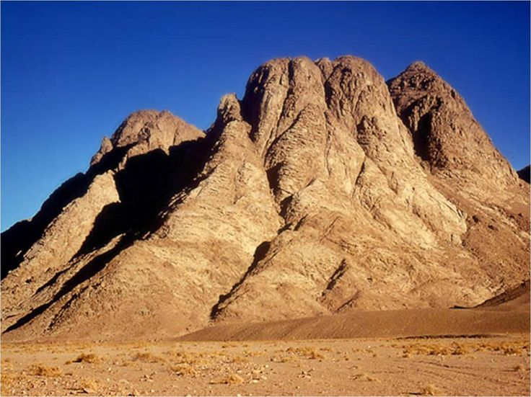
Mount Sinai, where God gave Moses the Ten Commandments

Slide 6
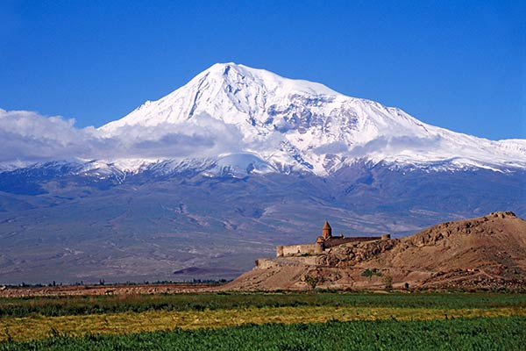
Mount Ararat, where Noah’s Ark came to rest after the great flood

Slide 7
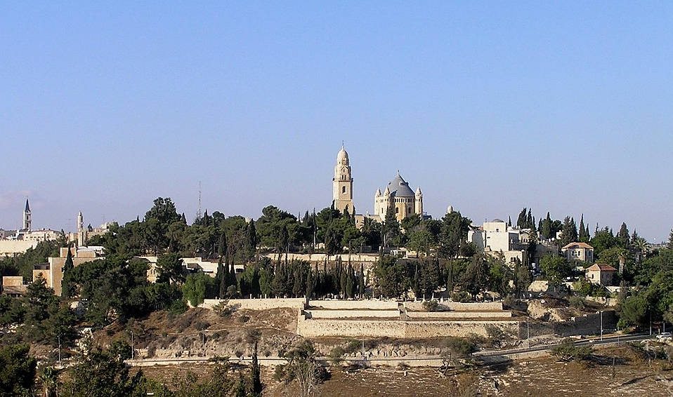
Mount Zion, where King David
built his palace

Slide 8
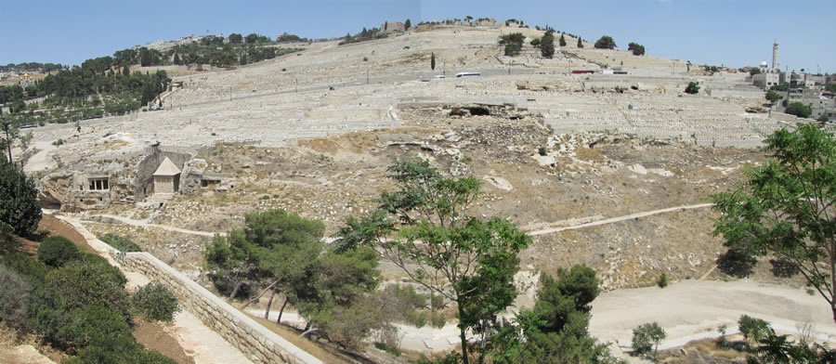
The Mount of Olives, where Jesus prayed the night before he died

Slide 9
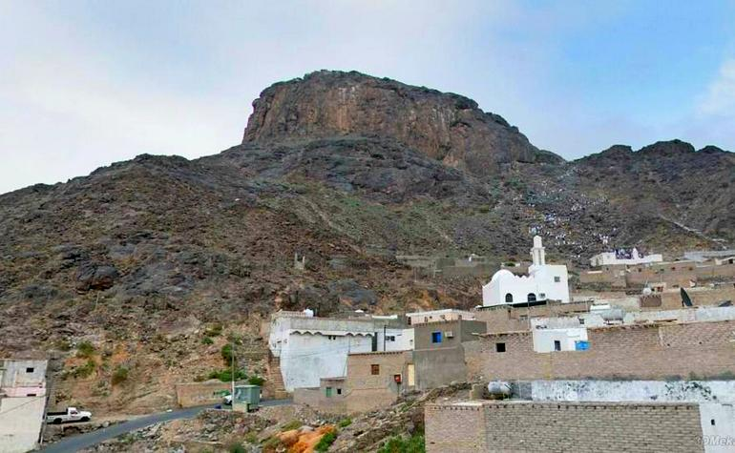
Mount Hira, where Muhammad had his first vision of the angel Jibril

Slide 10
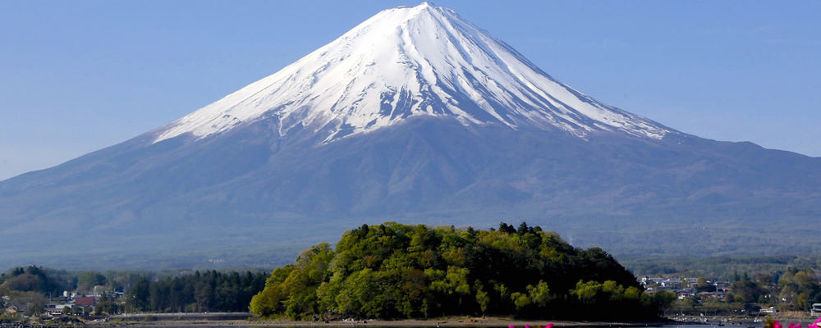
Mount Fuji, regarded as holy
in Buddhism and Shinto

Slide 11
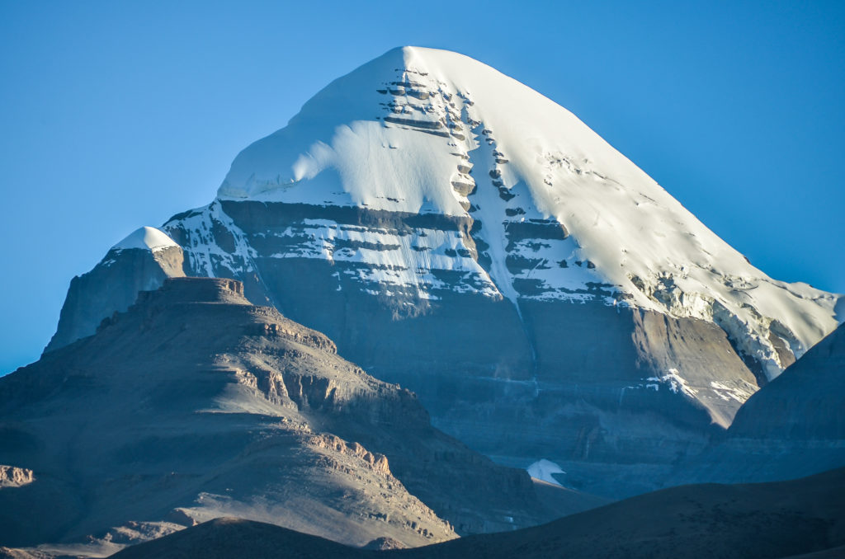
Mount Kailash, sacred in Hinduism, Buddhism, Jainism and Bon

Slide 12
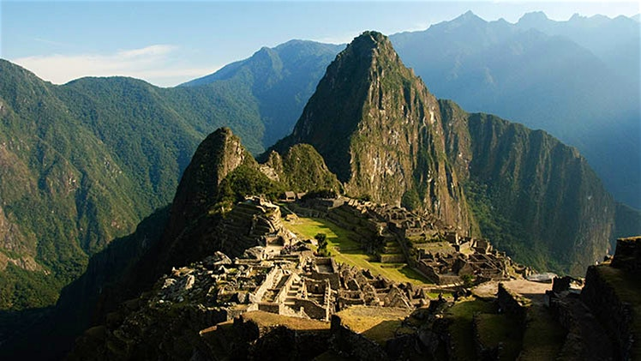
Machu Picchu, sacred to the Incas

