Slide 1


Slide 2


Slide 3



Slide 4
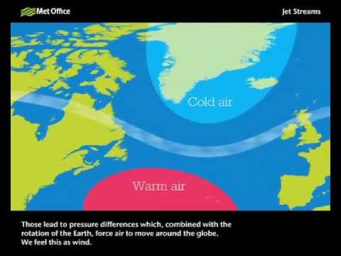

Slide 5
April showers bring forth May flowers

Slide 6
“And after you have suffered a little while, the God of all grace… will himself restore, confirm, strengthen, and establish you”.
(1 Peter 5:10).

