Slide 1
What do you see?

Slide 2
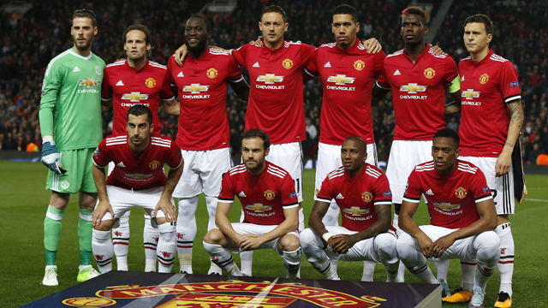

Slide 3
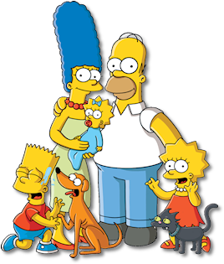

Slide 4


Slide 5


Slide 6


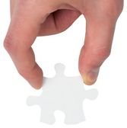

Slide 7


Slide 8
