Slide 1
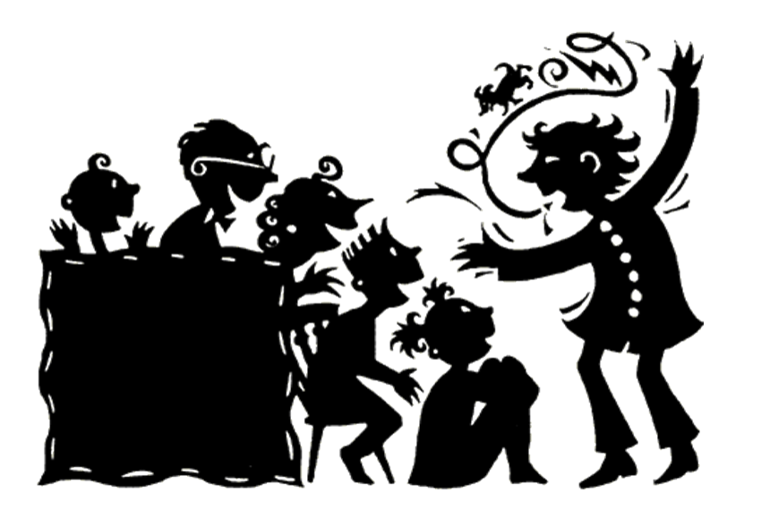


Slide 2


Slide 3


Slide 4


Slide 5


Slide 6


Slide 7


Slide 8


Slide 9


Slide 10


Slide 11

Sharing stories……
Stories have the power to motivate, persuade, inform and inspire.
Listening to stories changes our brain chemistry. It helps to build empathy and develops our ability to concentrate.
When we hear a story, the parts of our brain that we would use to experience the actual events of that story are activated.
Stories connect us with others: Stories are universal and they go across ages and cultures.

Slide 12
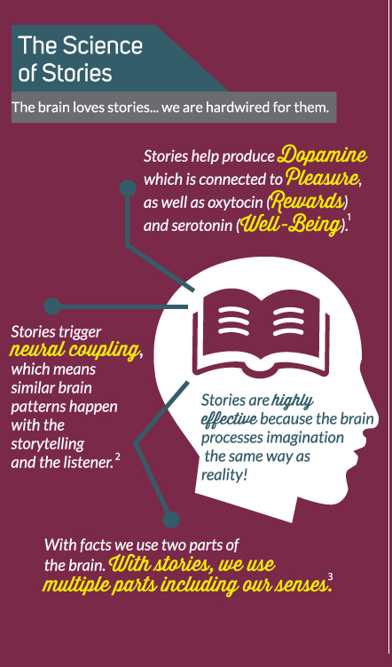

Slide 13


