Slide 1

What to love about School

Slide 2
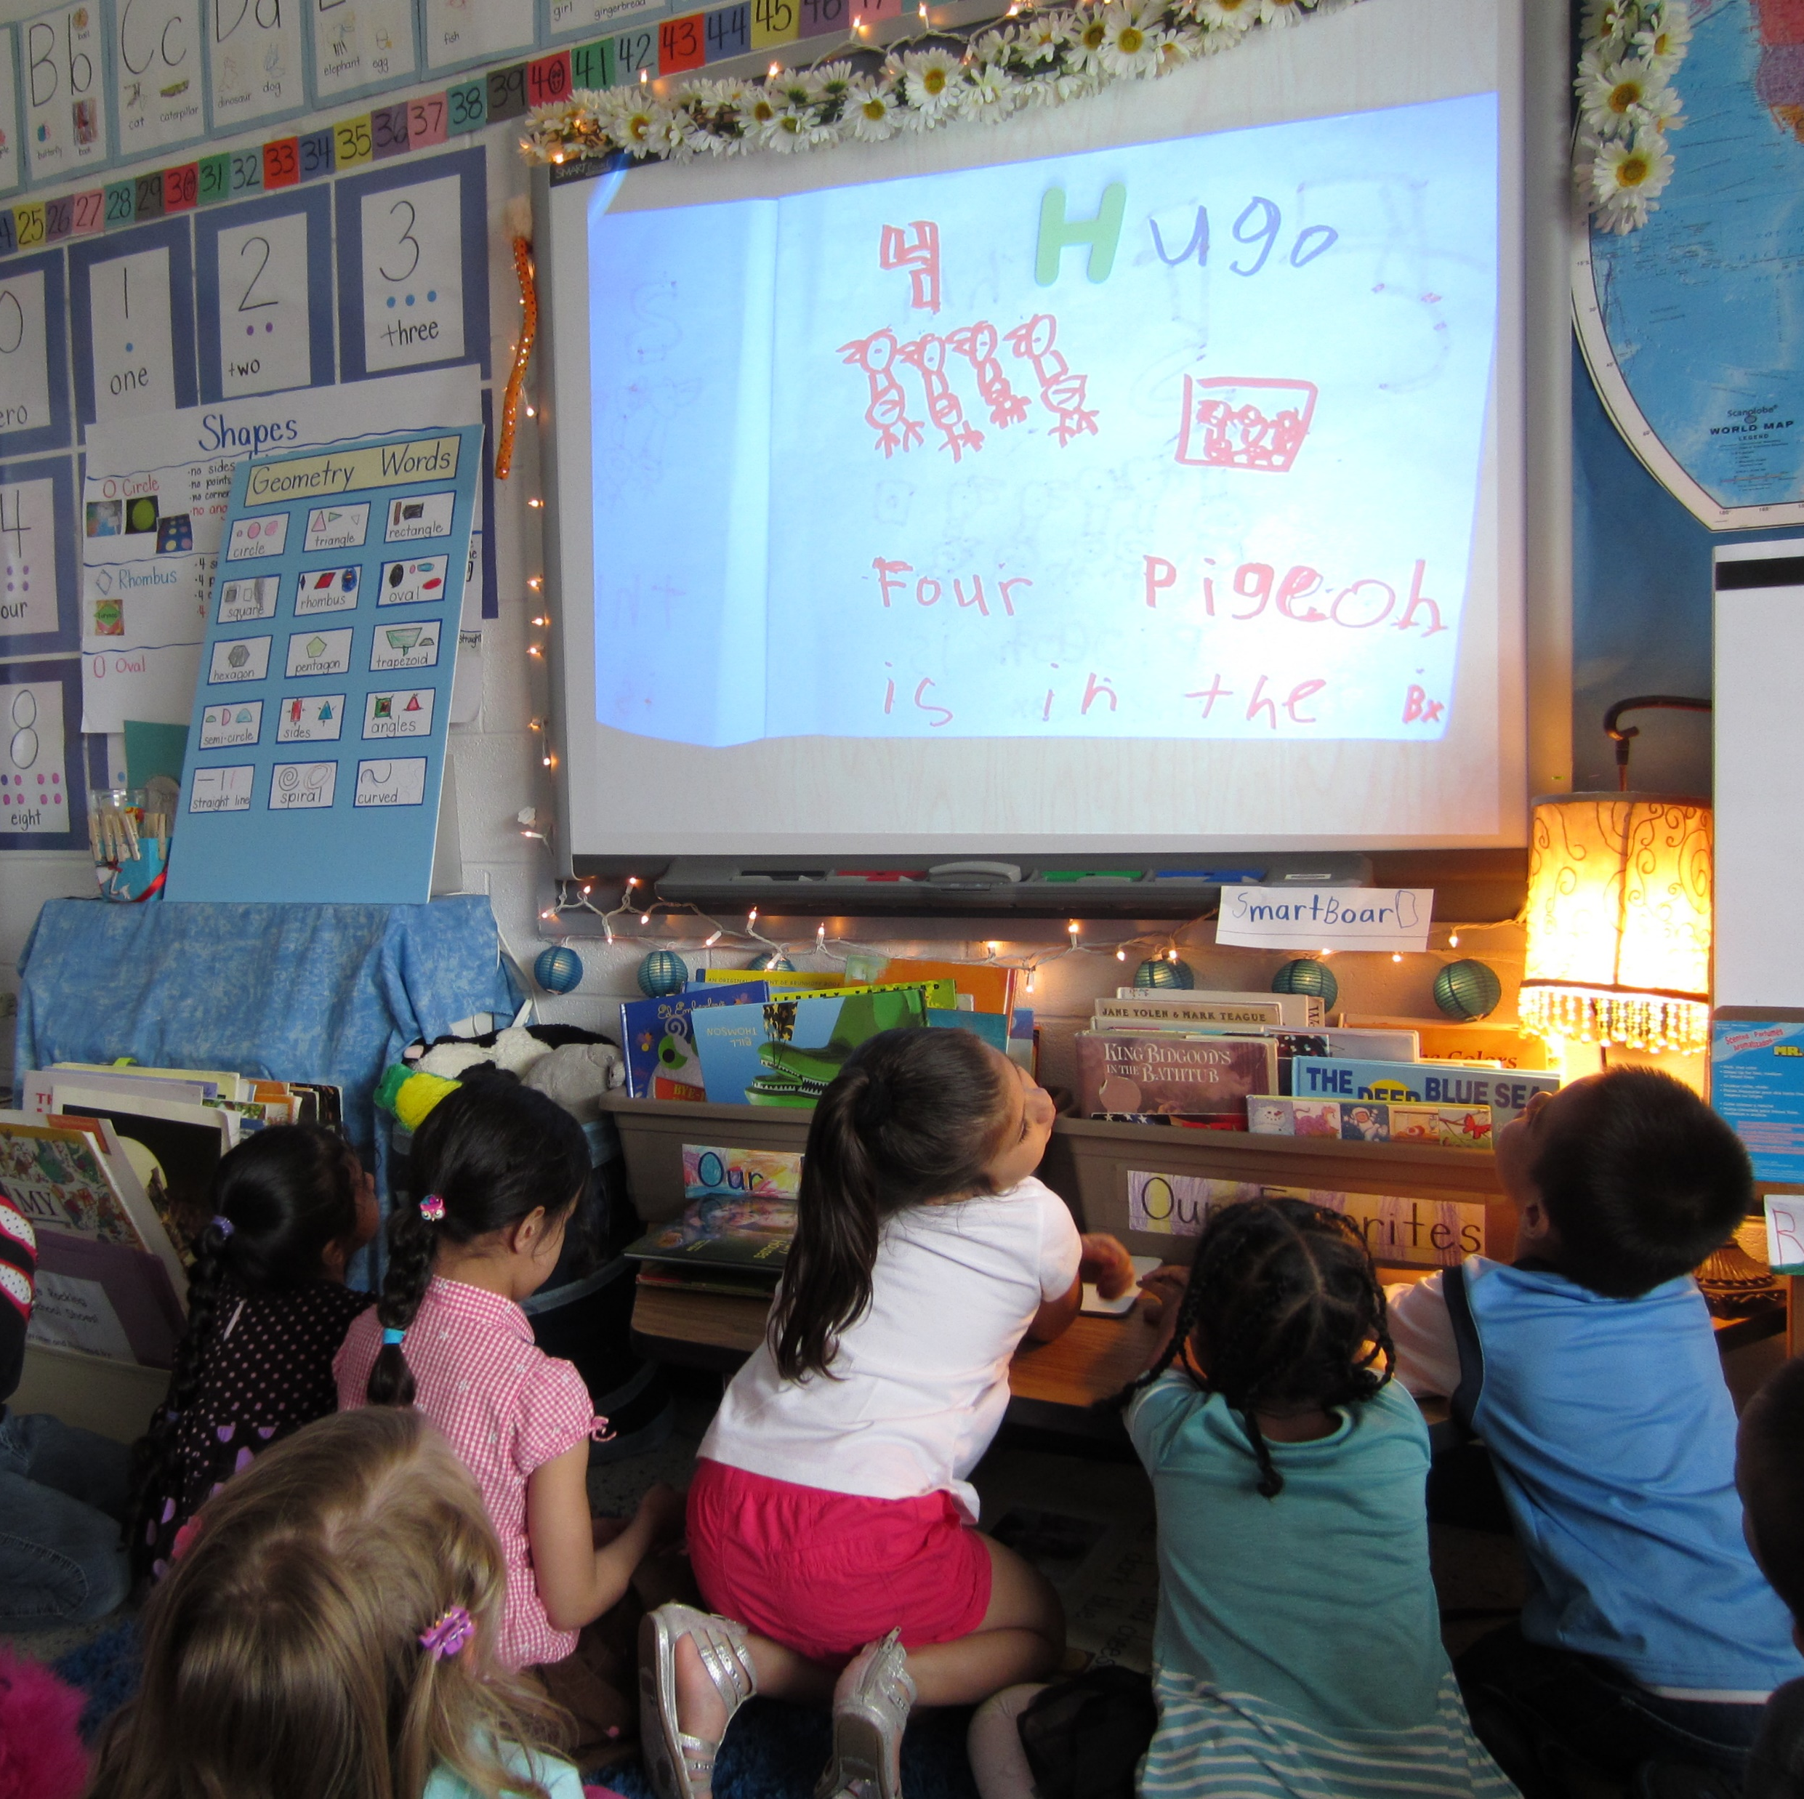
Writing on the whiteboard

Slide 3
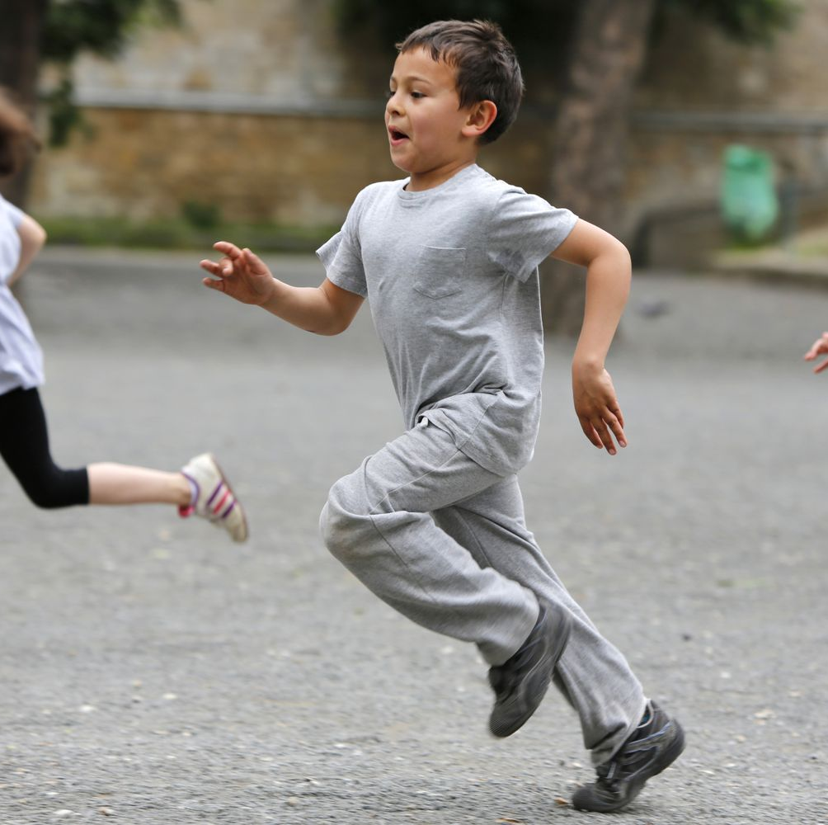
Playground games

Slide 4

Learning new things

Slide 5
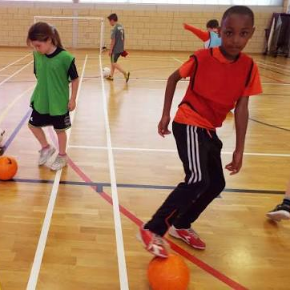
P.E

Slide 6
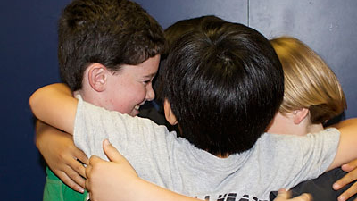
Making friends

Slide 7

Learning to read

Slide 8

Being creative

Slide 9
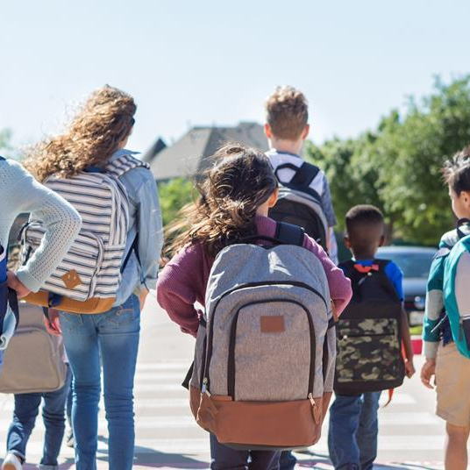
School trips

Slide 10
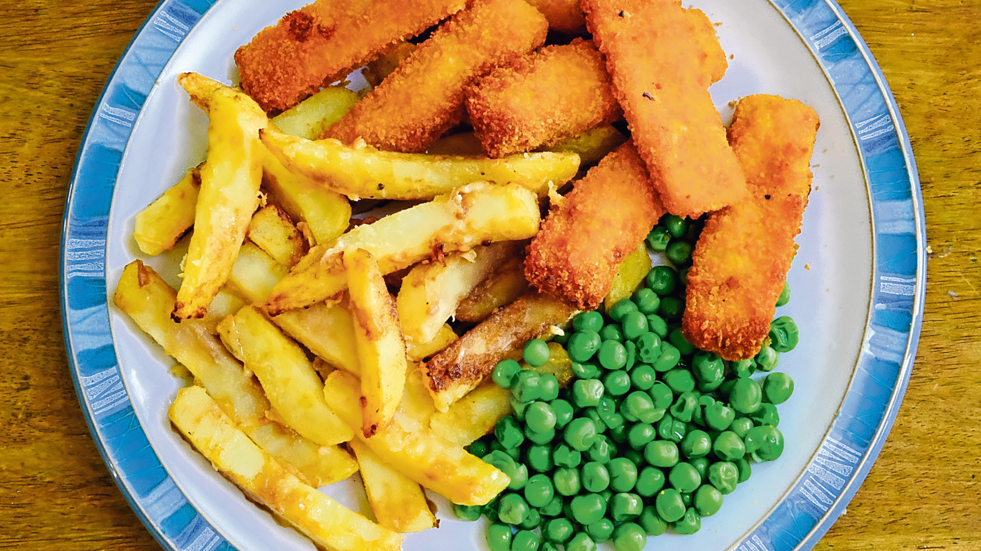
Chips on Friday!

