Slide 1
Welcome….

Slide 2


Slide 3
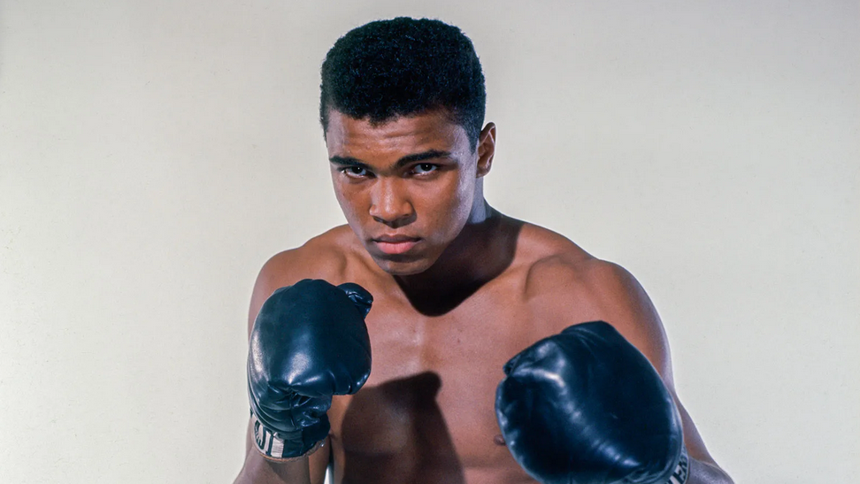

Slide 4


Slide 5


Slide 10
Jesus Calls Levi and Eats With Sinners
¹³ Once again Jesus went out beside the lake. A large crowd came to him, and he began to teach them. ¹⁴ As he walked along, he saw Levi son of Alphaeus sitting at the tax collector’s booth. “Follow me,” Jesus told him, and Levi got up and followed him.
¹⁵ While Jesus was having dinner at Levi’s house, many tax collectors and sinners were eating with him and his disciples, for there were many who followed him. ¹⁶ When the teachers of the law who were Pharisees saw him eating with the sinners and tax collectors, they asked his disciples: “Why does he eat with tax collectors and sinners?”
¹⁷ On hearing this, Jesus said to them, “It is not the healthy who need a doctor, but the sick. I have not come to call the righteous, but sinners.”
Mark 2:13-17

Slide 11
