Slide 1


Slide 2
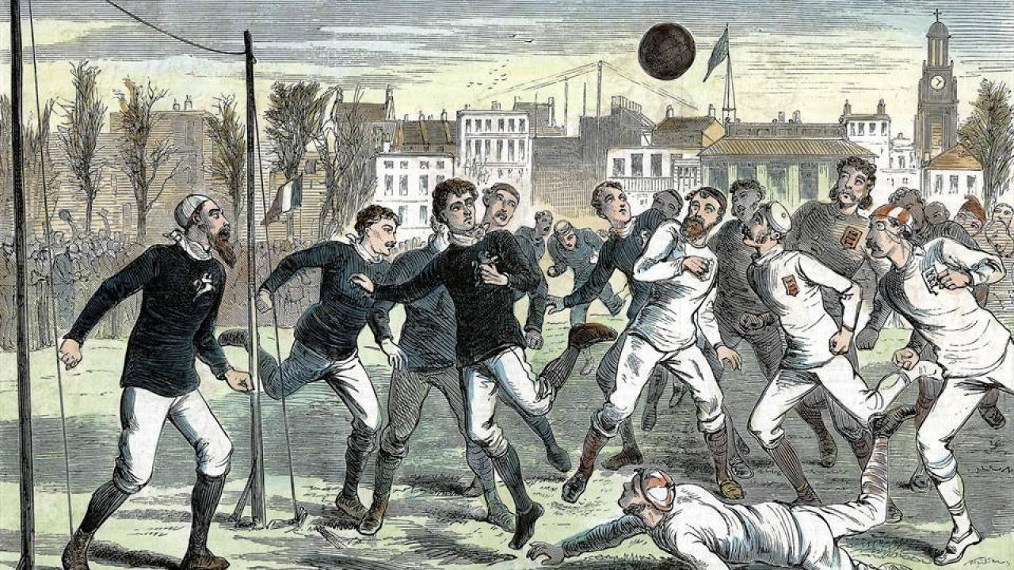

Slide 3
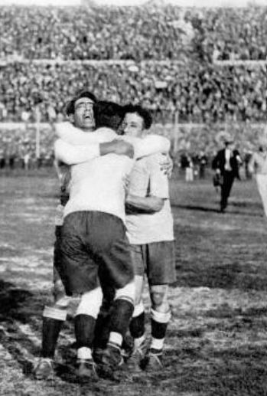


Slide 4
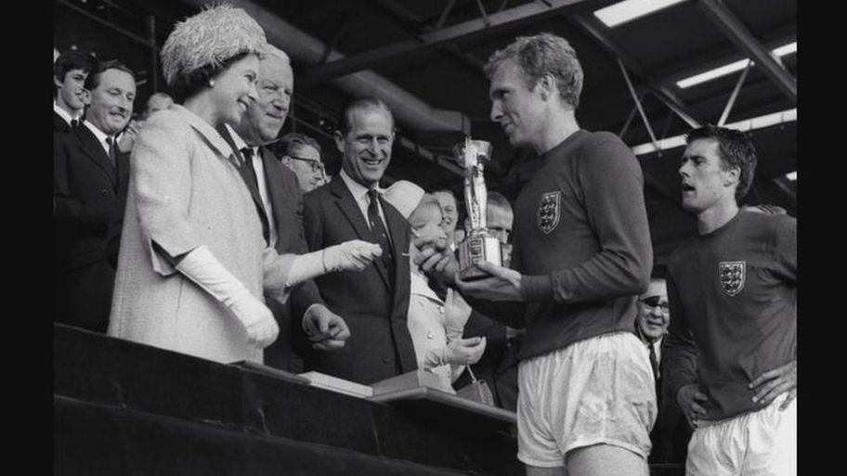

Slide 5

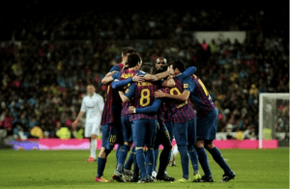
Two are better than one.
A cord of three strands is not quickly broken
Ecclesiastes 4:9 & 12

Slide 6
For just as the body is one and has many members, and all the members of the body, though many, are one body, so it is with Christ… there are many parts, yet one body… Now you are the body of Christ and individually members of it.
1 Corinthians 12: 12, 20, 27

