Slide 1
Welcome….

Slide 2
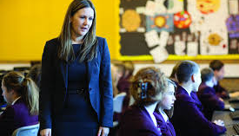
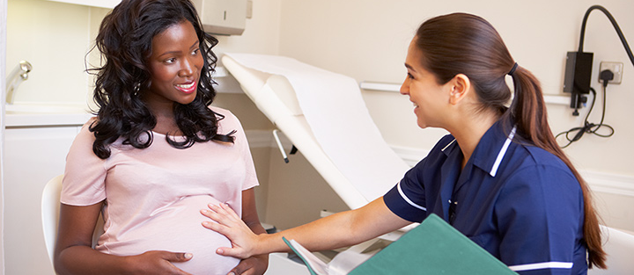

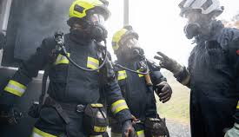

Slide 3


Slide 4
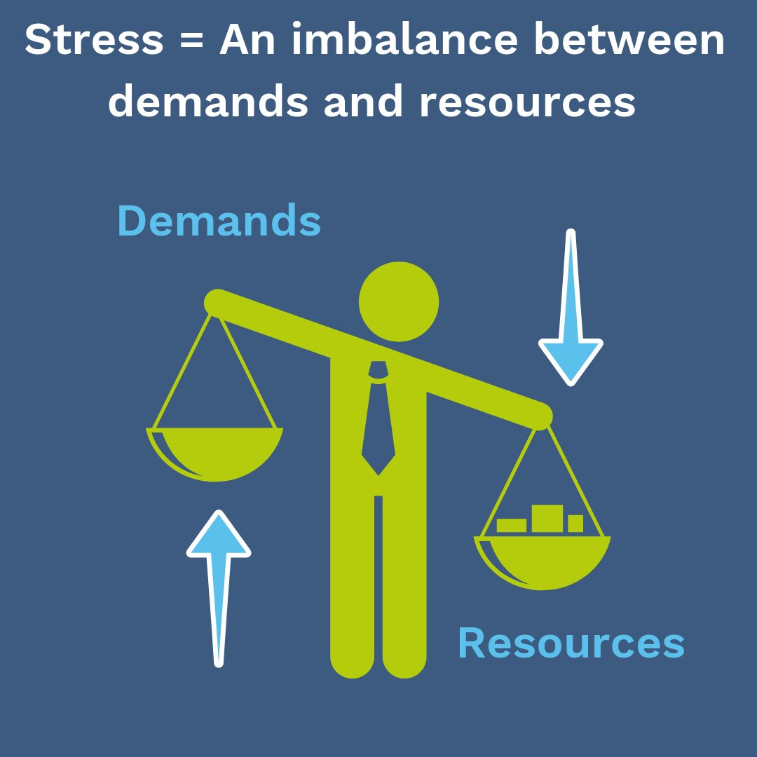

Slide 5
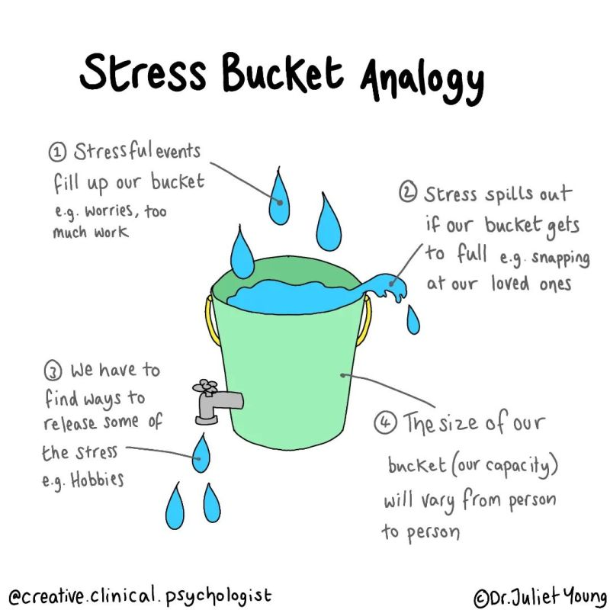

Slide 6
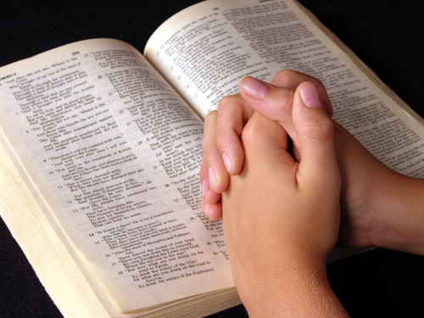
’Do not fear: I am with you; do not be anxious: I am your God. I will strengthen you, I will help you, I will uphold you with my victorious right hand.’
Isaiah 41:10

