Slide 1


24 DAYS OF CHRISTMAS
ADVENT CALENDAR CHALLENGE

Slide 2
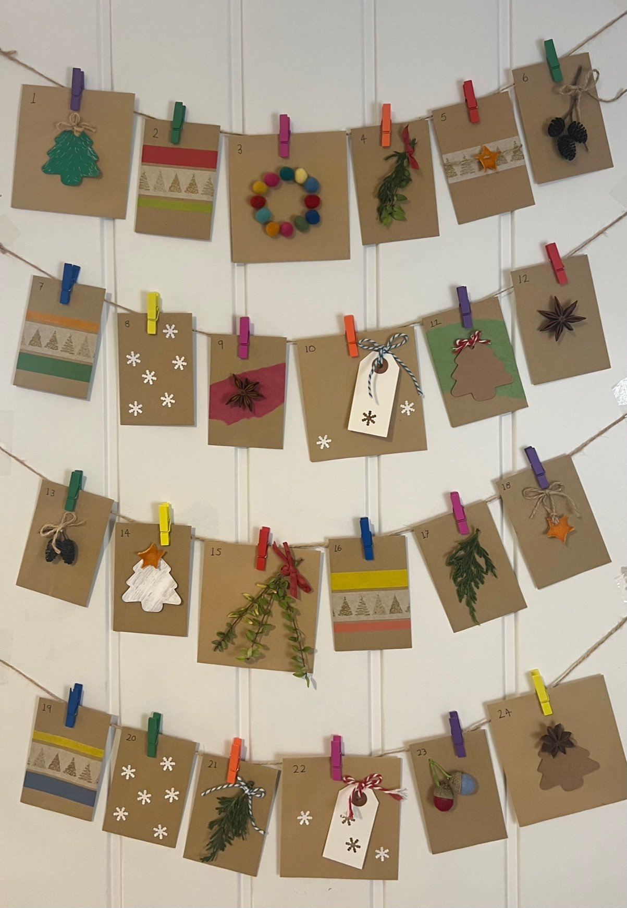
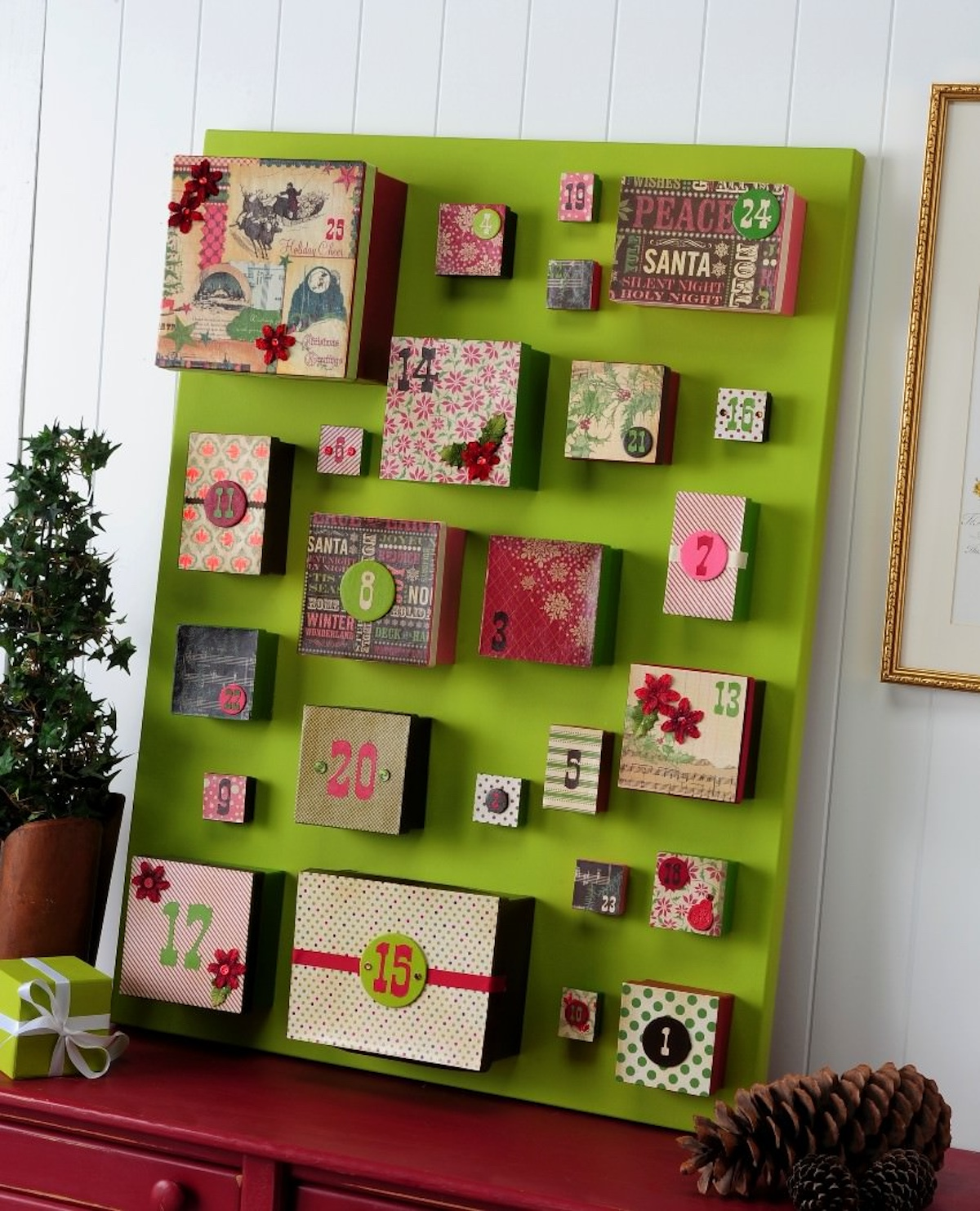
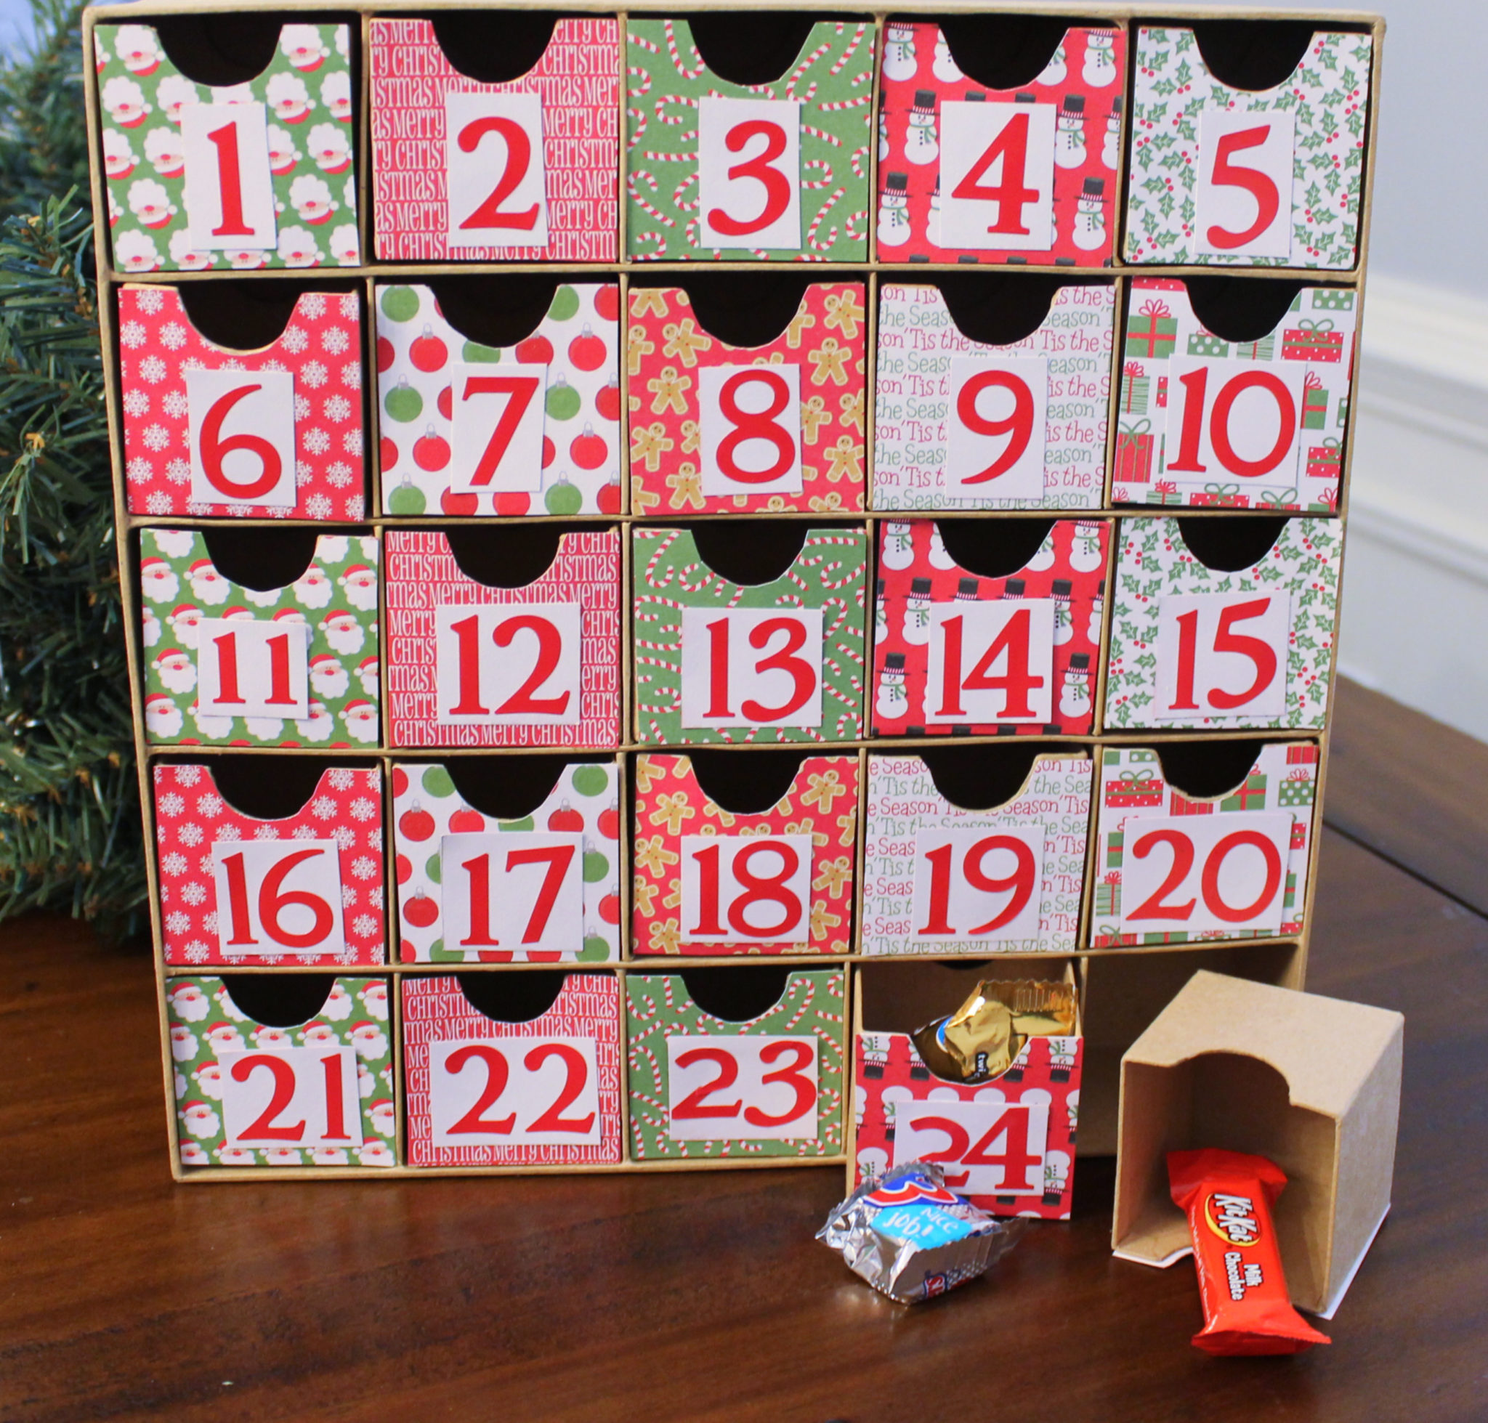

Slide 3

KINDNESS IDEAS
Donate food to a food bank.
Donate toys or gifts
Help at a charity shop
Raise money for charity
Help a neighbour
Help with chores
Compliment someone
Invite someone new to hang out with you
Say something kind to all of your family
Bake treats for others
Organise a community clean up

