Slide 1
Welcome

Slide 2
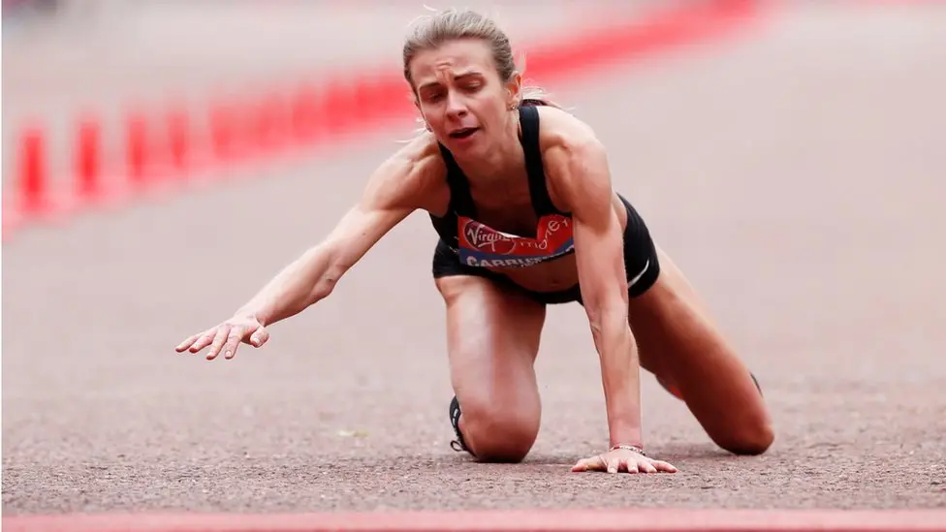

Slide 3
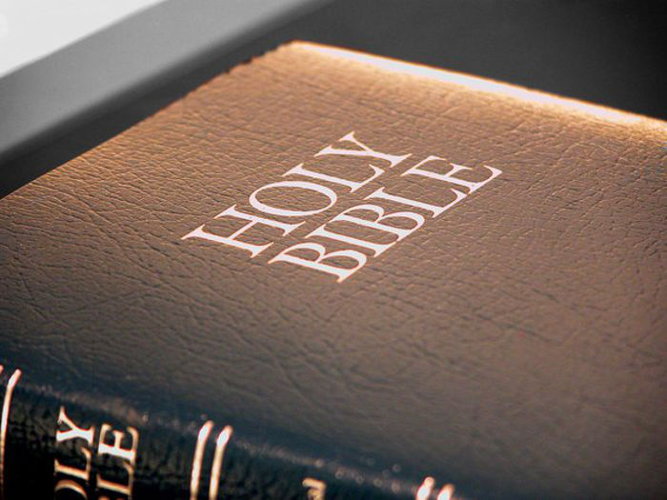
‘Therefore, since we are surrounded by so great a cloud of witnesses, let us rid ourselves of every burden and sin that clings to us and persevere in running the race that lies before us.’ Hebrews 12:1
‘Do you not know that the runners in the stadium all run in the race, but only one wins the prize?
Run so as to win. Every athlete exercises discipline in every way. They do it to win a perishable crown, but we an imperishable one.’ 1 Corinthians 9:24-25

