Slide 1
Welcome

Slide 2
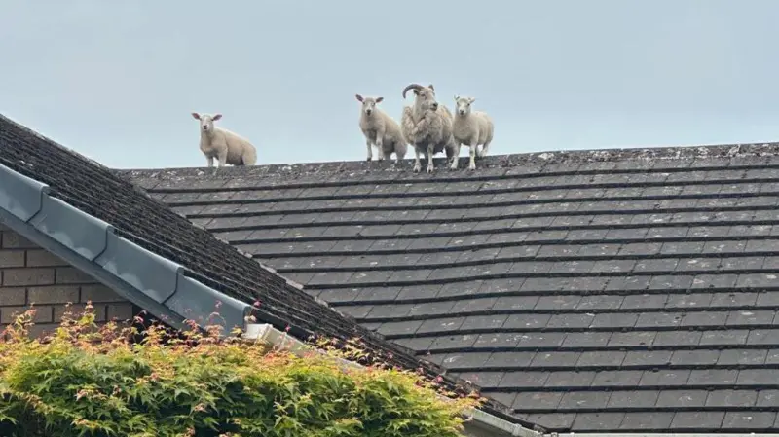

Slide 3
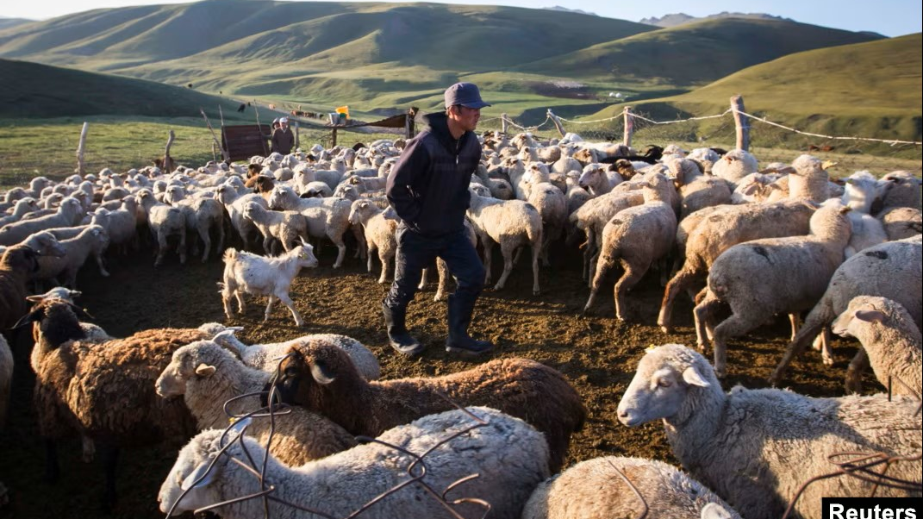

Slide 4
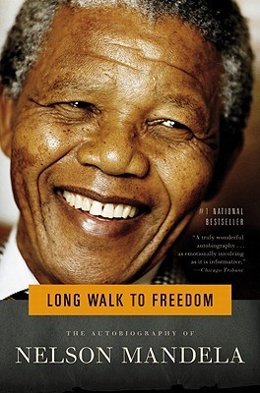
‘A leader. . .is like a shepherd… stays behind the flock, letting the most nimble go out ahead, whereupon the others follow, not realizing that all along they are being directed from behind.’
(Nelson Mandela, Long Walk to Freedom: Autobiography of Nelson Mandela).

Slide 5
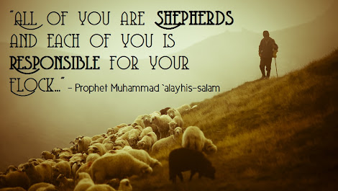

Slide 6
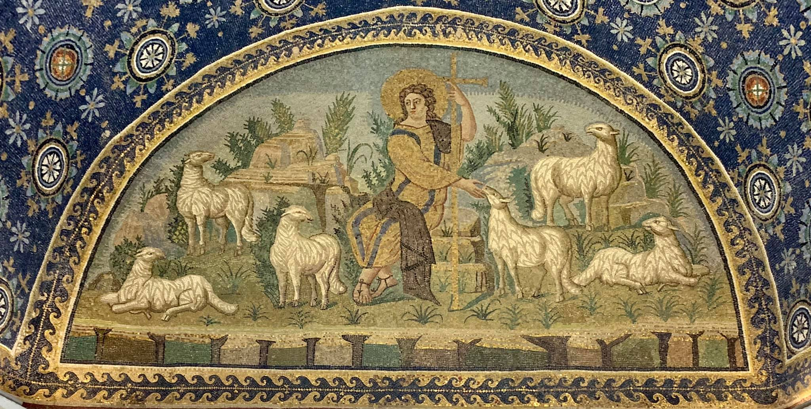

Slide 7
