Slide 1
Welcome

Slide 2
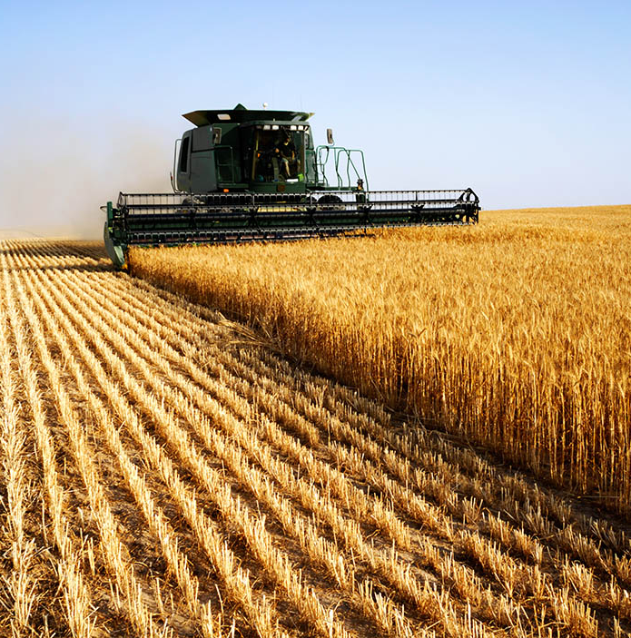
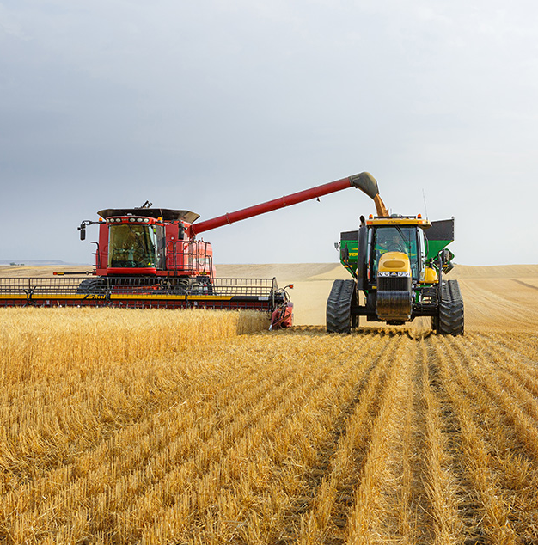

Slide 3
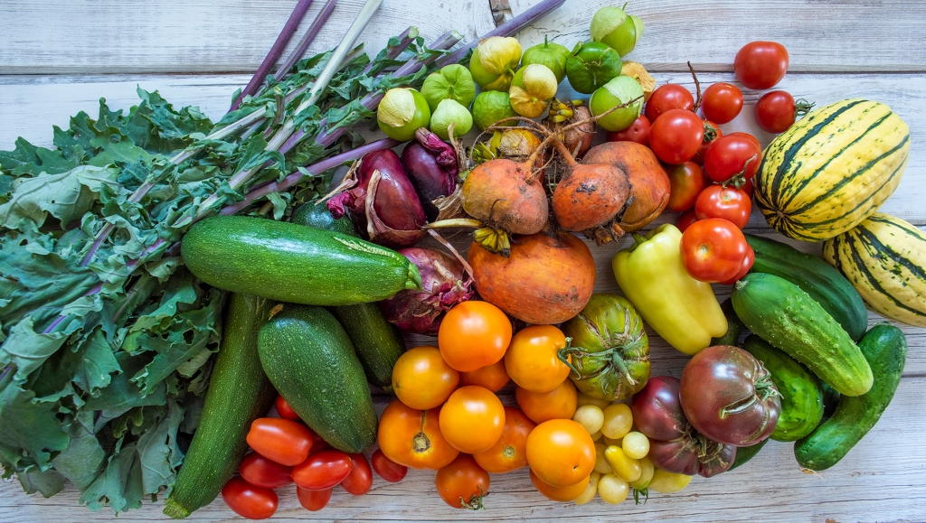

Slide 4

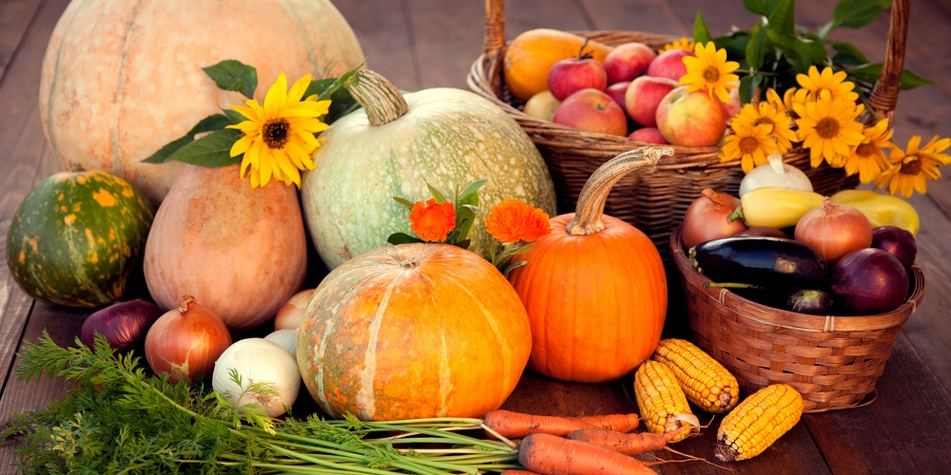

Slide 5
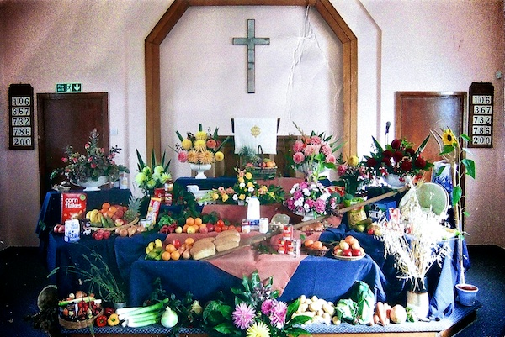

Slide 6
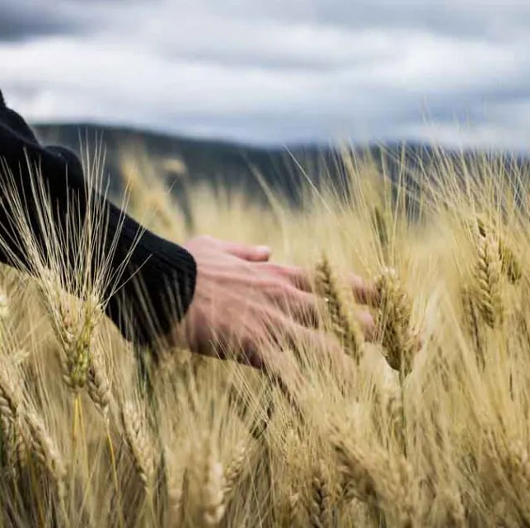
"When you reap the harvest of your land, do not reap to the very edges of your field or gather the gleanings of your harvest."
(Leviticus 23:22)

Slide 7
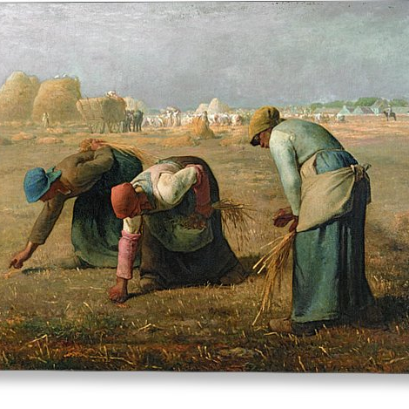
The Gleaners
by Jean-François Millet (1857).

Slide 8
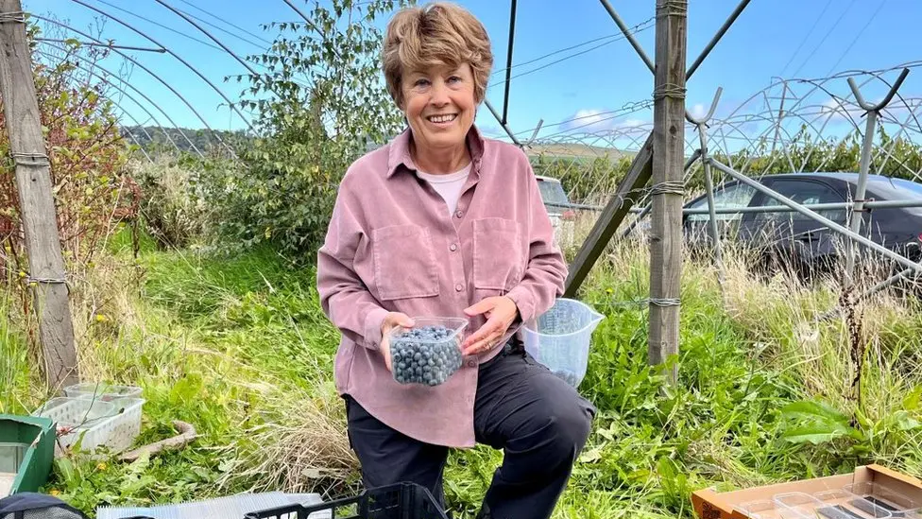

Slide 9
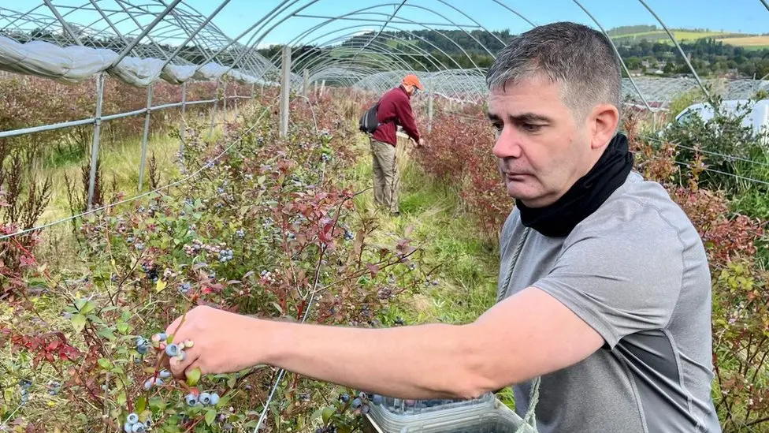

Slide 10
