Slide 1
Welcome

Slide 2
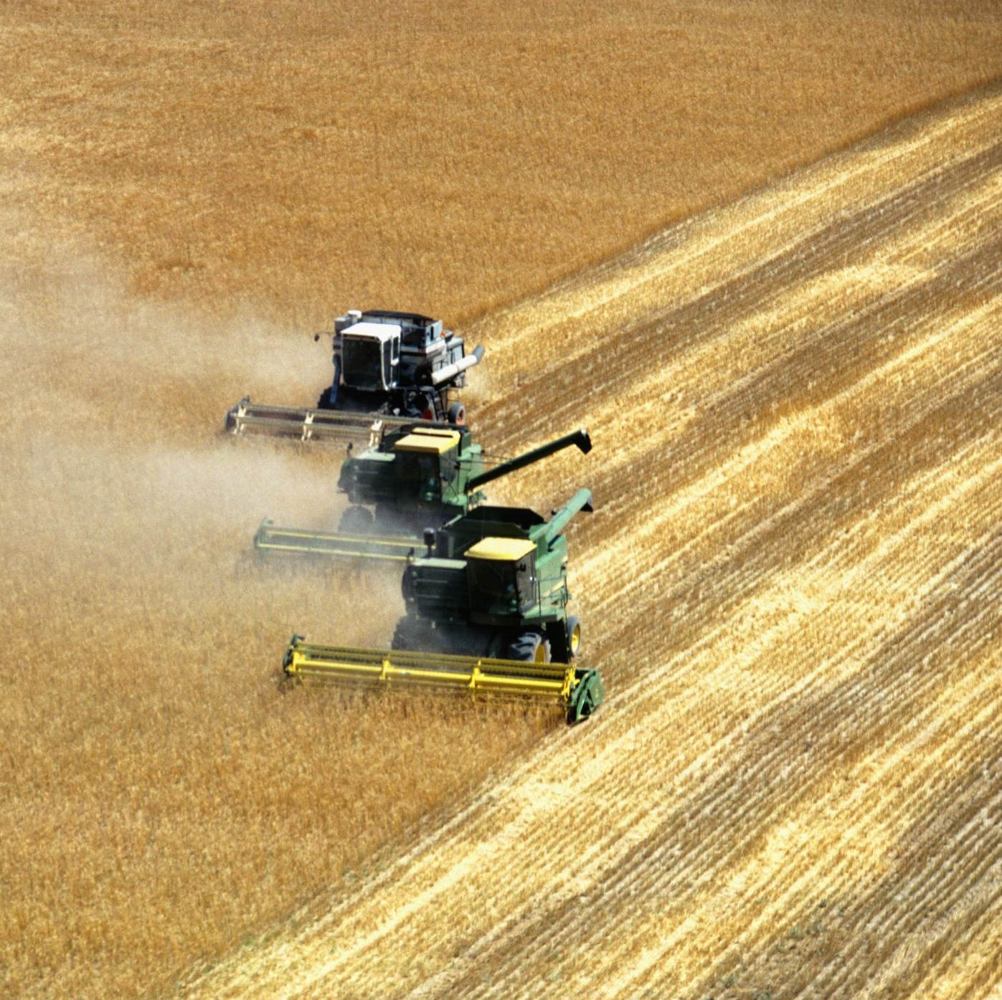
Harvest:
The season for gathering in agricultural crops.
The act or process of gathering in a crop.
The quantity of a natural product gathered in a single season.

Slide 3
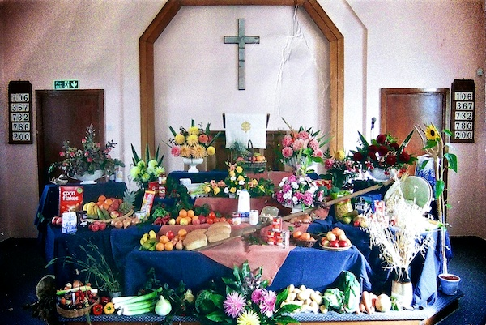

Slide 4
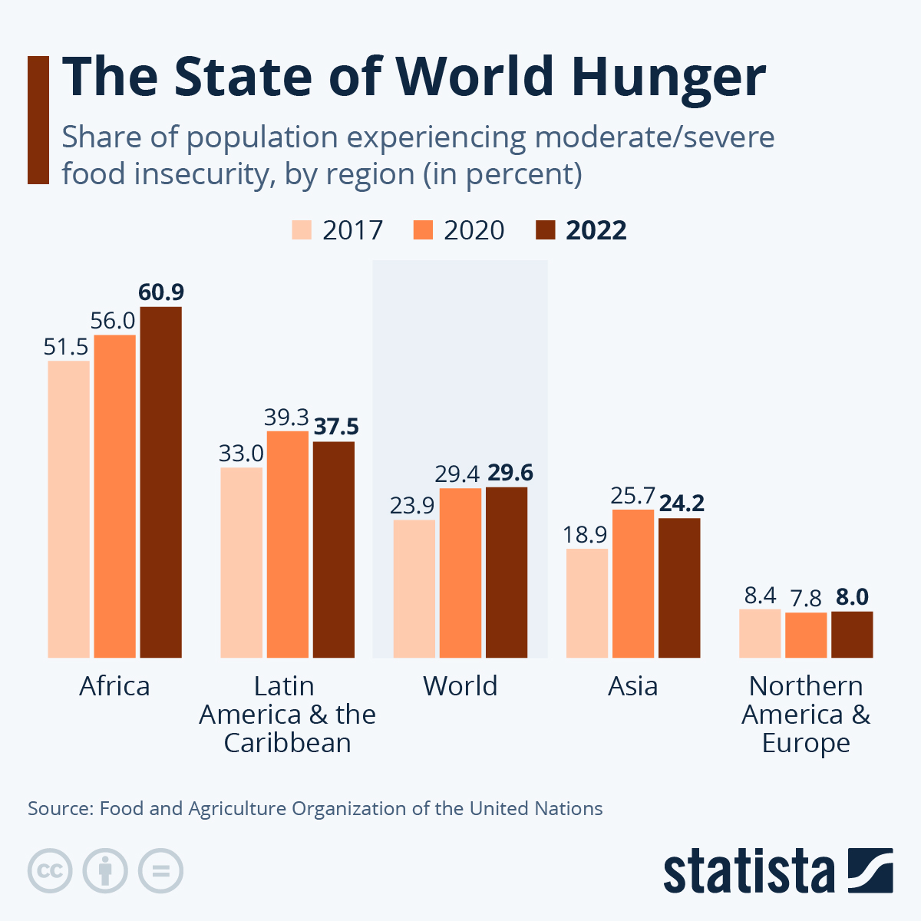

Slide 5
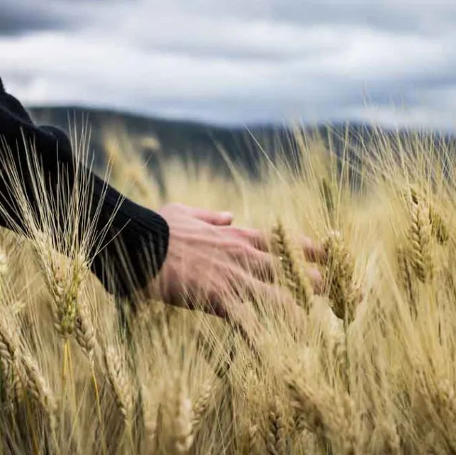
"When you reap the harvest of your land, do not reap to the very edges of your field or gather the gleanings of your harvest."
(Leviticus 23:22)

Slide 6
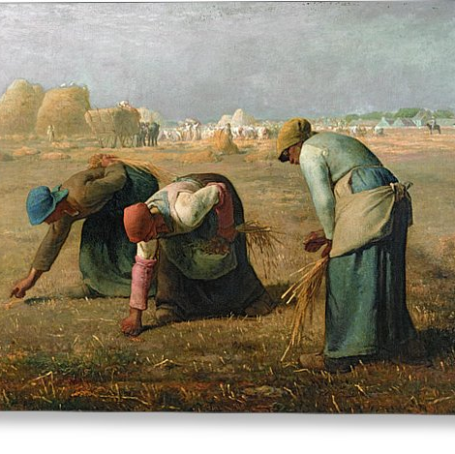
The Gleaners
by Jean-François Millet (1857).

Slide 7
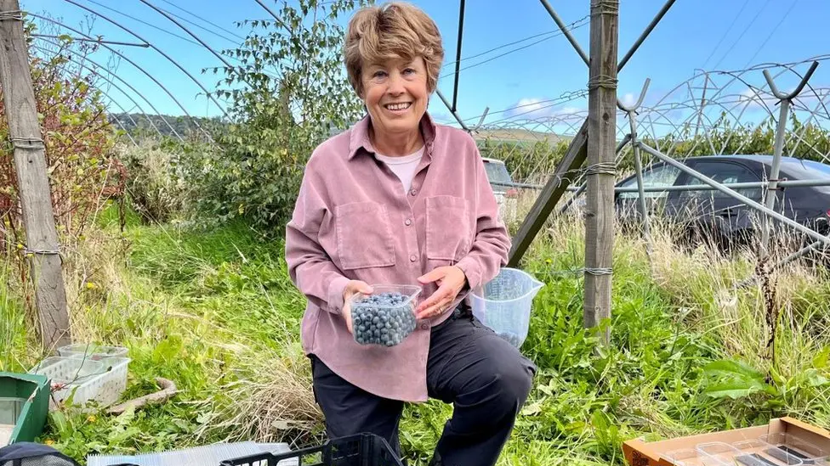

Slide 8
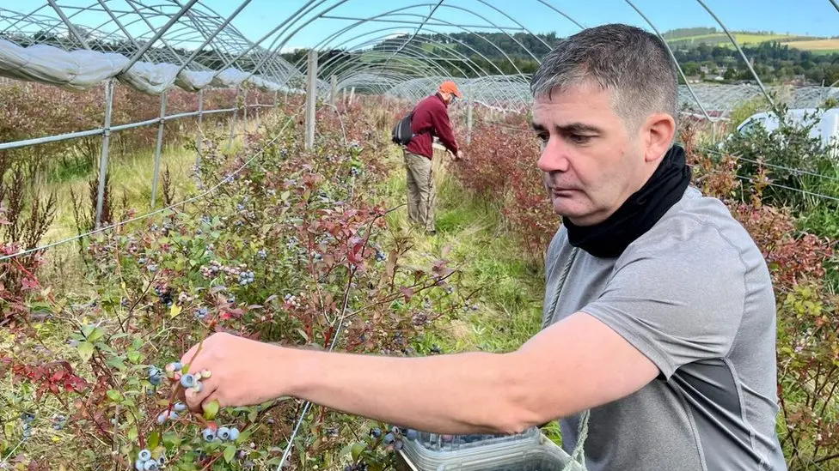

Slide 9
