Slide 1

The Honesty game
When should we tell the truth?

Slide 2
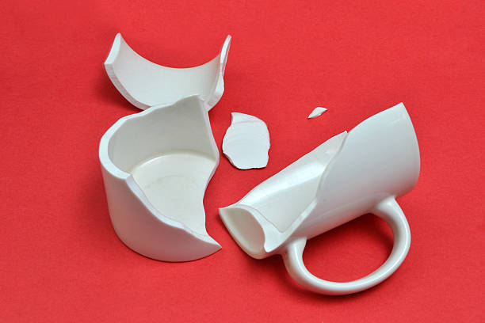
You accidentally break a mug, should you…
Tell the truth and tell someone you broke it
Lie and say someone else did it, so you don’t get into trouble

Slide 3

Someone asks you for an answer in a test…
Tell them the answer to the question
Tell them you can’t, as it wouldn’t be honest

Slide 4

Someone pushes you over, should you…
Tell the teacher
Not tell anyone

Slide 5

Someone tells you a secret, and asks you not to tell anyone, do you?
Tell your friends
Keep your promise

