Slide 1
Welcome

Slide 2
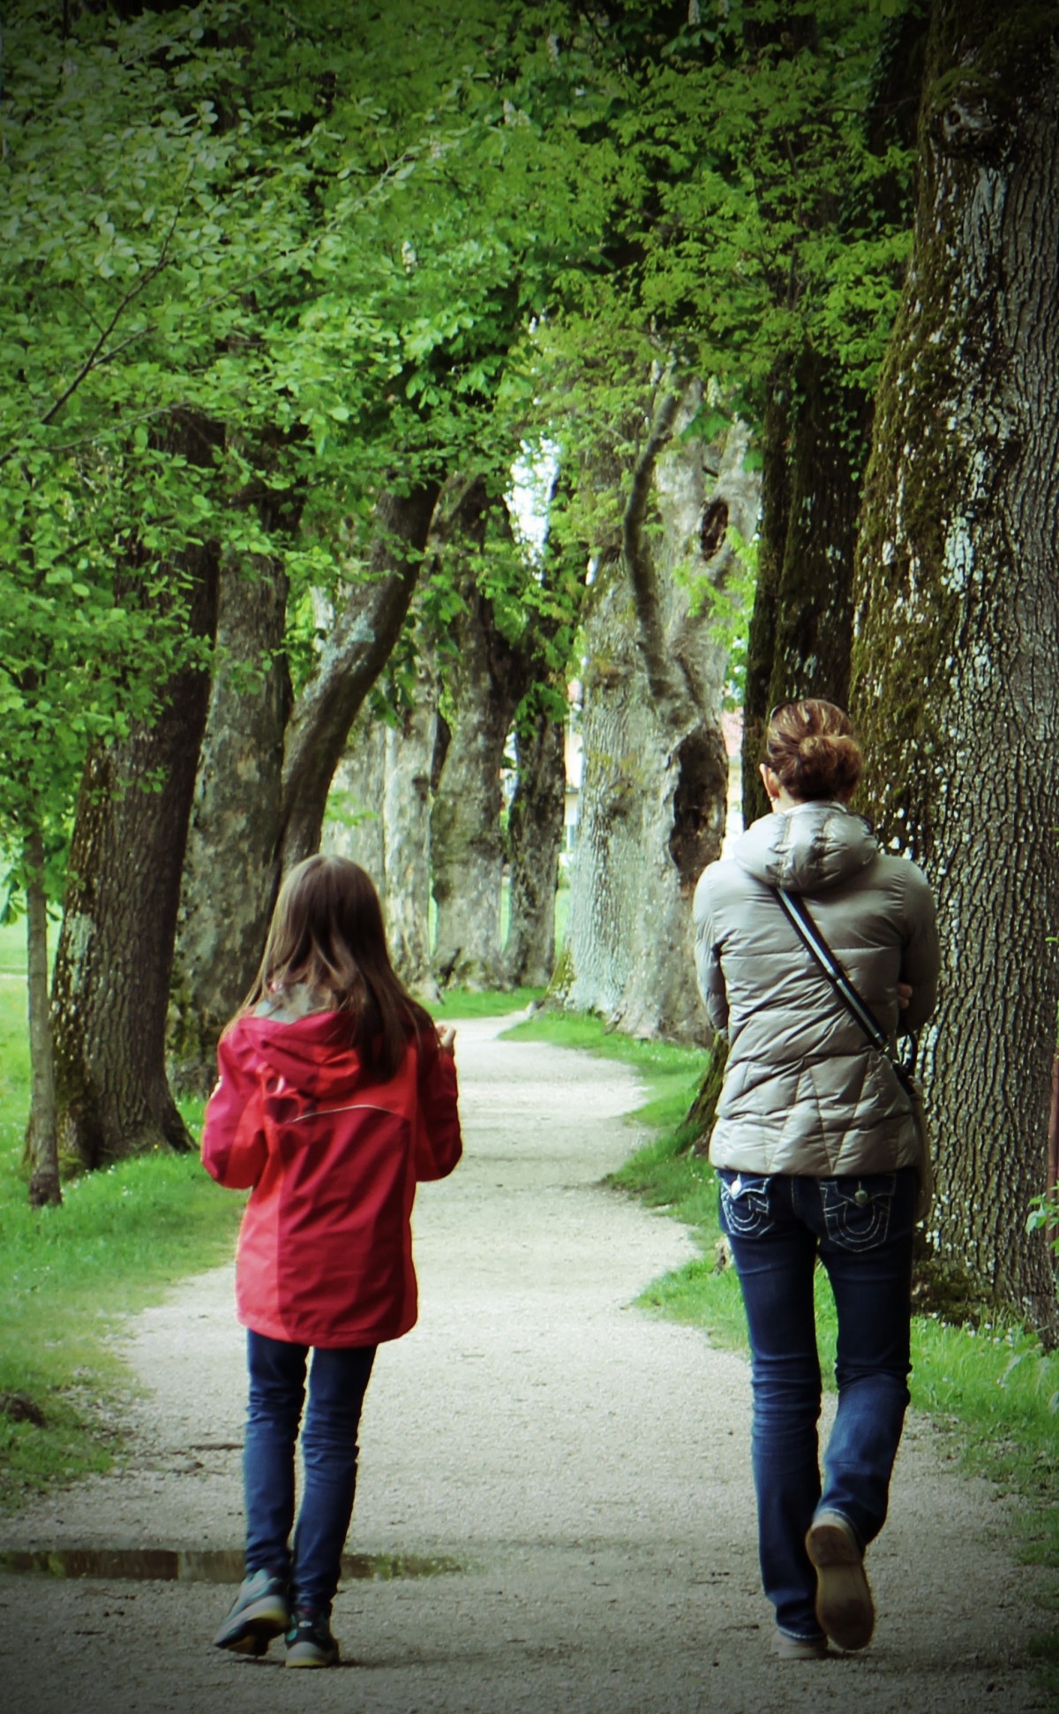
Go for a Saunter
Take a leisurely stroll
Disconnect from tech
Saunter with a friend
Practice mindfulness
Reflect and relax

Slide 3
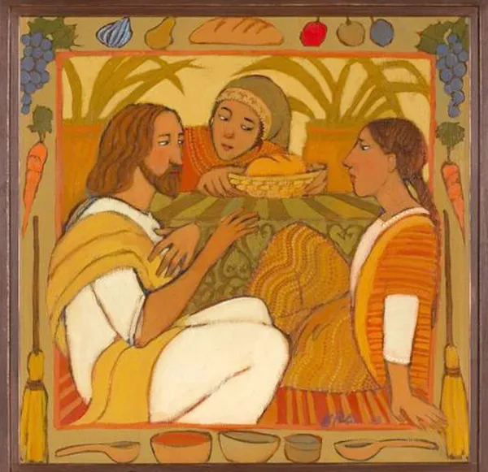
Martha or Mary?
Martha kept busy and focussed on hospitality – food and drink.
Mary took time to sit and listen, and chat, without any obvious purpose.
Jesus loved both Martha and Mary, as well as their brother, Lazarus.

Slide 4

‘Slow down. Take a deep breath. What’s the hurry? Why wear yourself out? Just what are you after anyway?’ Jeremiah 2:25
This Photo by Unknown Author is licensed under CC BY-SA

