Slide 1
Welcome….

Slide 2
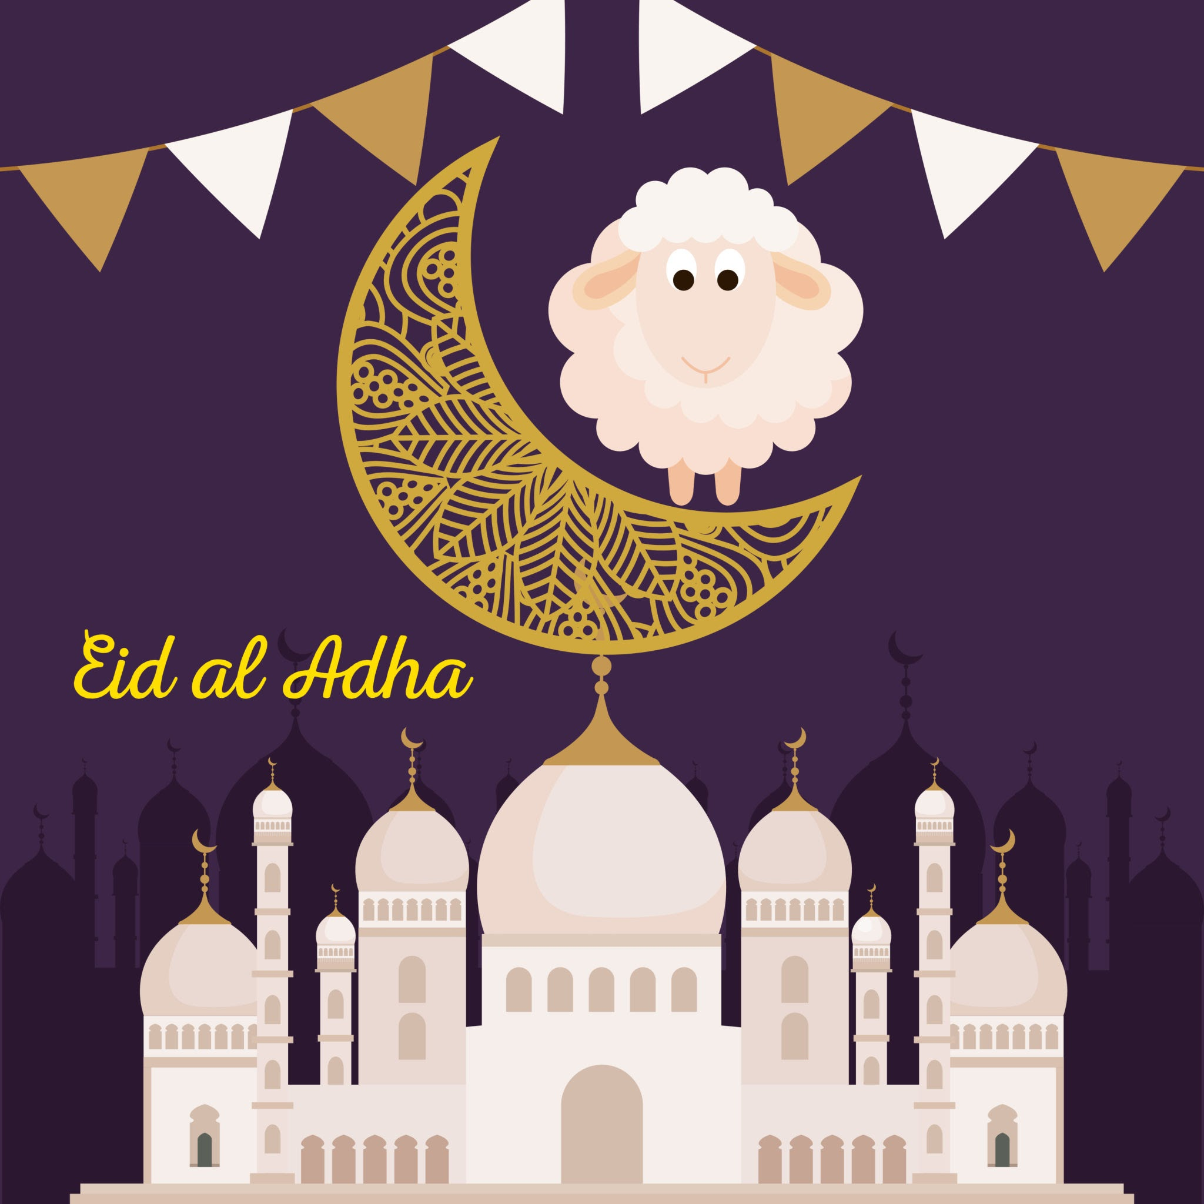
“Eid Mubarak” (عيد مبارك ) is the Arabic phrase used to say, “happy Eid”.
The phrase is used for both important festivals in Islam – Eid al-Fitr and Eid al-Adha.

Slide 3
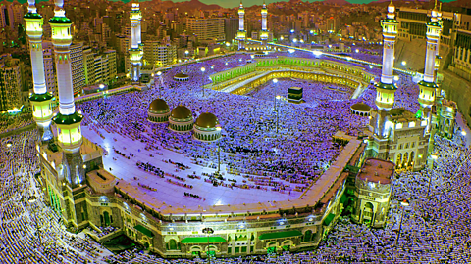

Slide 4
