Slide 1

Welcome

Slide 2
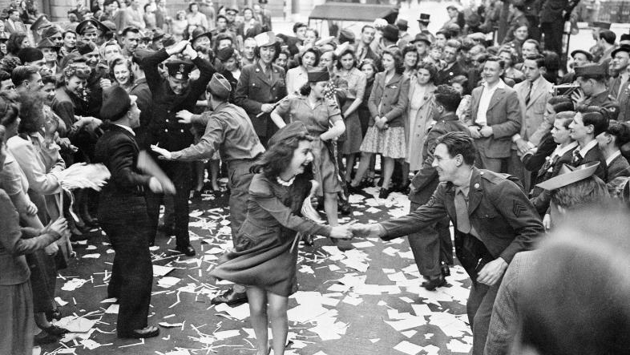

Slide 3
