Slide 1
Welcome

Slide 2

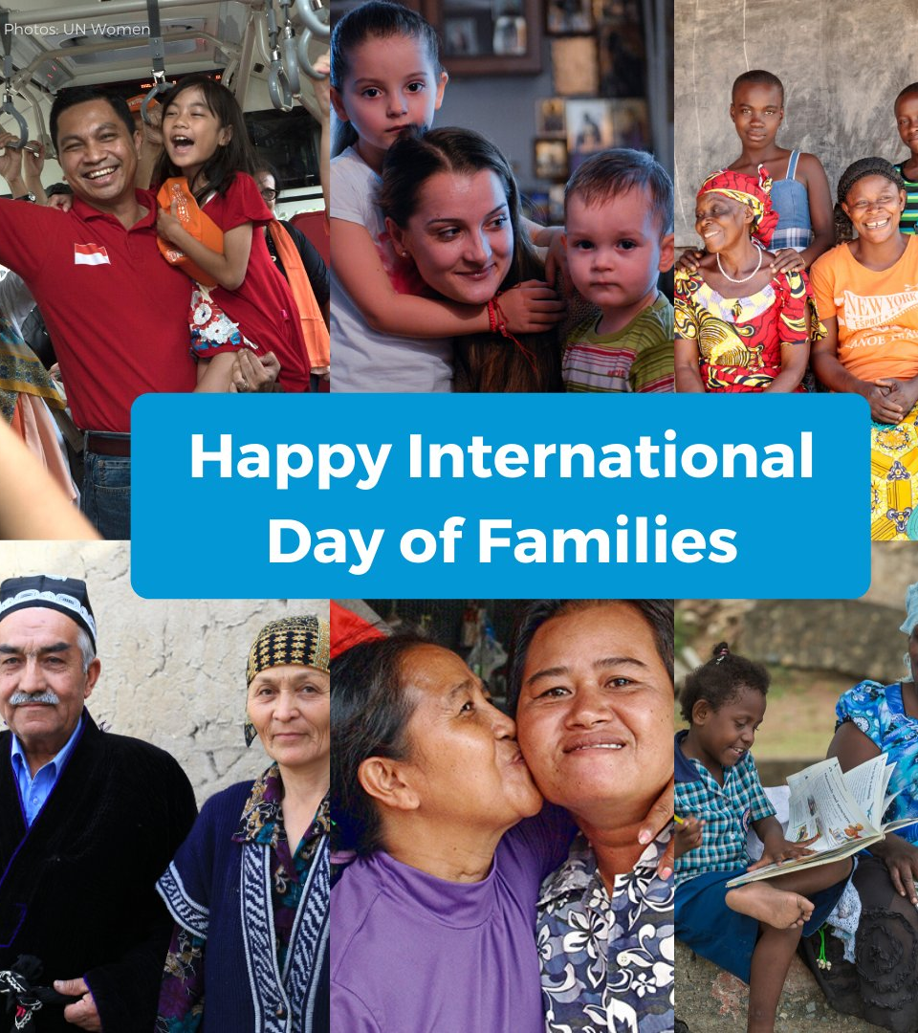

Slide 3

  Emotional support – Family members are often the first people we turn to in times of joy, sorrow, or stress.
  A sense of belonging – Family helps us feel connected and supported, regardless of challenges or differences.
  Guidance and mentorship – Families often shape our values, our views of the world, and our dreams for the future.
  Stability and security – The structure of family life offers a sense of comfort and consistency, even in difficult times.
  Cultural and personal identity – Families are where traditions are passed down, cultural heritage is honored, and we learn to be who we are.
Some of the things ‘Family’ provides…

Slide 4
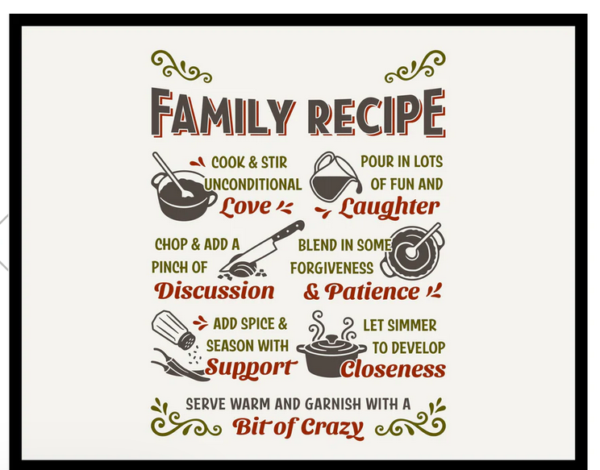

Slide 5

⁴ Love is patient, love is kind. It does not envy, it does not boast, it is not proud. ⁵ It does not dishonour others, it is not self-seeking, it is not easily angered, it keeps no record of wrongs. ⁶ Love does not delight in evil but rejoices with the truth. ⁷ It always protects, always trusts, always hopes, always perseveres.
(1 Corinthians 13: 4-7).

