Slide 1
Welcome

Slide 2
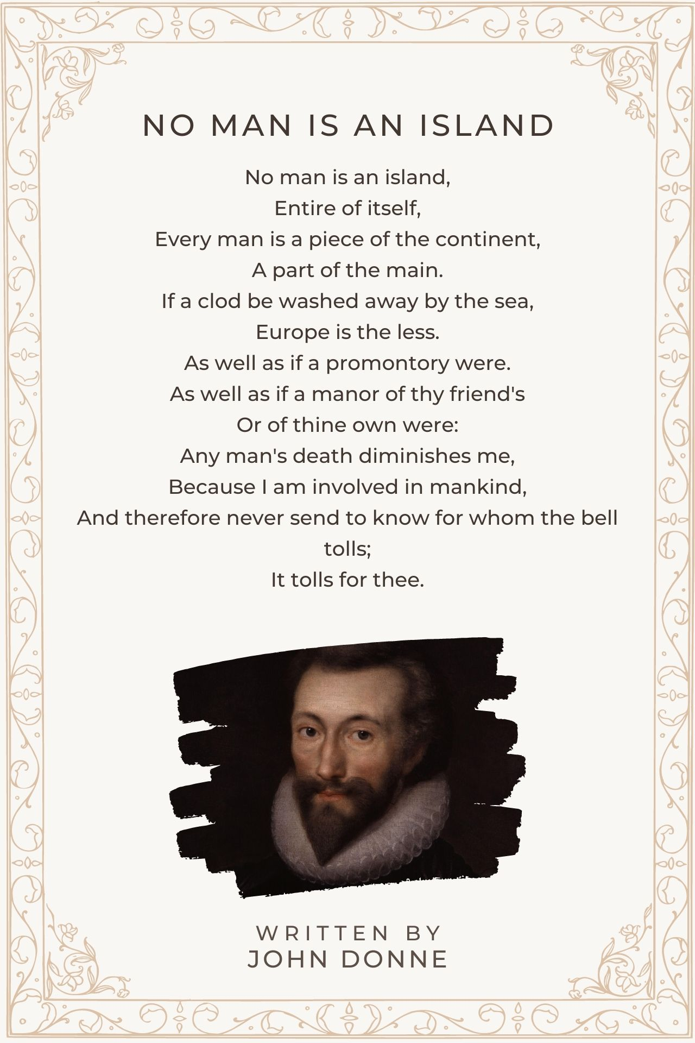
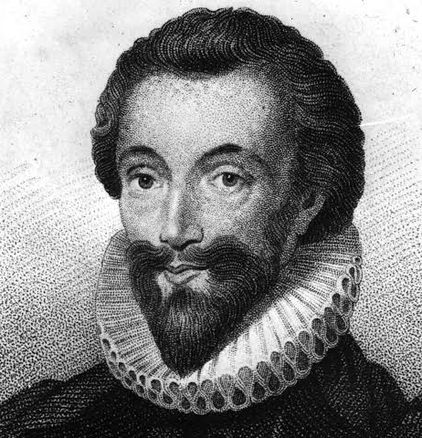

Slide 3
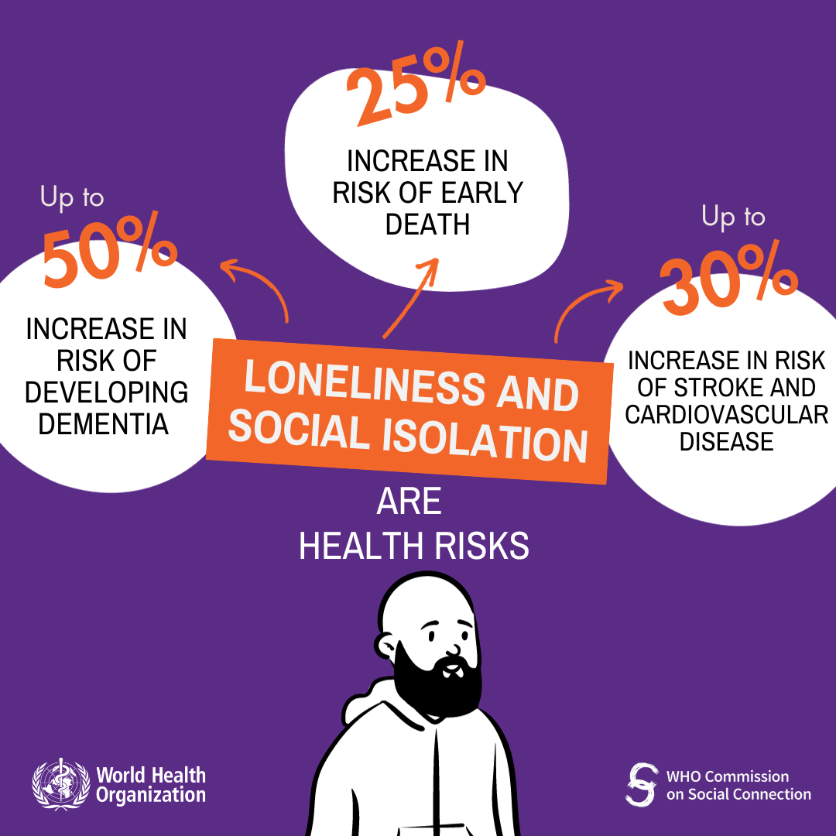

Slide 4
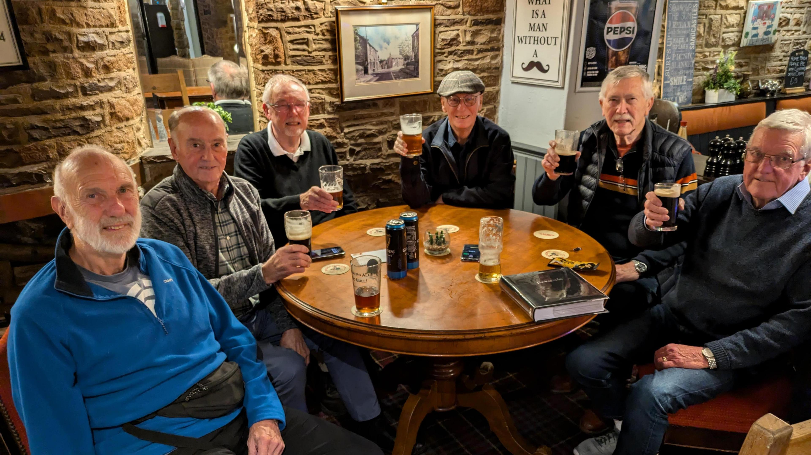

Slide 5

‘Faithful friends are a sturdy shelter; whoever finds one has found a treasure. Faithful friends are beyond price; no amount can balance their worth. Faithful friends are life-saving medicine’. Ecclesiastes 6:14-16a

Slide 6

‘Two people are better off than one, for they can help each other succeed. If one person falls, the other can reach out and help. But someone who falls alone is in real trouble’.
Ecclesiastes 4:9-10.

Slide 7
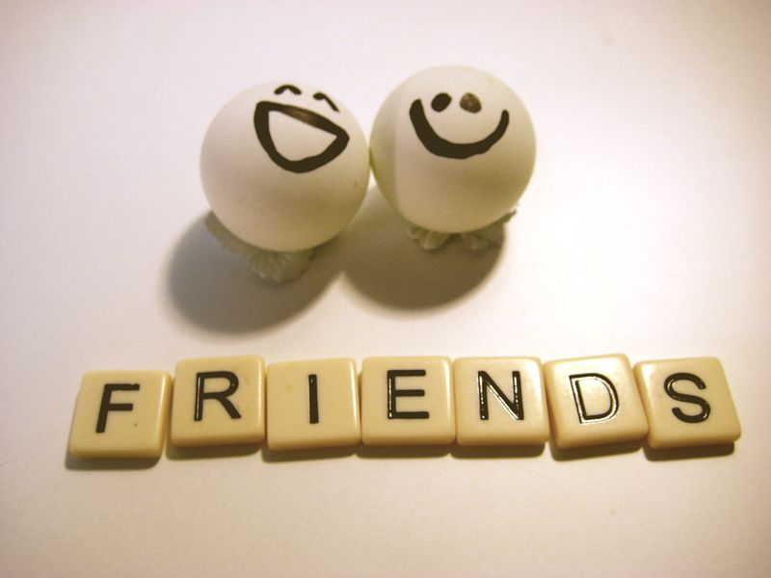
To foster faithful friendship, we could…
Spend time with a friend without looking at our phone for 30 mins.
Communicate openly and share our thoughts, feelings, and experiences.
Be a good listener and show interest in what others think, feel and want.
Be kind - kindness helps create trust and meaningful social connections.
Say yes to group activities such as group sports or extra-curricular clubs.
Chat to someone we’ve never spoken to before – they may be a friend waiting to be made.

