Slide 1
Welcome

Slide 2
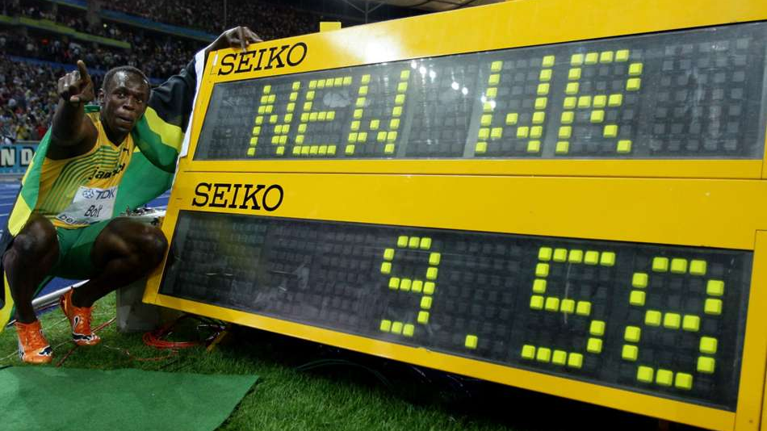

Slide 3
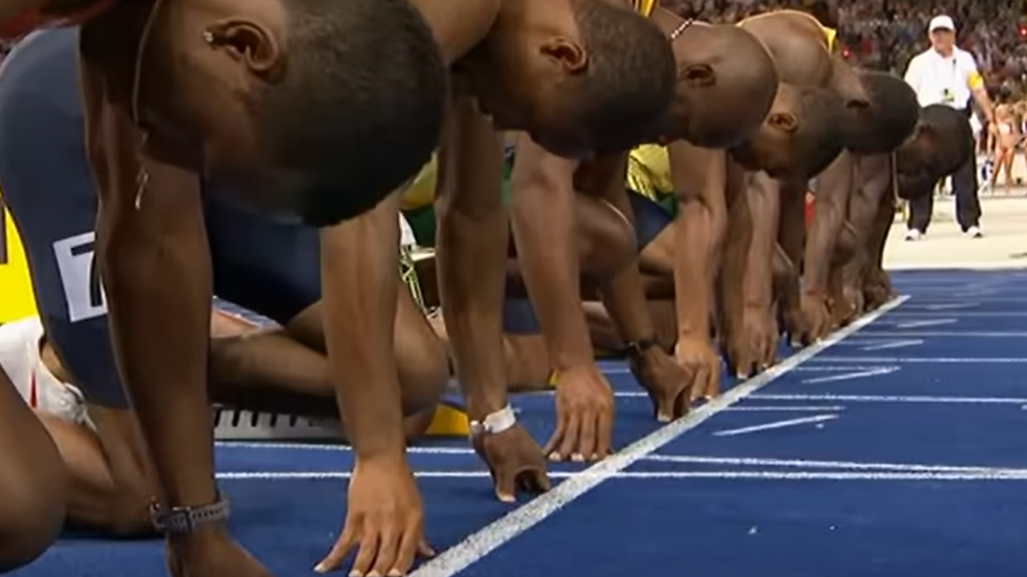

Slide 4

Get the basics right
Work on our reactions
Visualize

Slide 5


Slide 6
Get the basics right
Work on our reactions
Visualize

