Slide 1
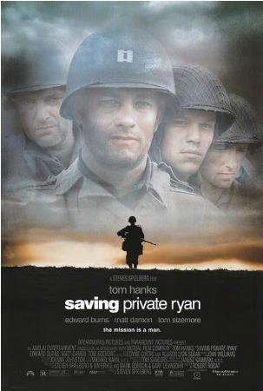
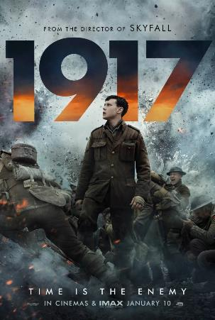
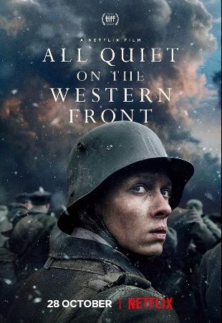
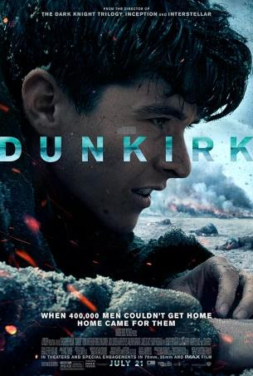
What do these film posters have in common?
Notes:
Copyright permissions: (left to right)
Fair Usage: https://en.wikipedia.org/wiki/File:Saving_Private_Ryan_poster.jpg
Fair Usage: https://en.wikipedia.org/wiki/File:1917_(2019)_Film_Poster.jpeg
Copyright ownership TBC: https://www.imdb.com/title/tt1016150/mediaviewer/rm3081122561/?ref_=ext_shr_lnk
OR Fair Usage: https://en.wikipedia.org/wiki/File:All_quiet_on_the_western_front_(2022_film).jpg (but in German)
Fair Usage: https://en.wikipedia.org/wiki/File:Dunkirk_Film_poster.jpg

Slide 2
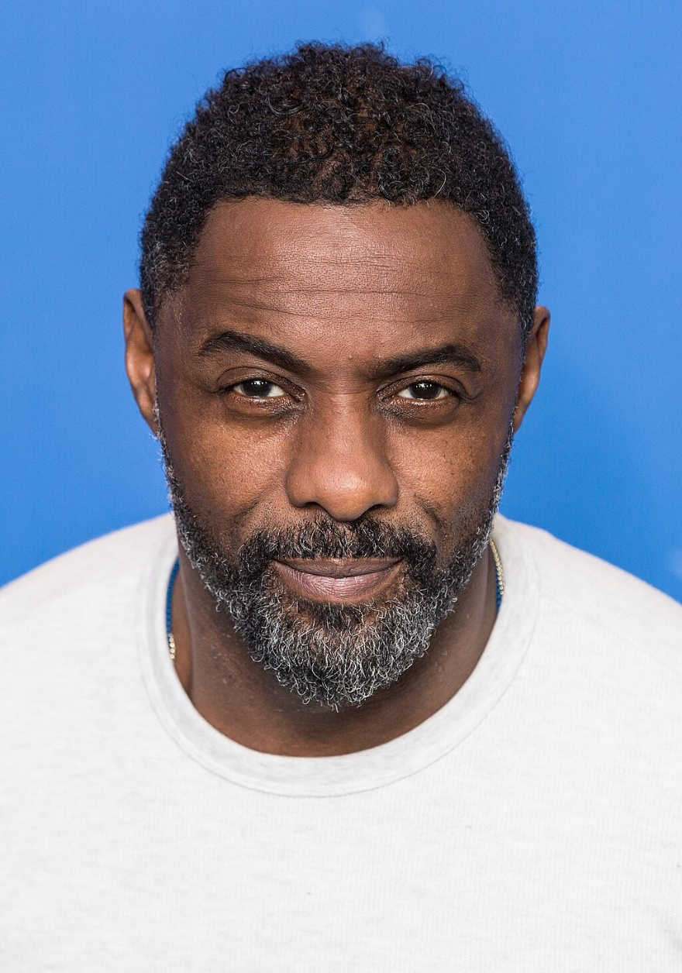
Notes:
By Harald Krichel - Own work, CC BY-SA 4.0, https://commons.wikimedia.org/w/index.php?curid=67876840

Slide 3
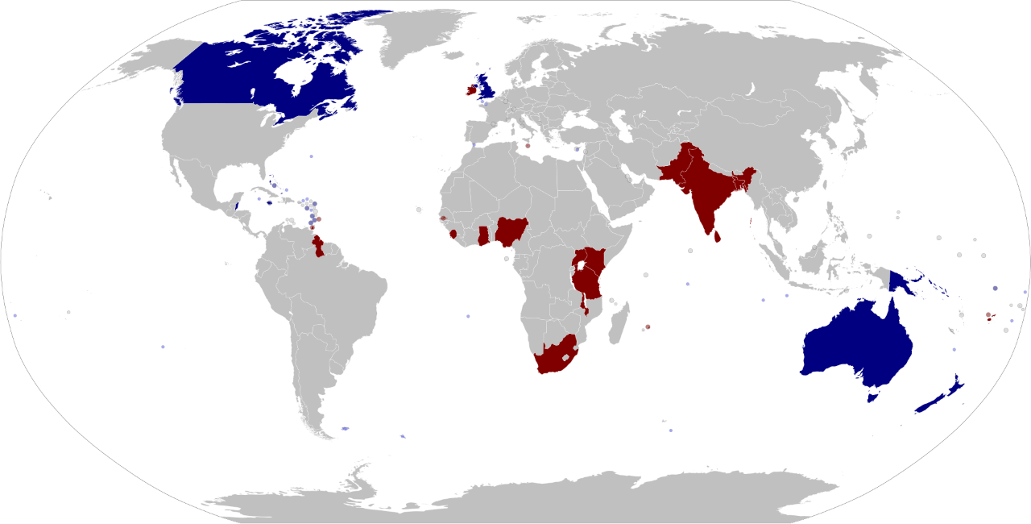
Notes:
Commonwealth realms map © Public Domain, https://en.wikipedia.org/wiki/Commonwealth_realm#/media/File:Commonwealth_realms_map.svg

Slide 4
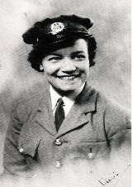
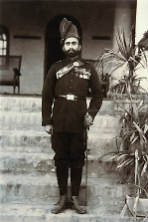
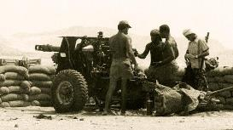
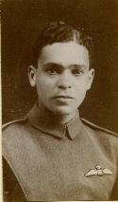
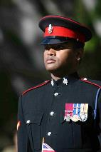
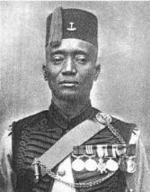
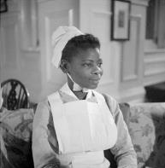
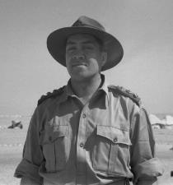
Notes:
The individuals shown on the slide are (clockwise from top):
Corporal Lilian Bader (Slide 9)
Subedar (Officer) Mir Dast (Slide 7)
(On the far left) Sergeant Talaiasi Labalaba (Slide 11)
Padre Wī Huata (Slide 10)
Princess Omo-Oba Adenrele Ademola (Slide 8)
Sergeant Major Alhaji Grunshi (Slide 5)
Warrant Officer Johnson Beharry (Slide 12)
Sergeant William Robinson ‘Robbie’ Clark (Slide 6)
When the students choose one of these individuals, click the image to go to the relevant slide. To return to the main map each time, press 4, and then press ENTER.
Copyright information:
Commonwealth realms map © Public Domain, https://en.wikipedia.org/wiki/Commonwealth_realm#/media/File:Commonwealth_realms_map.svg
Corporal Lilian Bader (Slide 9): (c) Imperial War Museum (HU 53753)
Subedar (Officer) Mir Dast (Slide 7): (c) Leeds University Library: LIDDLE/WW1/EP/019
Sergeant Talaiasi Labalaba (Slide 11): (c) Hodder/PA Wire
Padre Wī Huata (Slide 10): (c) Alexander Turnbull Library: DA-04461; F
Princess Omo-Oba Adenrele Ademola (Slide 8): (c) Imperial War Museum (D 16159)
Sergeant Major Alhaji Grunshi (Slide 5): public domain
Warrant Officer Johnson Beharry (Slide 12): CC-By-SA licence: Flickr by RMEIKLEJ at https://www.flickr.com/photos/20256721@N00/679983766
Sergeant William Robinson ‘Robbie’ Clark (Slide 6): (c) Royal Aero Club Trust

Slide 5


Sergeant Major Alhaji Grunshi
(dates unknown)
- First World War
- Ghanaian and Muslim
- Gold Coast Regiment,
West African Frontier Force
- Grunshi fired the first shot of the First World War on 7 August 1914, four days before firing began on the Western Front
- He was awarded the Military Medal and the Distinguished Conduct Medal in 1919

Slide 6
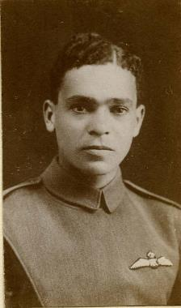
Sergeant William
Robinson ‘Robbie’ Clark
(Oct 1895 – April 1981)
- First World War
- Jamaican and Christian
- Royal Flying Corps
(before it became known as the Royal Air Force, or RAF)
- After qualifying as a pilot on 26 April 1917, he became the first Black pilot to fly for Britain
- On one mission in 1917, he was shot through the spine, but safely landed his plane. He took five months to recover

Slide 7
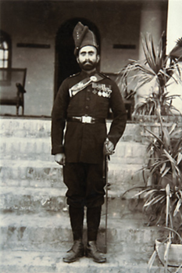
Subedar (Officer) Mir Dast
(Dec 1874 – Jan 1945)
- First World War
- From British India (Pakistan)
and Muslim
- Indian Expeditionary Force
- He was awarded the Victoria Cross for bravery. On 26 April 1915, he rescued eight men from no man’s land while wounded and suffering the after-effects of a gas attack
- The medal was presented to him by King George V himself

Slide 8

Princess Omo-Oba
Adenrele Ademola
(Jan 1916 – unknown)
- Second World War
- Nigerian and Christian
- Qualified as a nurse in 1941
- She worked in several London hospitals during the Blitz and throughout the war

Slide 9
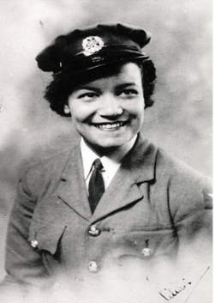
Corporal Lilian Bader
(Feb 1918 – March 2015)
- Second World War
- British-Barbadian from
Liverpool and Christian
- Women’s Auxiliary Air Force
- She was one of the first women to qualify as an instrument repairer in 1941
- She remained in the WAAF until February 1944, when she became pregnant with her first son

Slide 10

Padre Wī Huata
(Sept 1917 – Dec 1991)
- Second World War
- Māori (New Zealand)
and Christian
- Chaplain with the 28th New Zealand (Māori) Battalion
- Led Anglican services in English and Māori, helped the wounded during battle and buried the dead. He also organized entertainment for his soldiers and was famous for his singing
- He was awarded the Military Cross in 1945

Slide 11
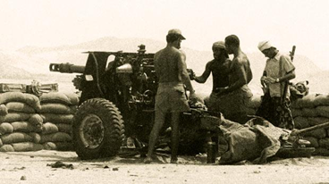
Sergeant Talaiasi Labalaba (2nd from the right)
(July 1942 – July 1972)
- Cold War (1947–1991)
- Fijian and Christian
- Special Air Service (SAS)
- He was mentioned in dispatches for single-handedly manning a 25-pounder field gun for over two and a half hours against at least 250 fighters, even after being wounded. He continued to fight until he was killed by a shot to the neck

Slide 12
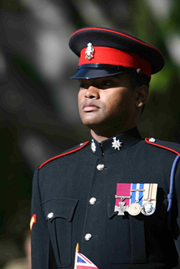
Warrant Officer Class 2 Johnson Beharry
(July 1979 – present)
- Iraq War (2003–2011)
- Grenadian and Christian
- Princess of Wales’ Royal Regiment
- He was awarded the Victoria Cross in 2005 for saving his crew after two occasions when the armoured vehicle that he was driving was ambushed. Despite suffering intense fire and serious injuries, he managed to keep driving and extract his wounded comrades
- In 2014, Beharry set up a charity to counter gangs in London

Slide 13



What do these individuals have in common?
What makes them different?
Notes:
Commonwealth realms map © Public Domain, https://en.wikipedia.org/wiki/Commonwealth_realm#/media/File:Commonwealth_realms_map.svg
Commonwealth realms map © Public Domain, https://en.wikipedia.org/wiki/Commonwealth_realm#/media/File:Commonwealth_realms_map.svg
Corporal Lilian Bader (Slide 9): © Imperial War Museum (HU 53753)
Subedar (Officer) Mir Dast (Slide 7): © Leeds University Library: LIDDLE/WW1/EP/019
Sergeant Talaiasi Labalaba (Slide 11): © Hodder/PA Wire
Padre Wī Huata (Slide 10): © Alexander Turnbull Library: DA-04461; F
Princess Omo-Oba Adenrele Ademola (slide 8): © Imperial War Museum (D 16159)
Sergeant Major Alhaji Grunshi (Slide 5): © Public Domain
Warrant Officer Class 2 Johnson Beharry (Slide 12): © CC-BY-SA licence: Flickr by RMEIKLEJ at http://www.flickr.com/photos/20256721@N00/679983766
Sergeant William Robinson ‘Robbie’ Clark (Slide 6): © Royal Aero Club Trust

Slide 14


Slide 15


