Slide 1
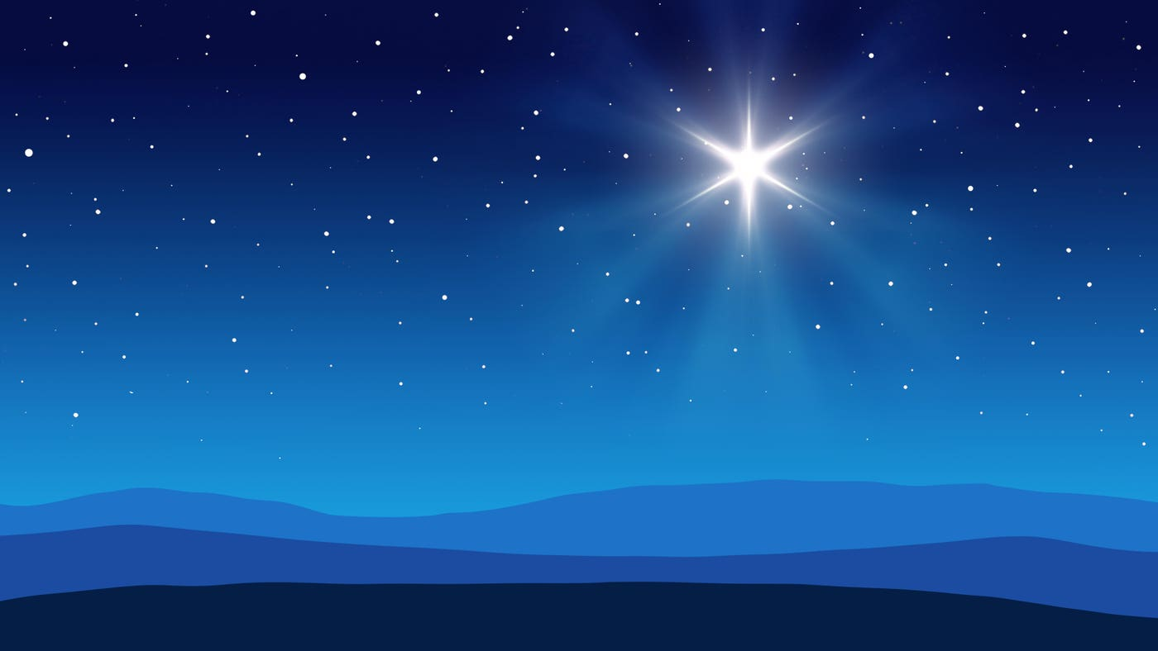
Silent Night
Verse 1
Silent night, holy night!
All is calm, all is bright.
Round yon Virgin, Mother and Child.
Holy infant so tender and mild,
Sleep in heavenly peace,
Sleep in heavenly peace

Slide 2
Silent Night
Verse 2
Silent night, holy night!
Shepherds quake at the sight.
Glories stream from heaven afar,
Heavenly hosts sing Alleluia,
Christ the Saviour is born!
Christ the Saviour is born.

Slide 3
Silent Night
Verse 3
Silent night, holy night!
Son of God, love's pure light.
Radiant beams from thy holy face
With dawn of redeeming grace,
Jesus Lord, at thy birth.
Jesus Lord, at thy birth.

Slide 4
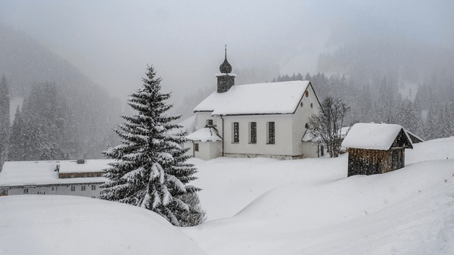

Slide 5
Stille Nacht, heilige Nacht!
Alles schläft; einsam wacht
Nur das traute hochheilige Paar.
Holder Knabe im lockigen Haar,
Schlaf in himmlischer Ruh!
Schlaf in himmlischer Ruh!

Slide 6
