Slide 1
Welcome
to our assembly

Slide 2
Human rights are the fundamental rights and freedoms that belong to every single one of us

Slide 3
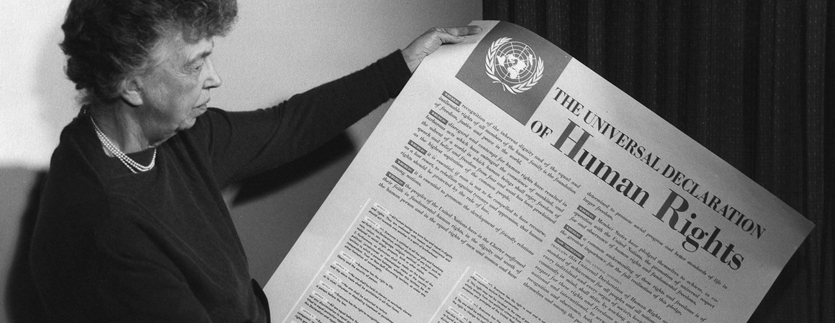
Eleanor Roosevelt with the Universal Declaration of Human Rights in 1948

Slide 4

Article 18 protects your right to freedom of thought, belief and religion
It includes the right to change your religion or beliefs at any time
You also have the right to put your thoughts and beliefs into action, practise your religion freely and change your religion

Slide 5
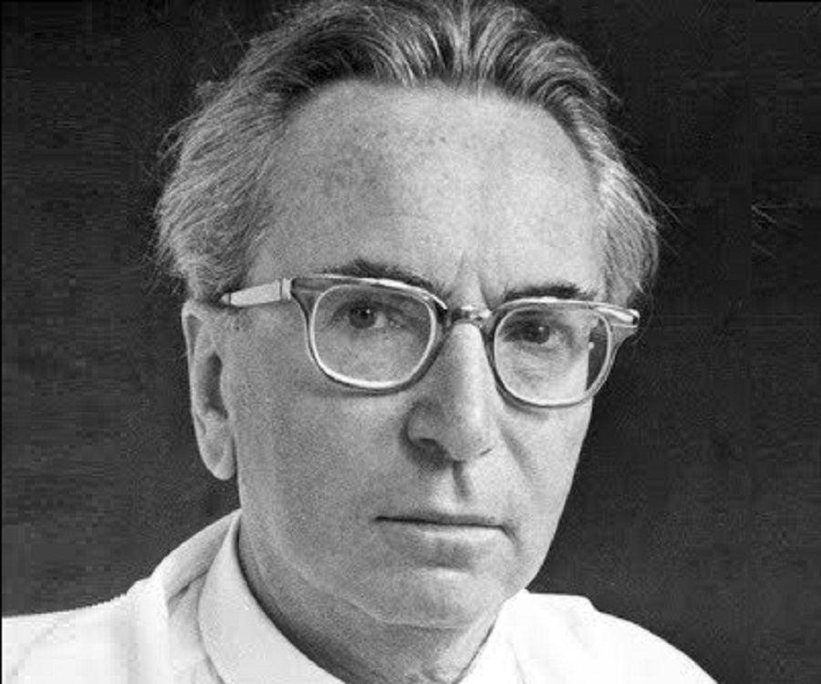
Viktor Frankl (1905–1997)

