Slide 1
Welcome

Slide 2
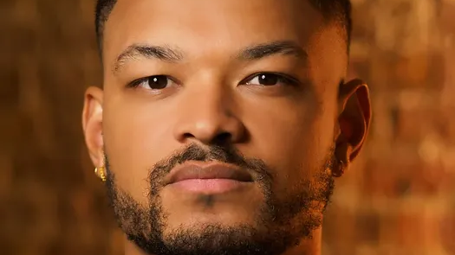

Slide 3
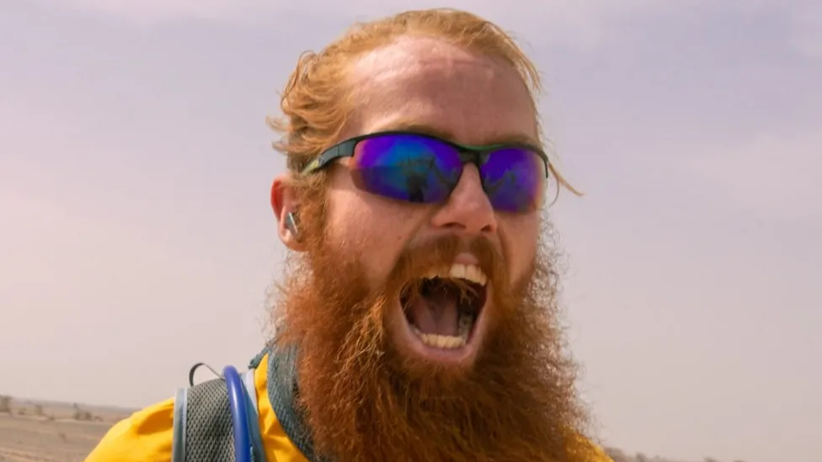

Slide 4
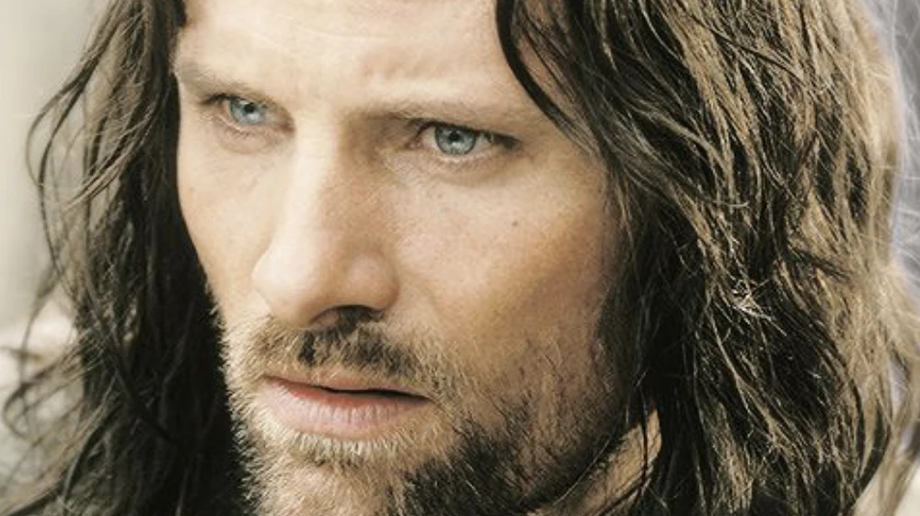

Slide 5
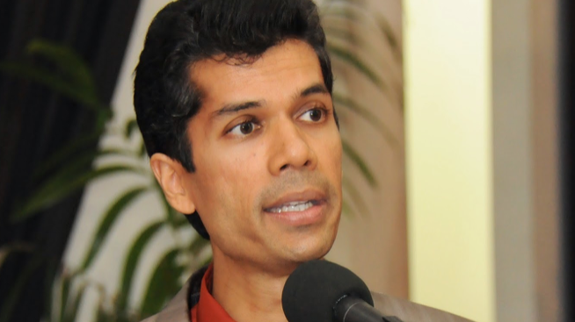

Slide 6
International Men’s Day: Objectives
To promote positive male role models
To celebrate men’s positive contributions to society
To focus on men’s health and wellbeing
To highlight discrimination against men
To improve gender relations and promote gender equality
To create a safer, better world

