Slide 1
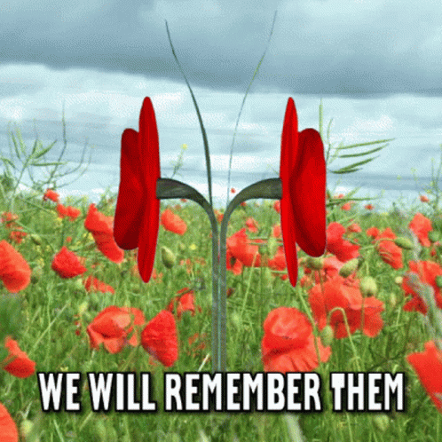
Remembrance Day

Slide 2
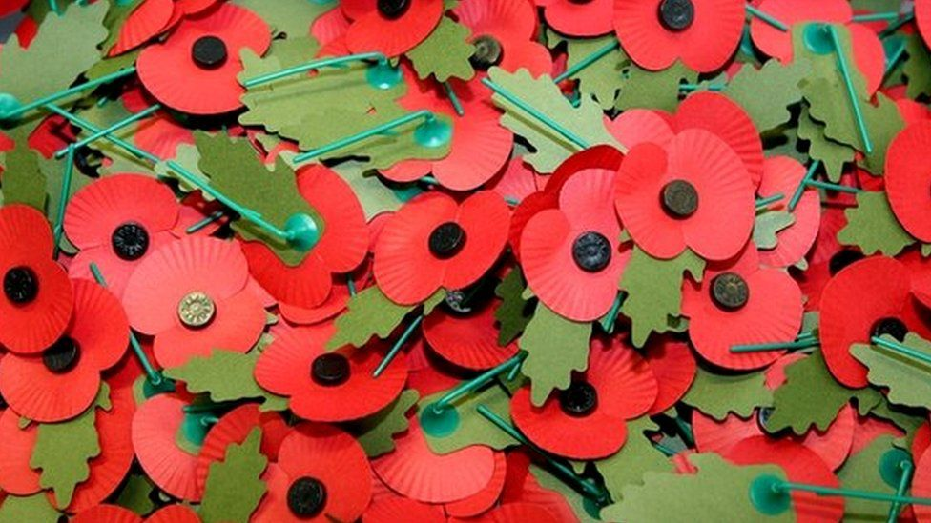
Why do we wear poppies?

Slide 3
